Slide 1
Culture as Prevention:
Embracing culturally appropriate tools to improve health and wellbeing with Indigneous populations.
Melissa Buffalo, Meskwaki, MS, CEO

Slide 2
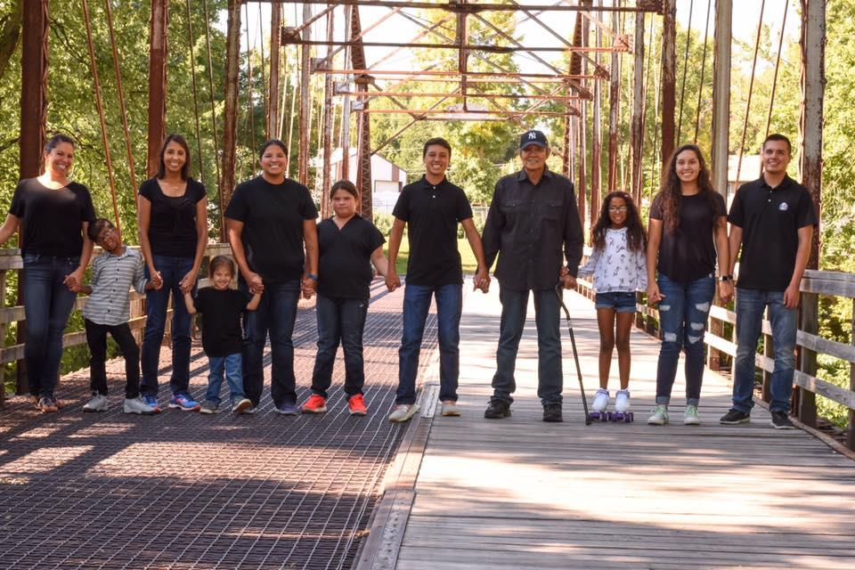
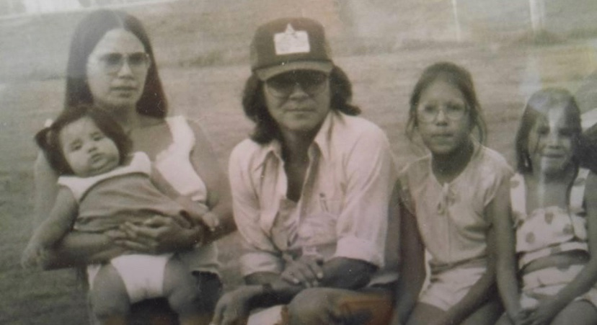

Slide 3

Objectives
Indigenous cancer burdens
Historical trauma and perspectives within Indigenous communities
Culturally appropriate tools & resources
Indigenous wellbeing

Slide 4
American Indian Cancer Foundation (AICAF)
A national non-profit established to address tremendous cancer inequities faced by American Indian and Alaska Natives.
Mission:
To eliminate cancer burdens on American Indian families through education and improved access to prevention, early detection, treatment and survivor support.

Slide 5
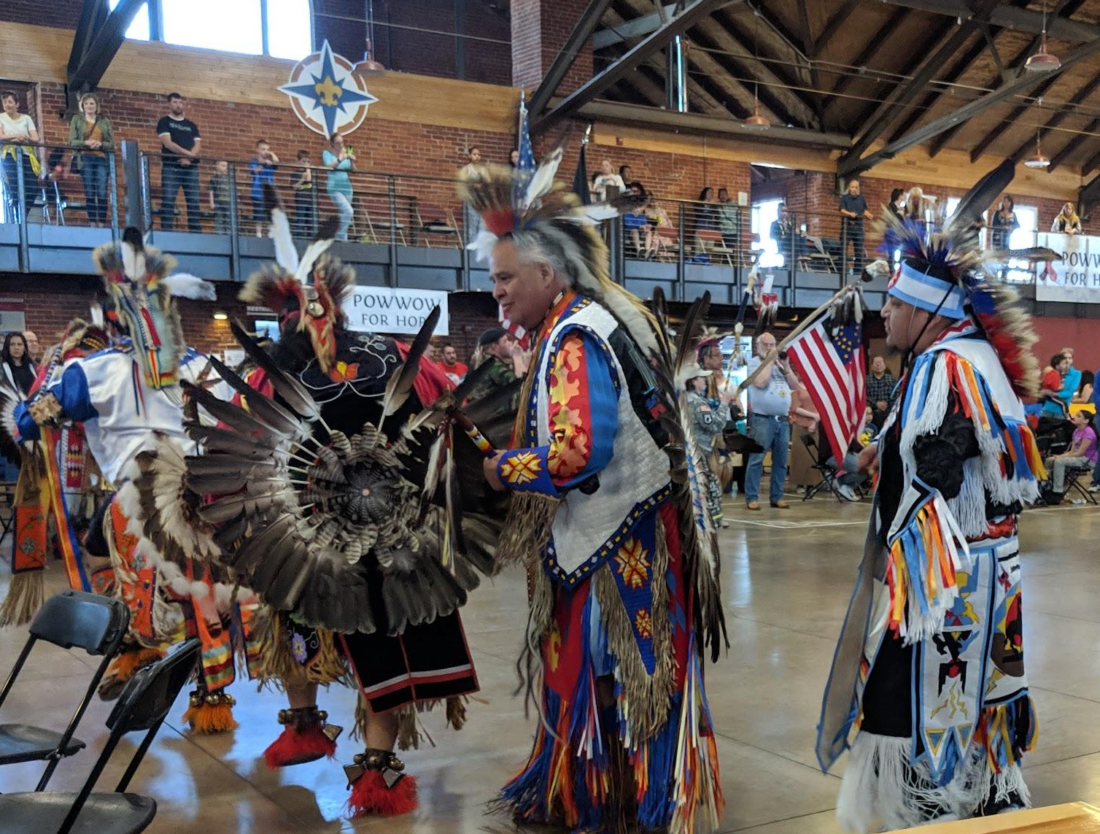
Our Vision & Mission
Our vision is a world where cancer is no longer a leading cause of death for American Indian and Alaska Natives.
We believe…
Native communities have the wisdom to find the solutions to health inequities, but are often seeking the organizational capacity, expert input and resources to do so.

Slide 6
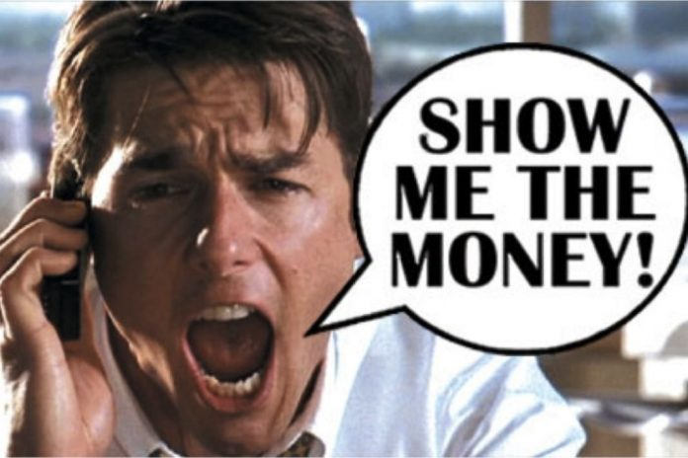
Indigenous Cancer Burdens
D A T A

Slide 7
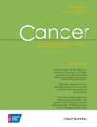
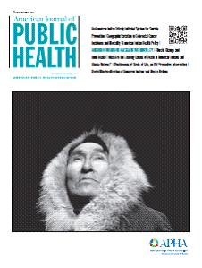
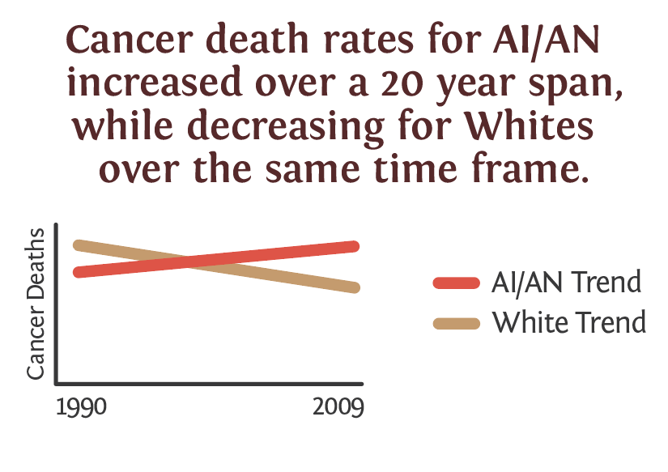
Inequities: American Indian Cancer Data
Other populations have celebrated decreasing cancer mortality rates in the past 20 years, but American Indian cancer mortality rates are still on the rise.

Slide 8
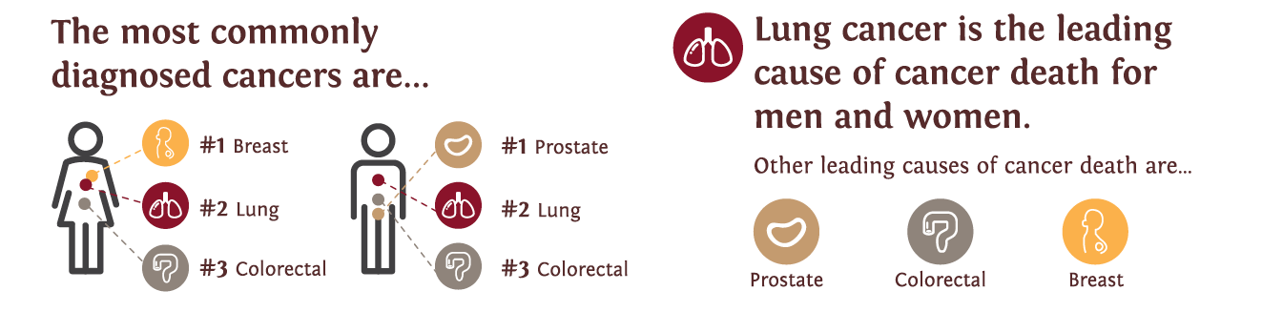
Indigenous Cancer Burdens

Slide 9
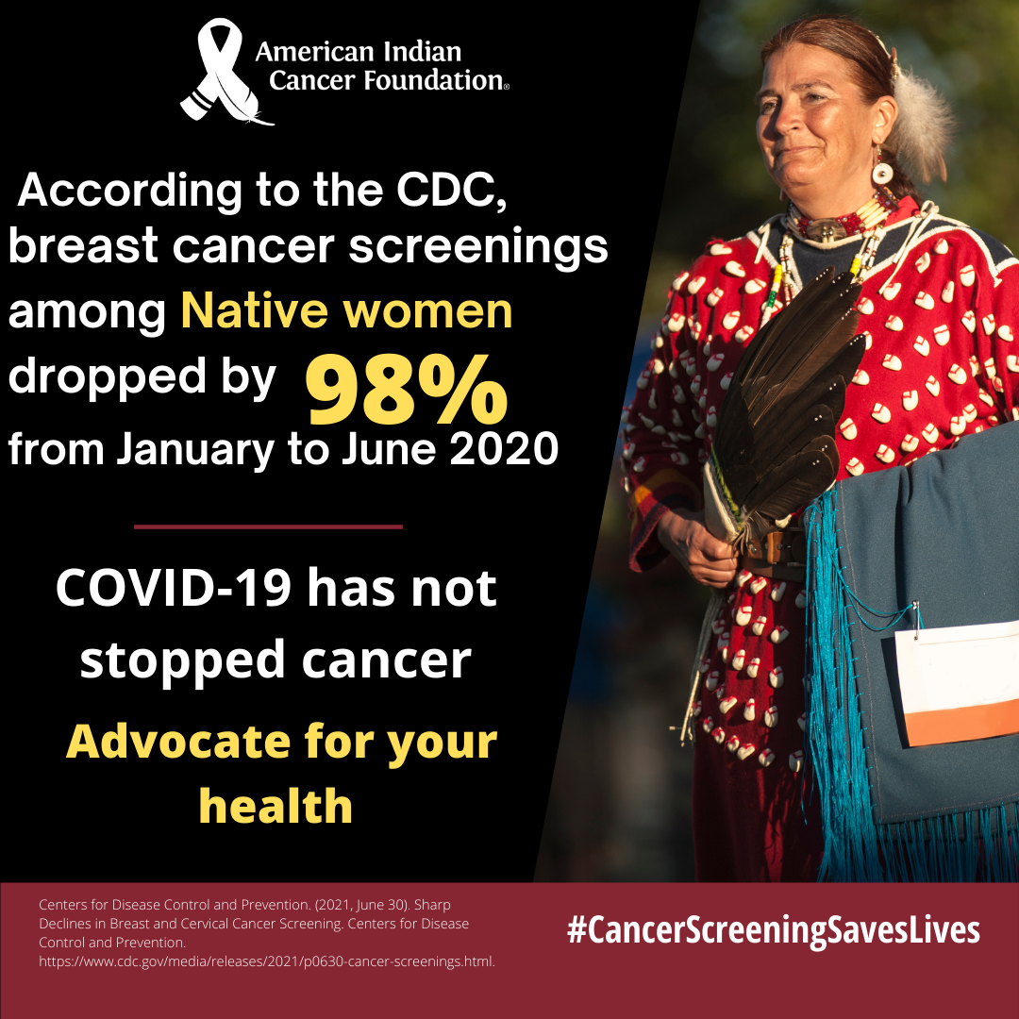

Slide 10
How did we get here…

Slide 11
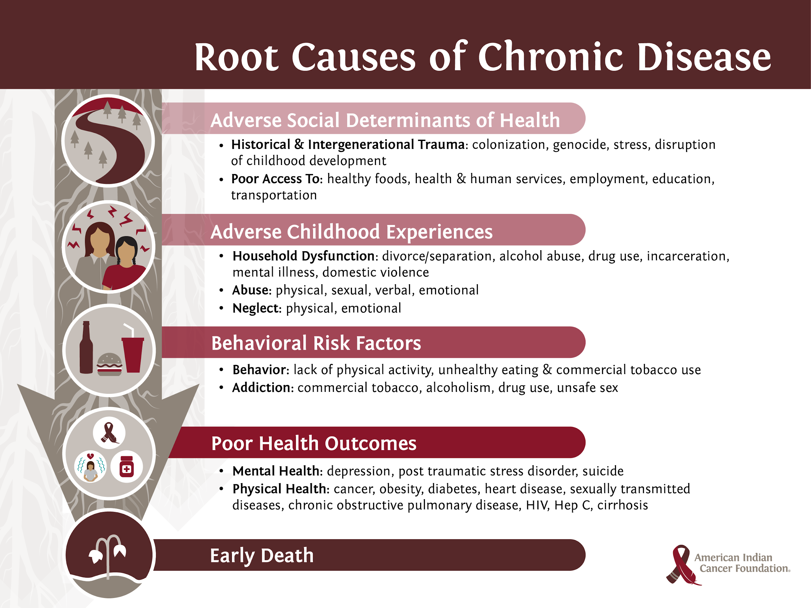

Slide 12
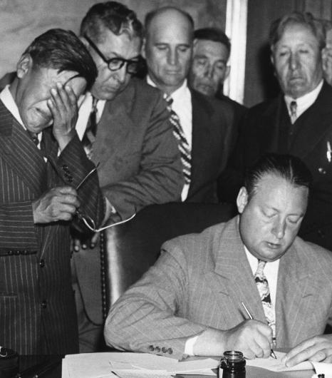
Government Policies, Systems & Environments
Indian Removal Act
Allotment Act (Dawes Act)
Indian Reorganization Act (Indian New Deal)
Indian Relocation Act
Indian Religious Freedom Act
Votings rights
Government food system
Forced Sterilization
Flood Control Act
Boarding school era

Slide 13
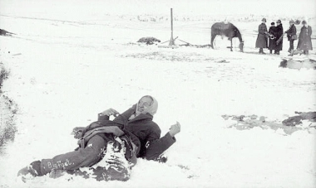
Historical events
1862 - Dakota 38+2 mass execution
1868 - Laramie Treaty/Sioux Treaty of 1968
1869 - Transcontinental Railroad completed
1874 - Gold was discovered in the Black Hills
1879 - Boarding school era begun
1886 - Statue of Liberty was dedicated
1887 - Allotment Act/Dawes Act
1890 - Wounded Knee Massacre

Slide 14
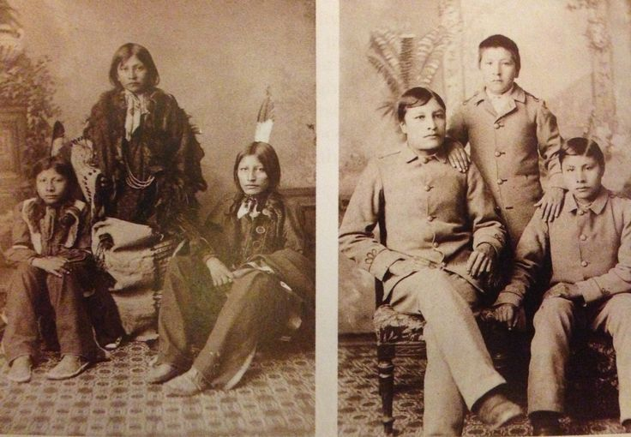
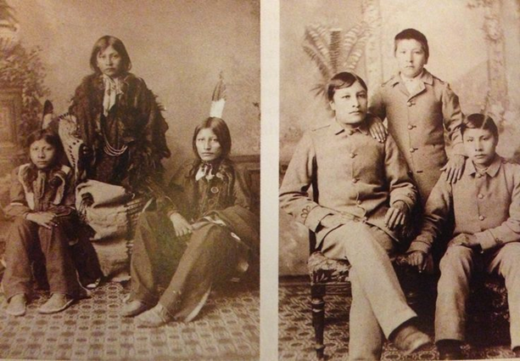
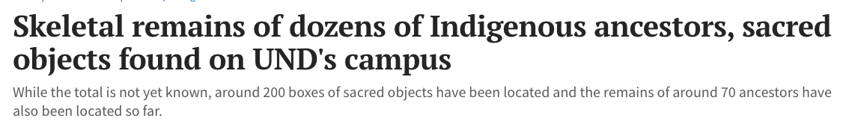
Historical trauma is CURRENT trauma

Slide 15
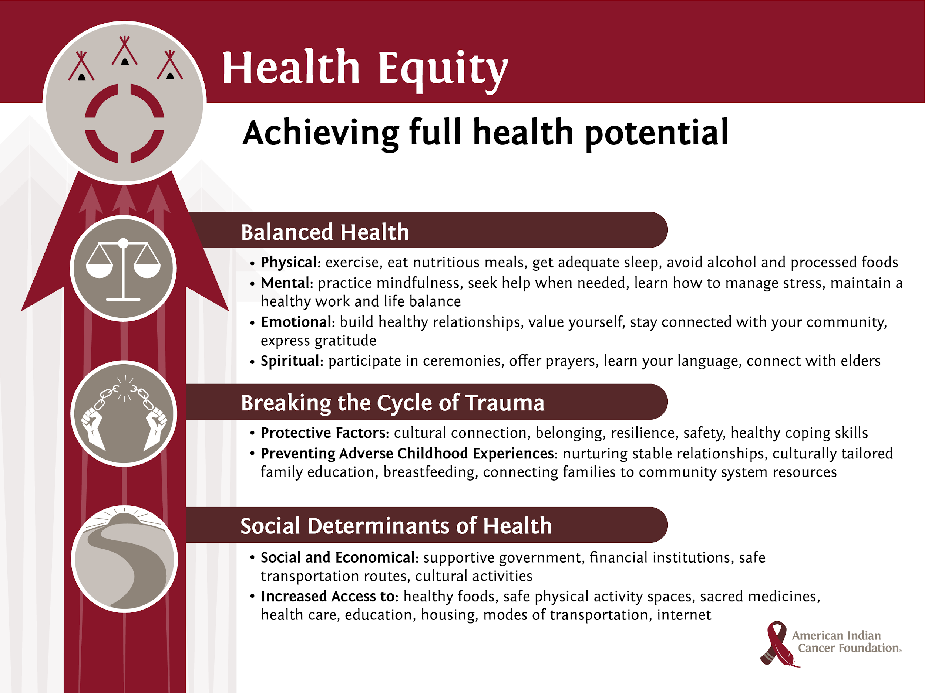
Notes:
But we have the opportunity for our relatives to achieve their full potential - through partnerships right? By bringing work that balances our health, there is so much work and effort out there to come back to our tradiational foods, not commod cheese or frybread. Our ancestors were hunters, gatherers, they knew when and where to harvest,
By engaging in an upstream approach to achieving health equity, means we need to support positive social determinants of health; such as social and economic opportunities and increased access to healthy foods and sacred medicines, having safe physical activity spaces, access to health care, education, housing, modes of transportation and access to the internet. Many of talk about indigenous determinants of health. So much of our cultural and traditional ways can help determine and increase our health for the better.
Another key piece to achieving full health potential is by breaking the cycle of trauma.
This includes protective factors such as cultural connectedness, a sense of belonging, resiliency, and practicing healthy coping skills.
By nurturing stable relationships, providing culturally tailored family education, connecting families to community system resources and providing spaces for breastfeeding allows us to help prevent adverse childhood experiences.
And finally, by incorporating a balanced lifestyle including physical, mental, emotional and spiritual balance, we are able to achieve health equity and achieve our full health potential as Indigenous people and communities.

Slide 16
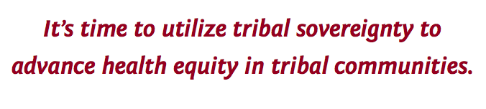
Tribal Sovereignty
Federally recognized tribes are recognized as possessing certain inherent rights of self-government and are entitled to receive certain federal benefits, services, and protections because of their special relationship with the United States. - US Department of Interior Indian Affairs

Slide 17
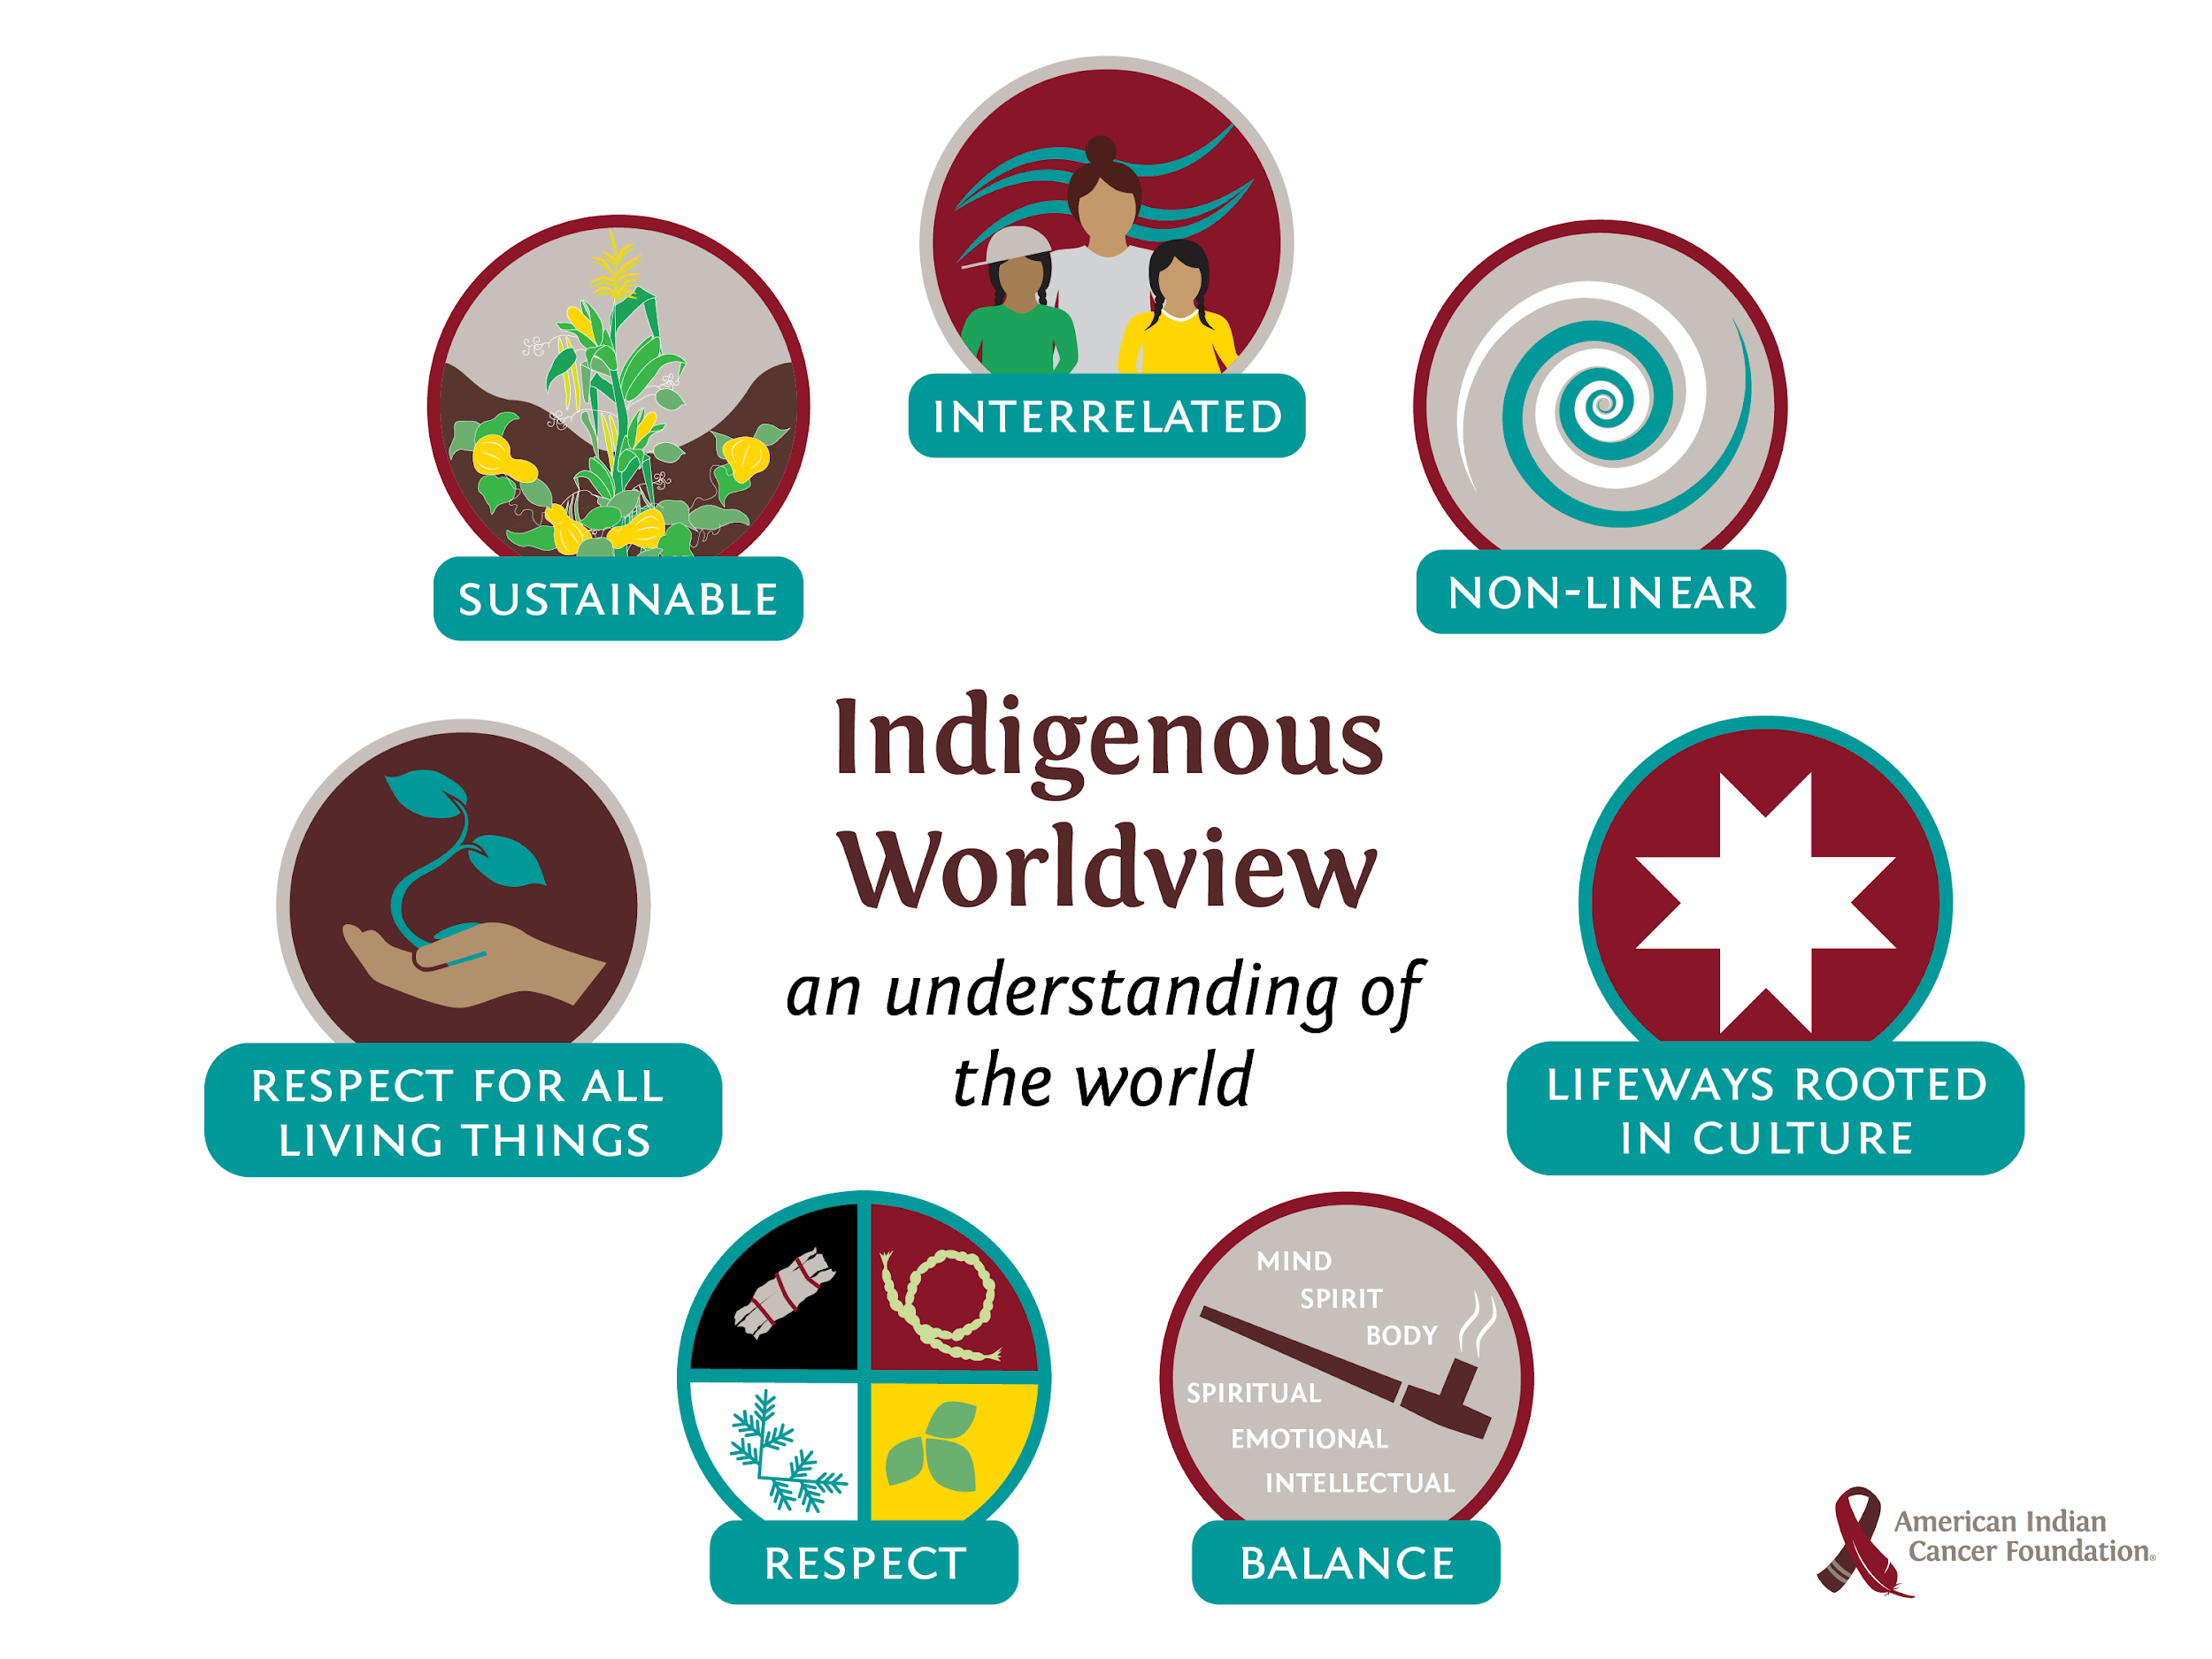

Slide 18
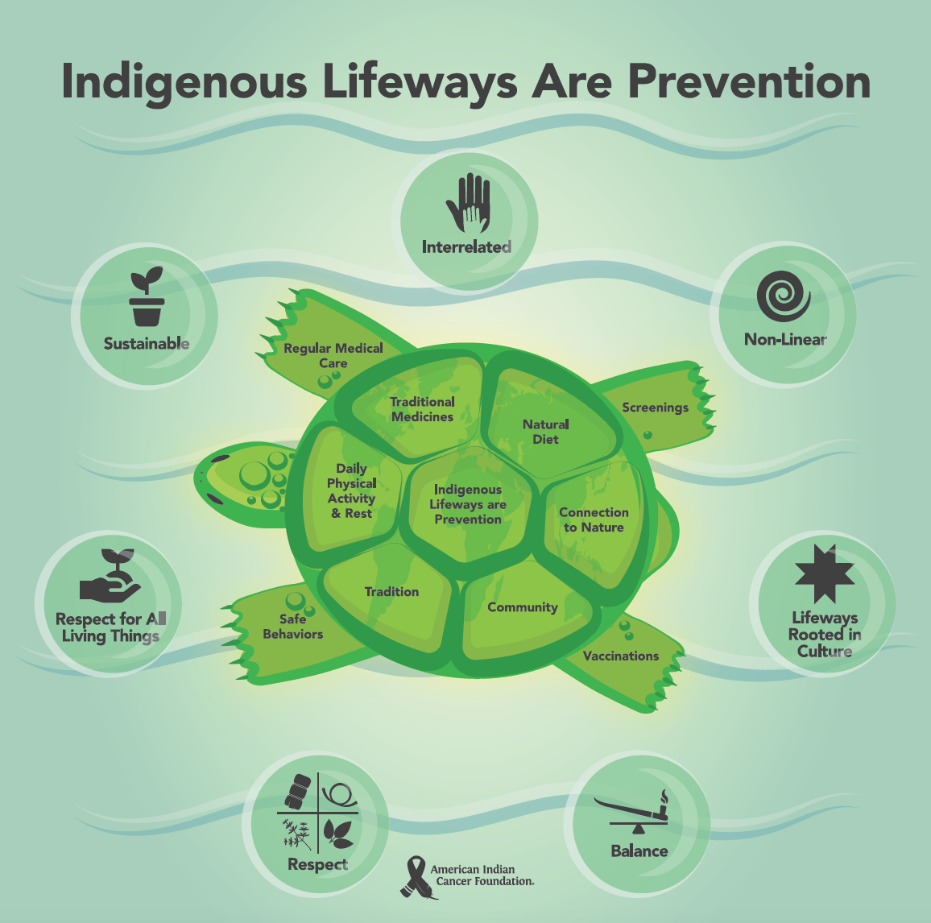
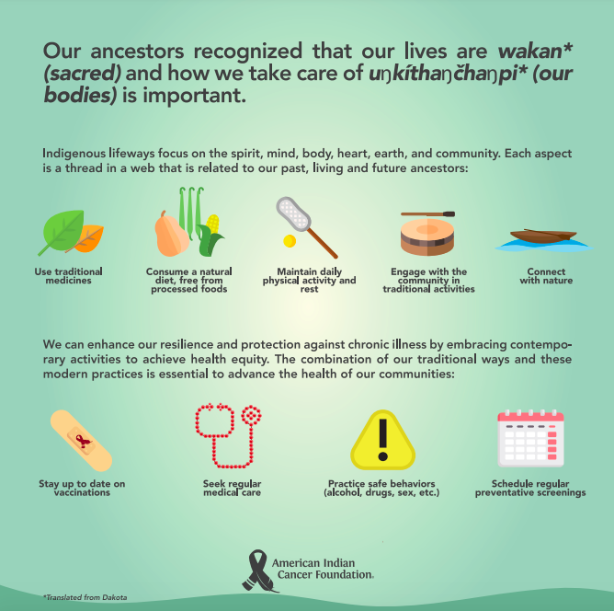

Slide 19
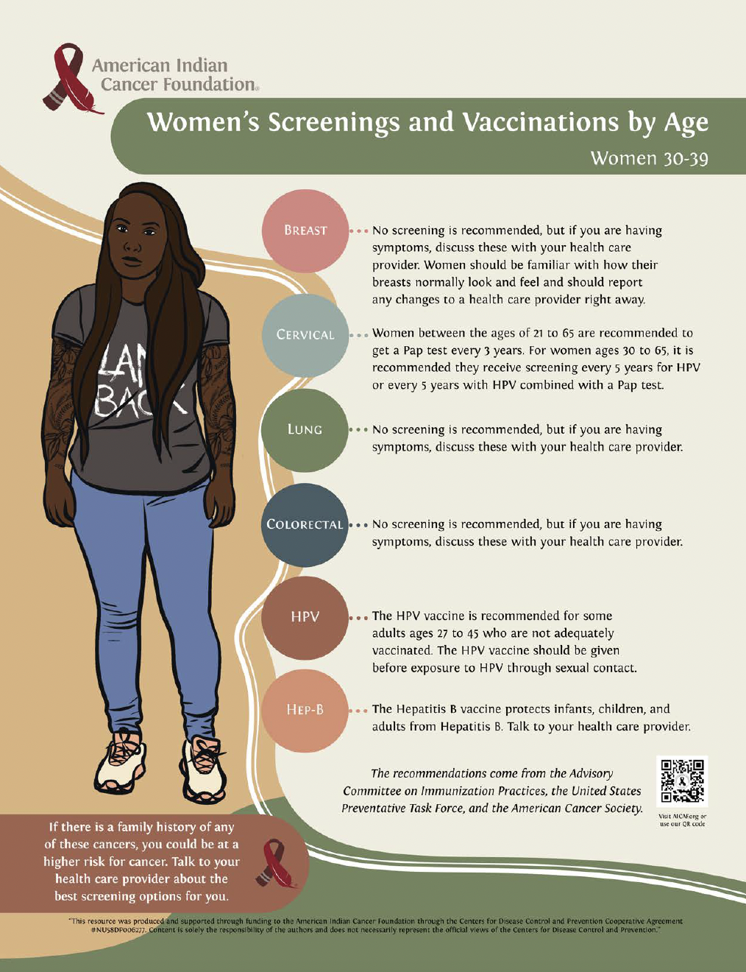
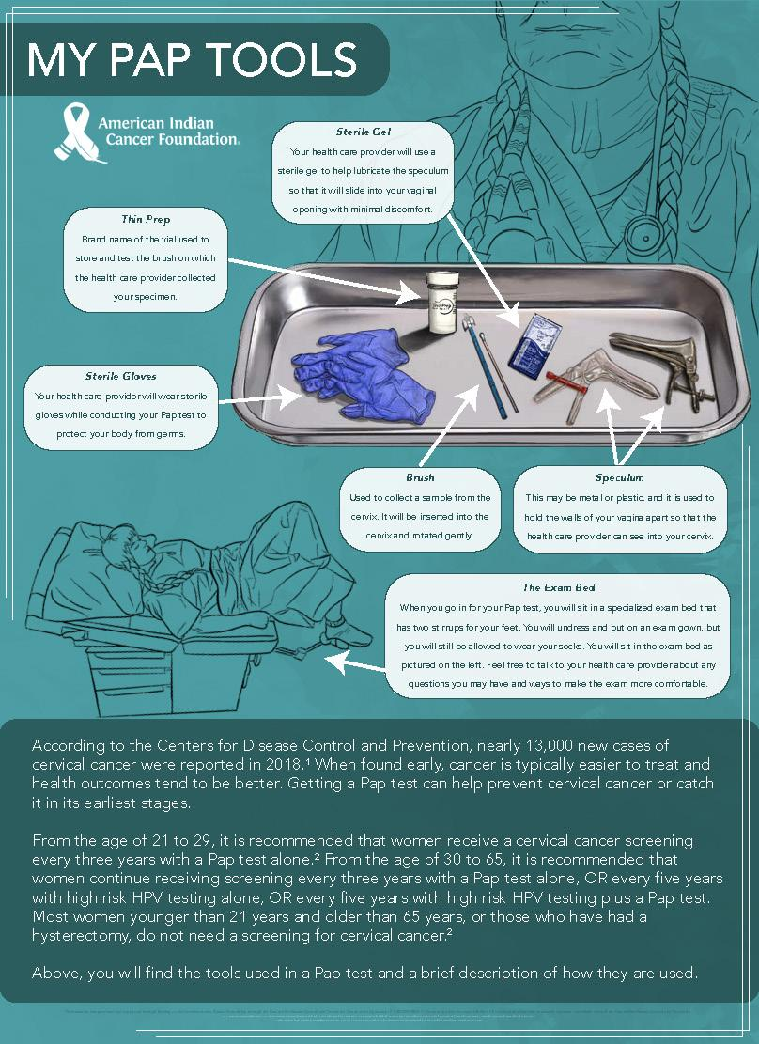

Slide 20
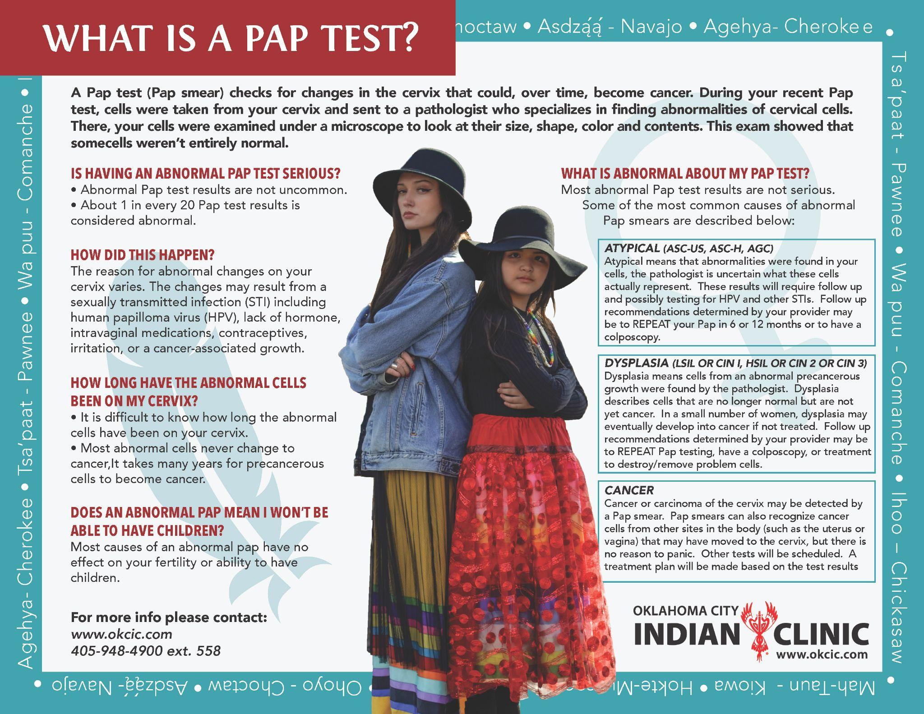

Slide 21
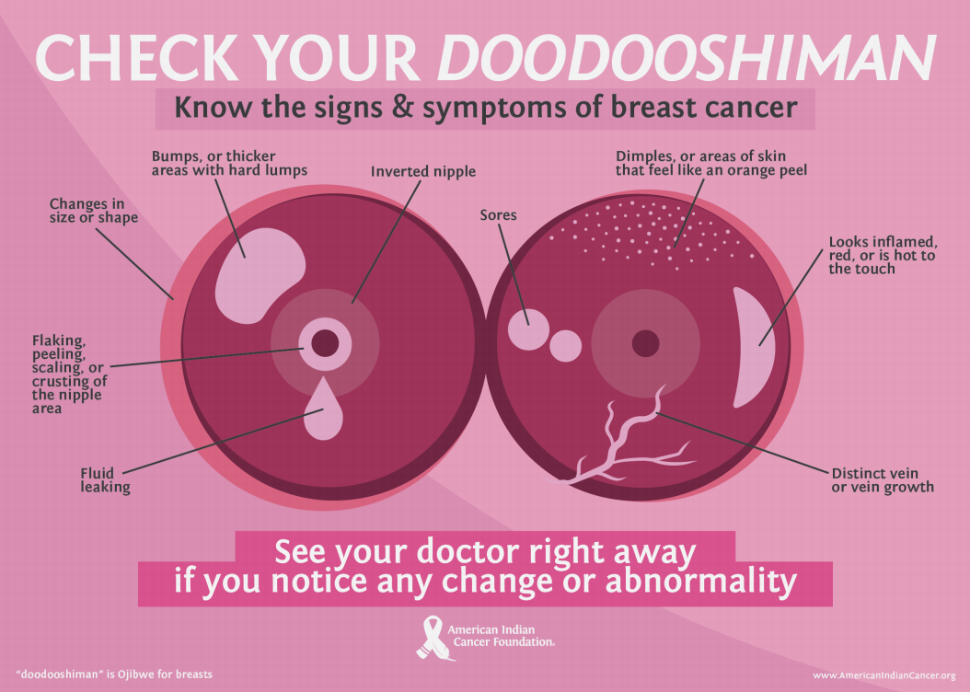

Slide 22
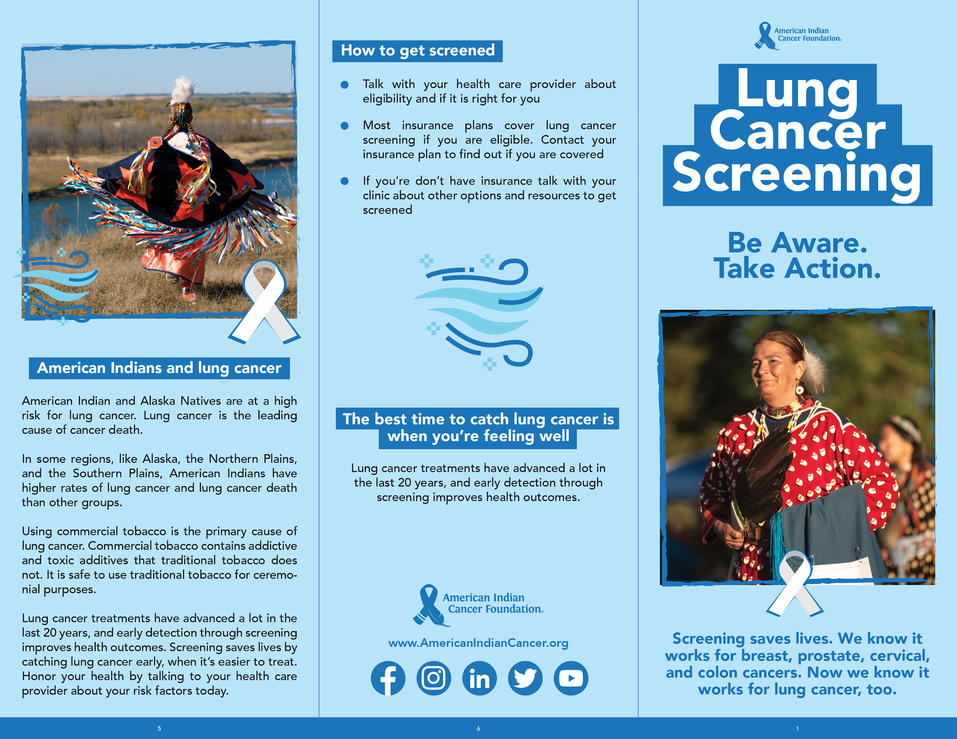
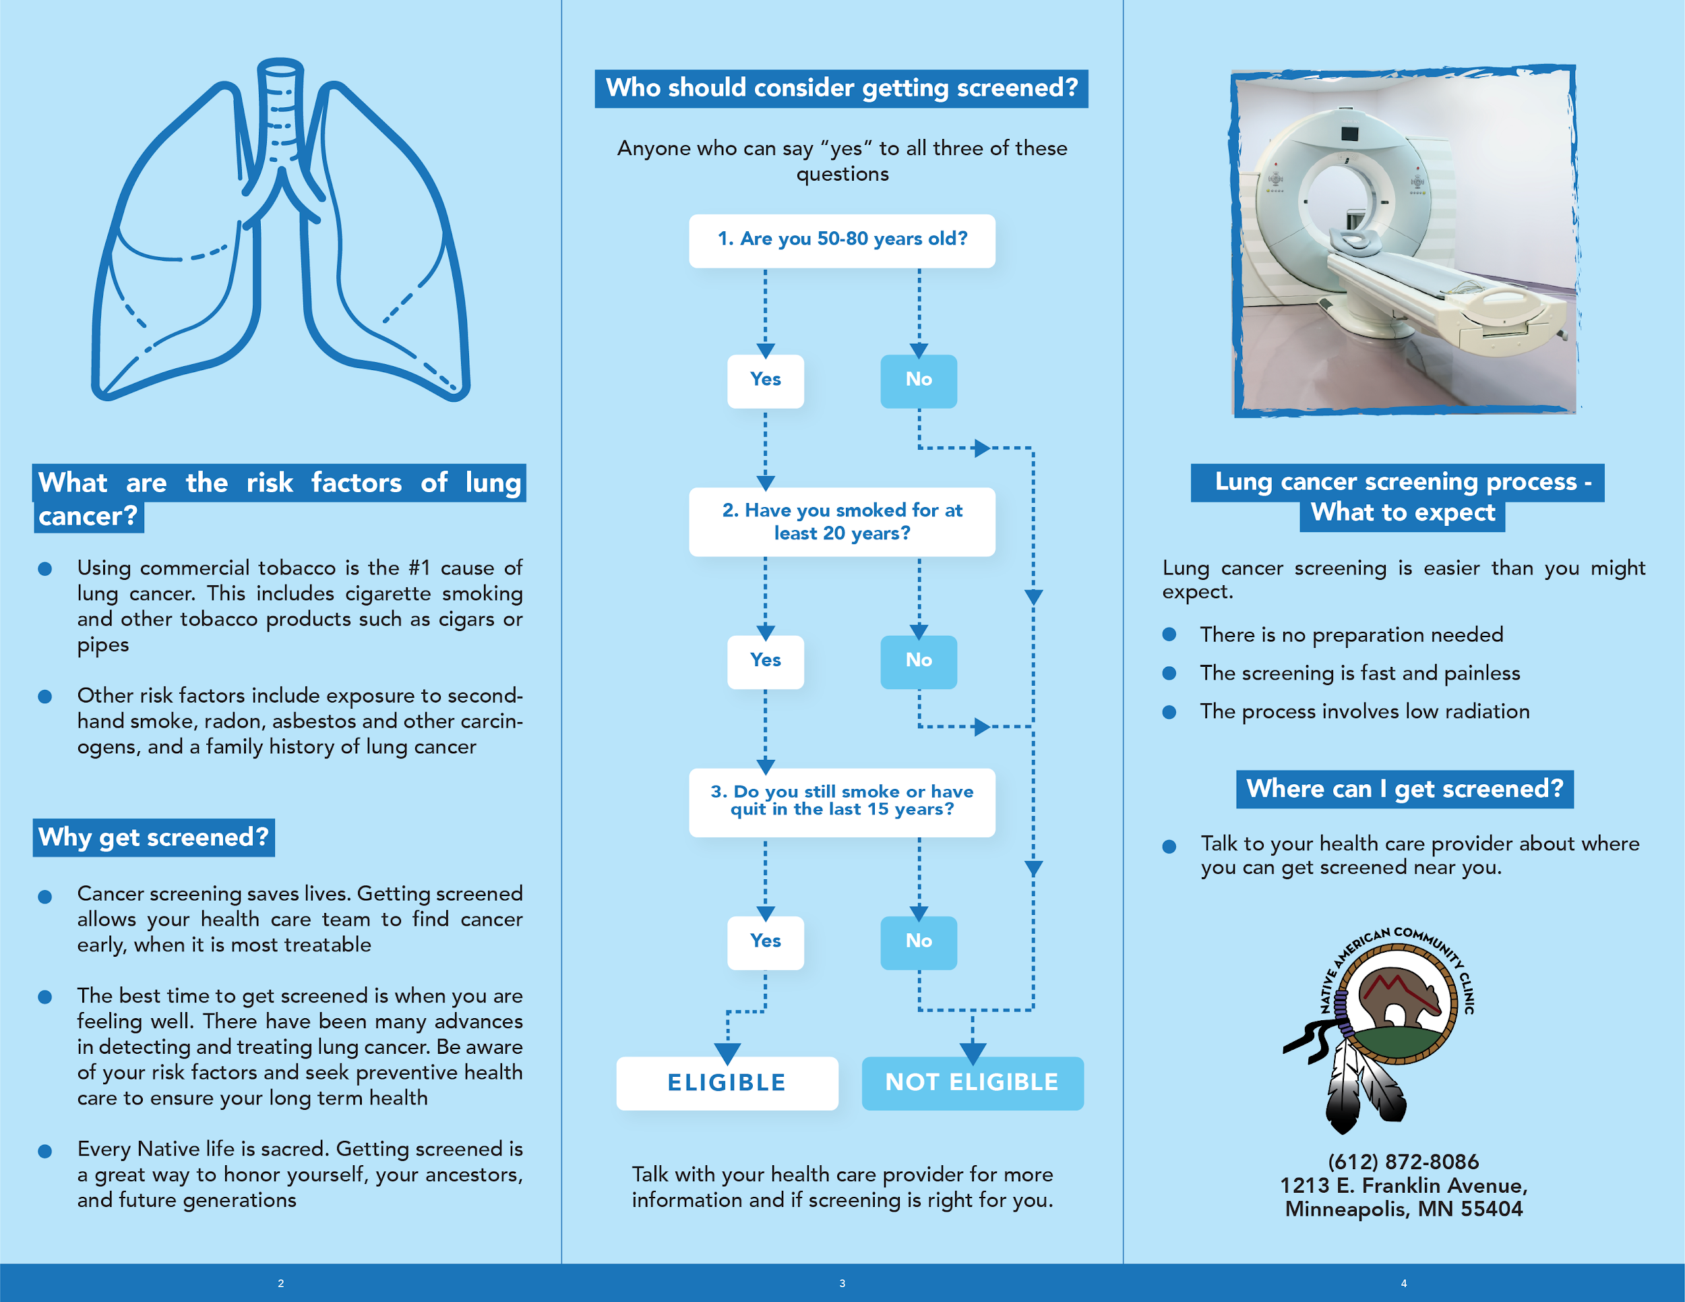
Notes:
WP

Slide 23
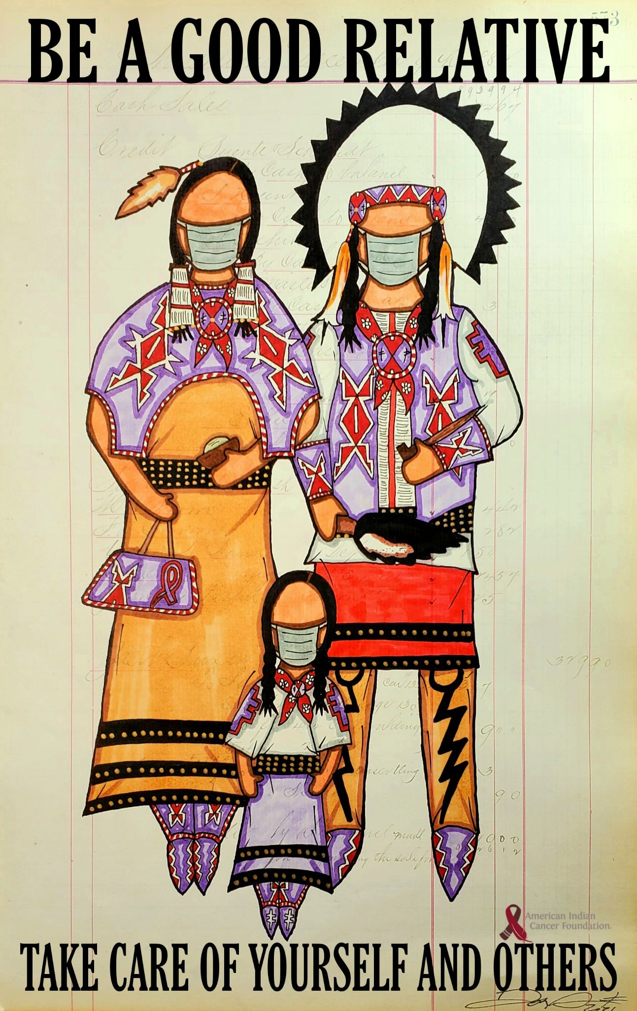
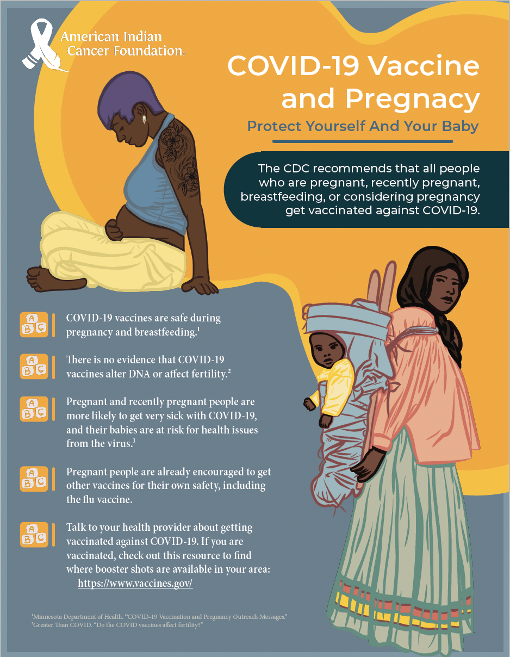

Slide 24
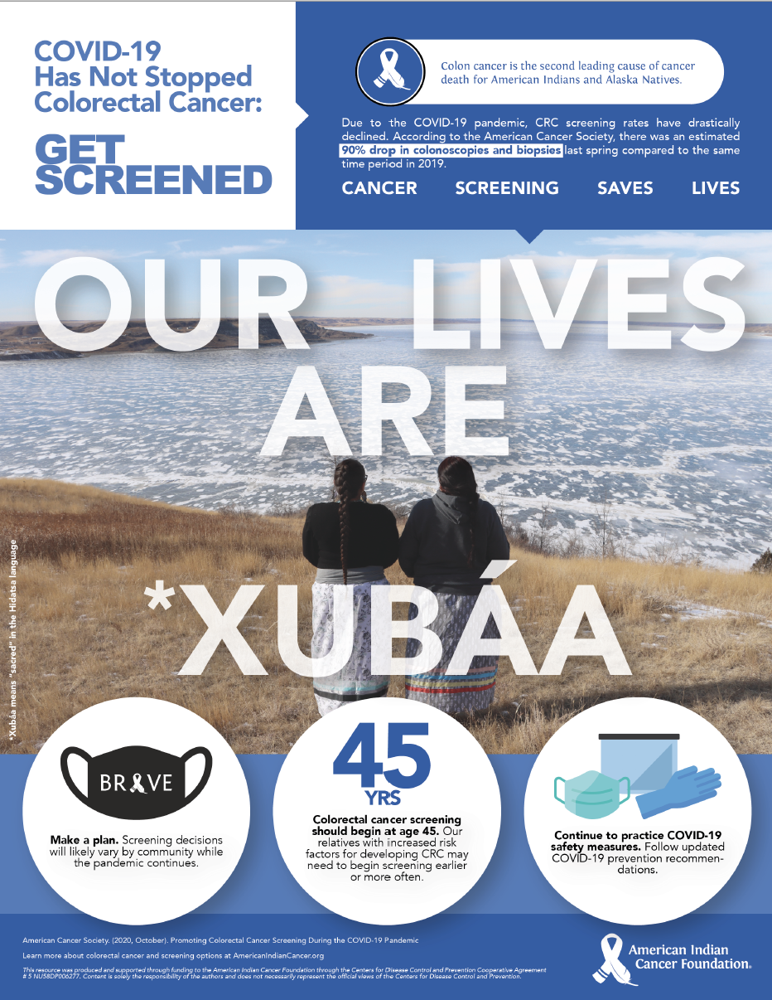
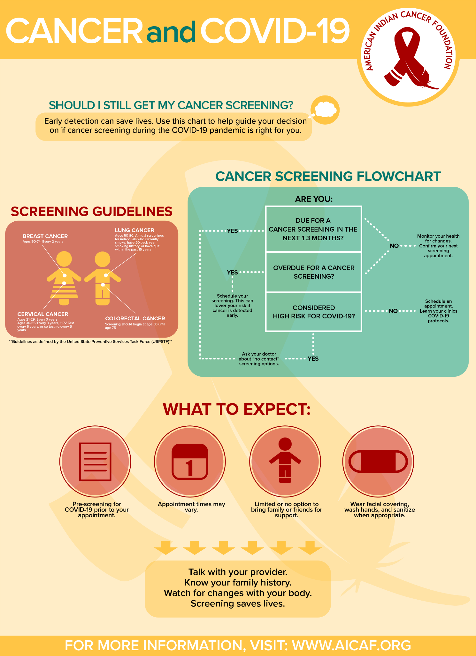

Slide 25
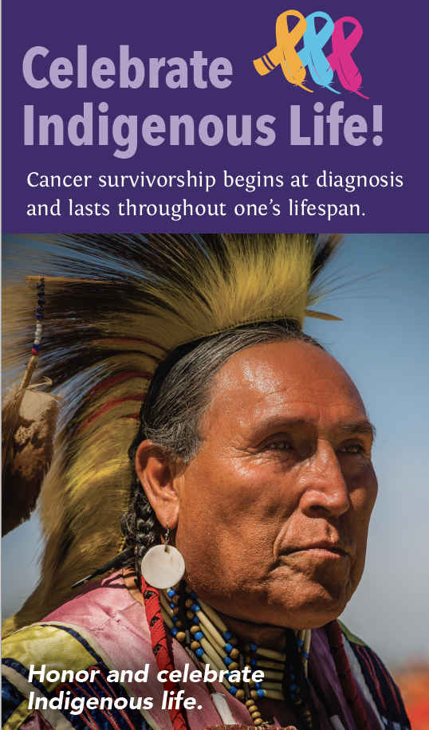
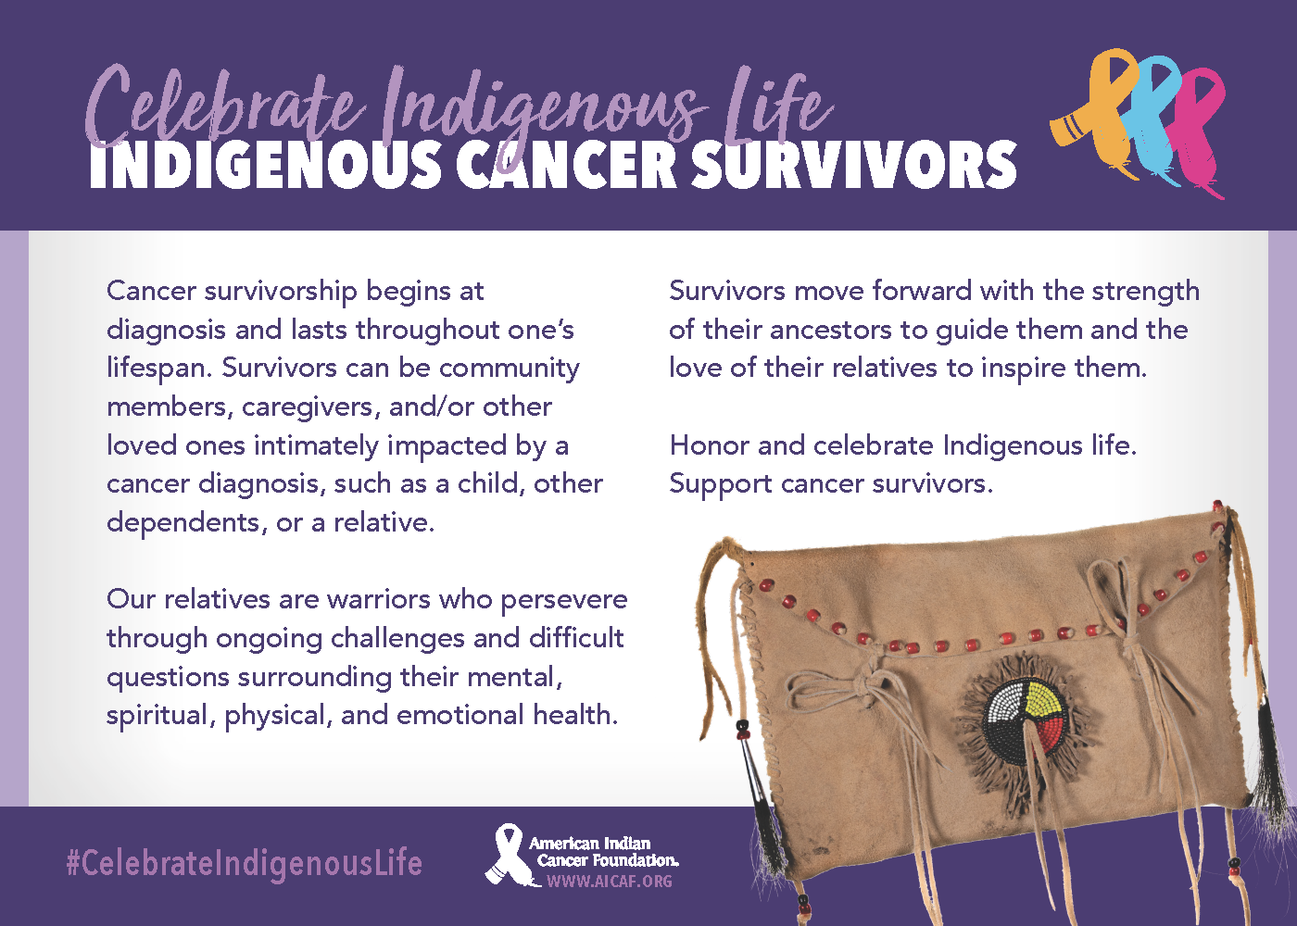

Slide 26







Slide 27
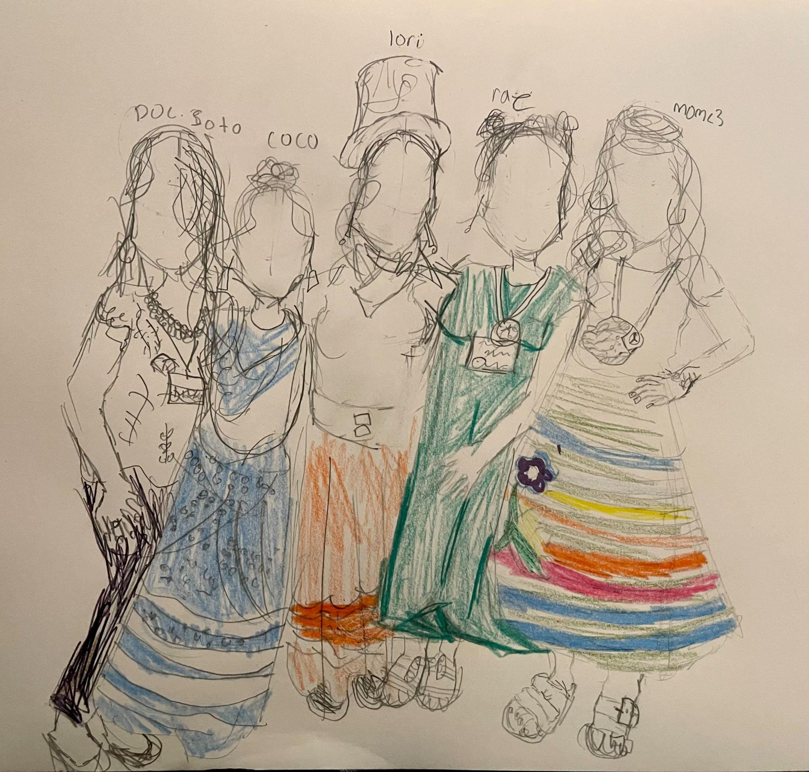
Ketabi/Pidamaya
(Thank You)
https://americanindiancancer.org/
health@aicaf.org
info@aicaf.org

Slide 28
Francys Crevier, JD (Algonquin)
Chief Executive Officer

Slide 29
MISSION STATEMENT
The National Council of Urban Indian Health (NCUIH) serves as a resource center for individuals and organizations dedicated to improving the health of American Indians and Alaska Natives living in urban areas. NCUIH provides advocacy, education, technical assistance, training, leadership, and connections to Urban Indian Organizations and others who share our important mission.

Slide 30

Urban Indian Origins

Slide 31
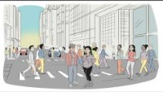
Notes:
Urban Indian Origins - YouTube

Slide 32
What are Urban Indian Organizations?

Slide 33
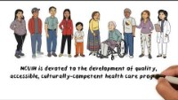
Notes:
What are Urban Indian Organizations? - YouTube

Slide 34
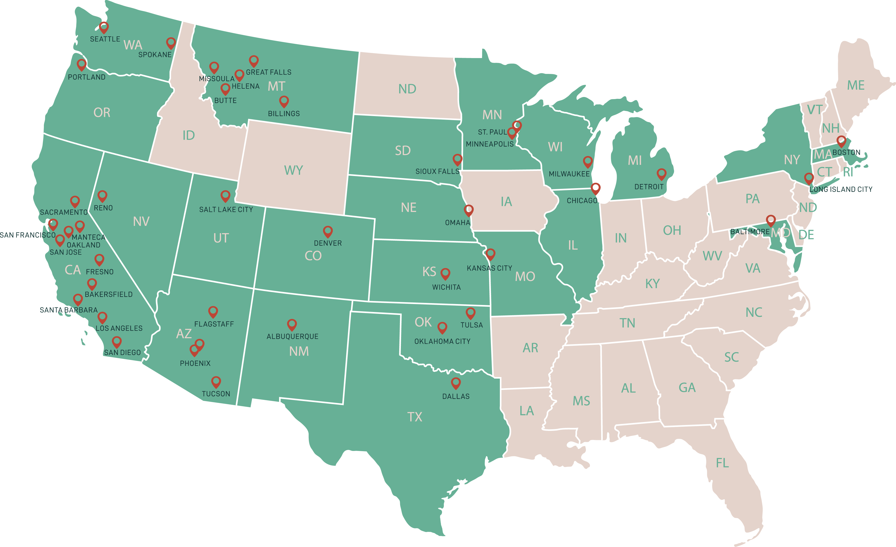

Urban Indian Organizations (UIOs)

Slide 35
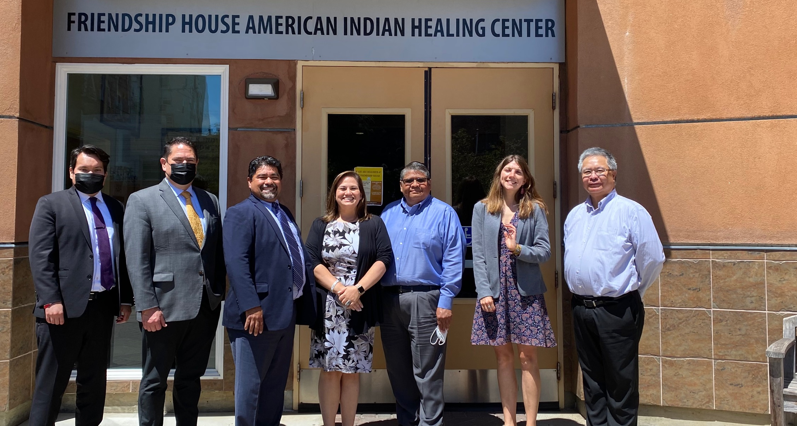
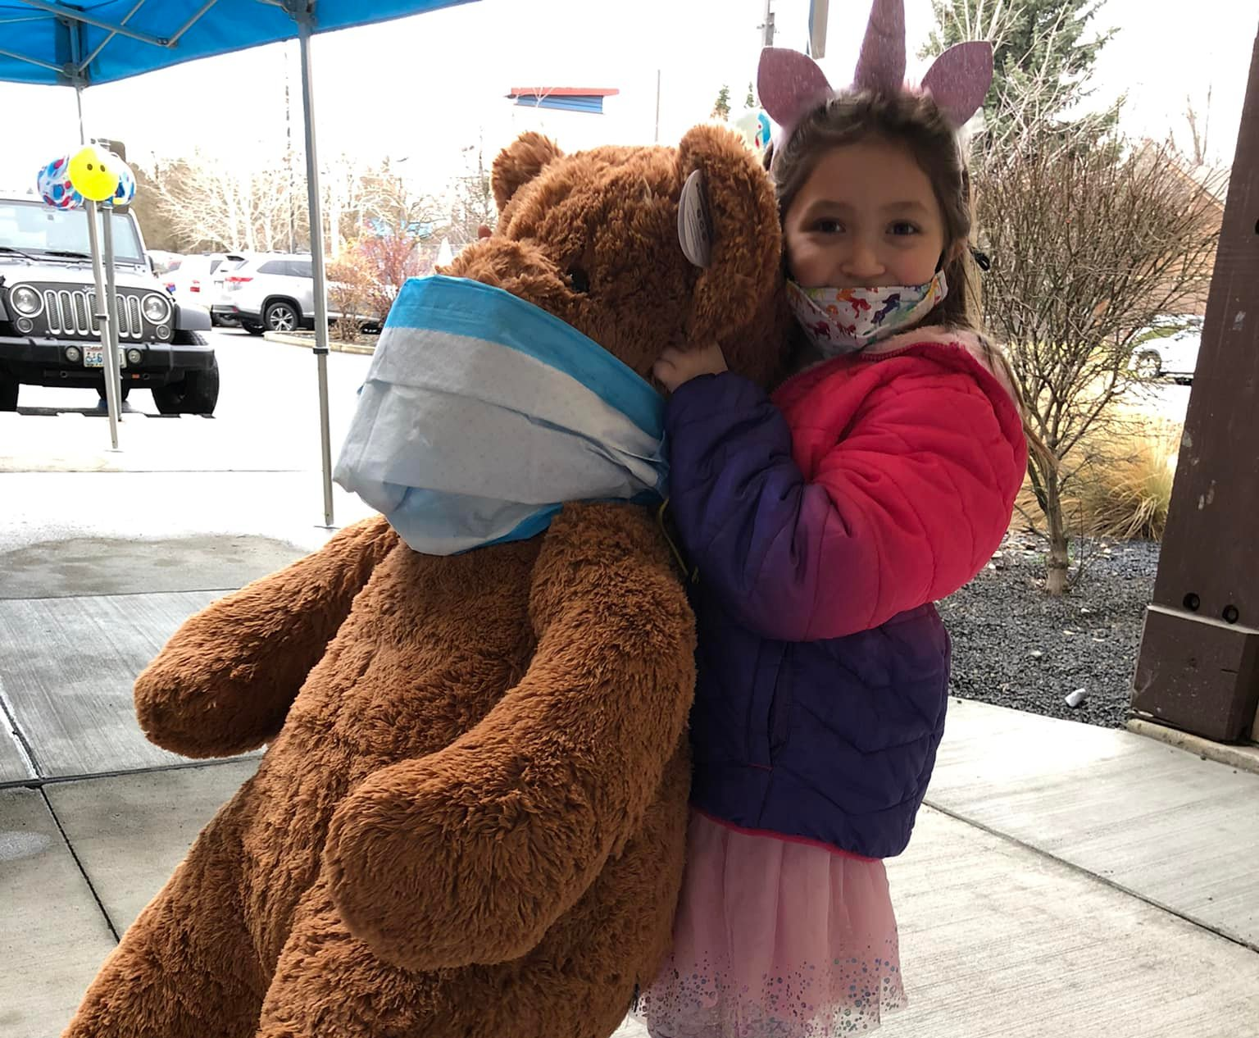
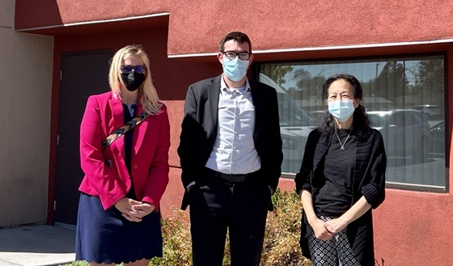
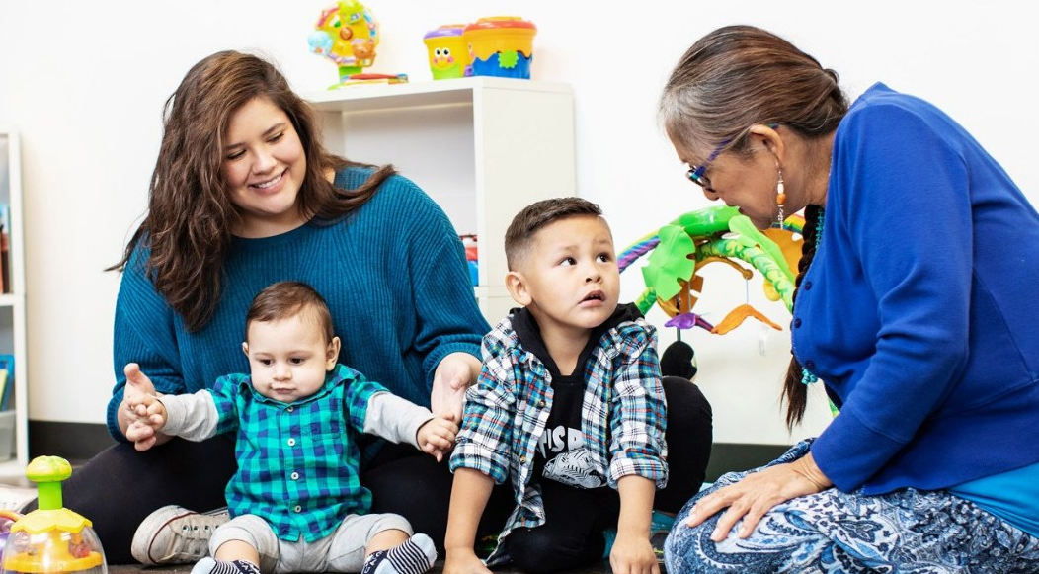

Slide 36
#BeAGoodRelative Campaign: COVID-19 Myths vs Facts

Slide 37
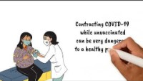

Slide 38
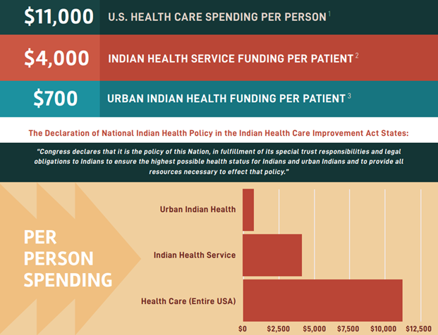
The National Council of Urban Indian Health recently published a resource that visually demonstrates disproportionate gaps in national healthcare investment for American Indians and Alaska Natives.

Slide 39

“The federal government needs to invest more in the Indian health system and support the over 70% of us in urban areas. And we are pressing them to do just that.”

Slide 40
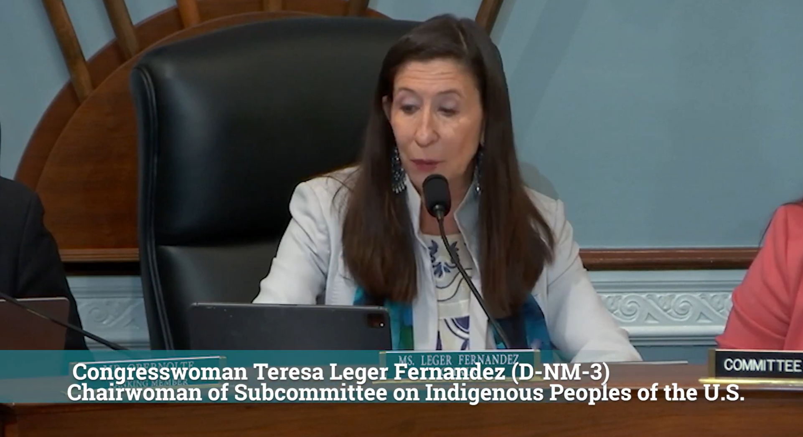
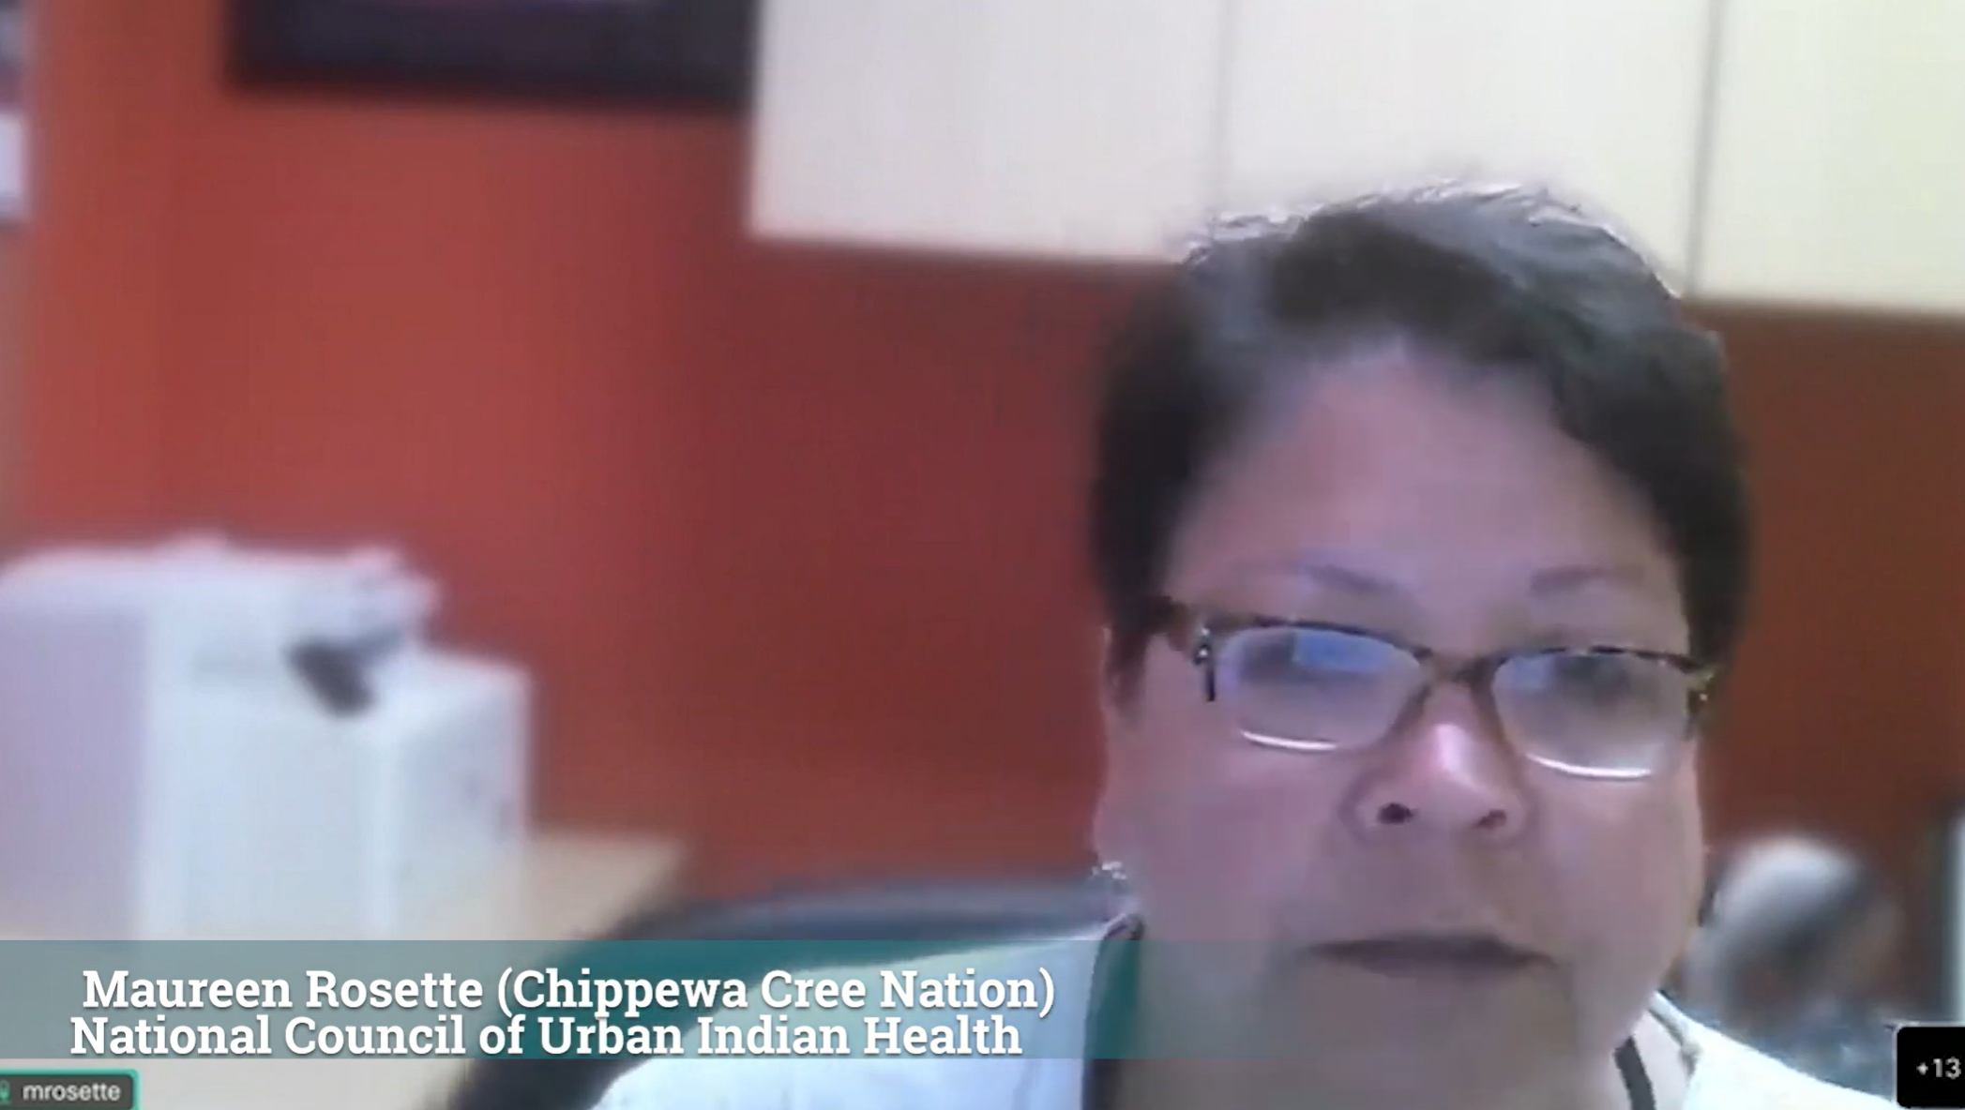
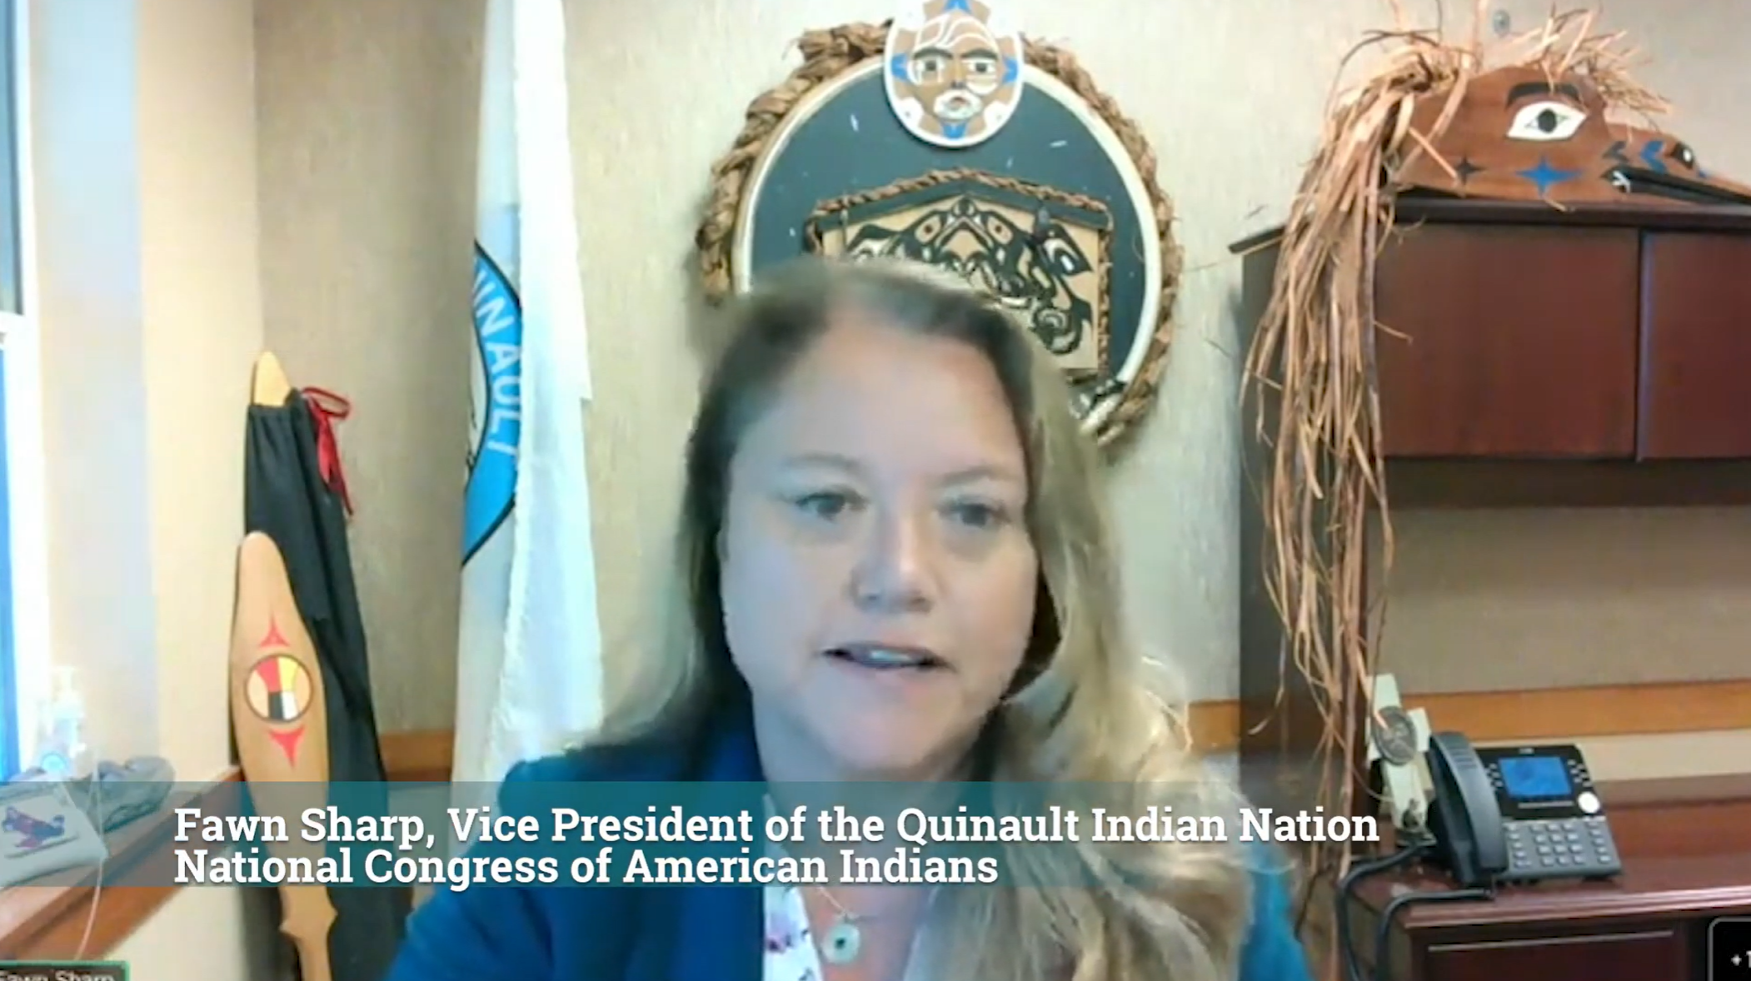
“Advance appropriations is imperative to provide certainty to the Indian healthcare system and ensure unrelated budget disagreements do not risk lives.”

Slide 41
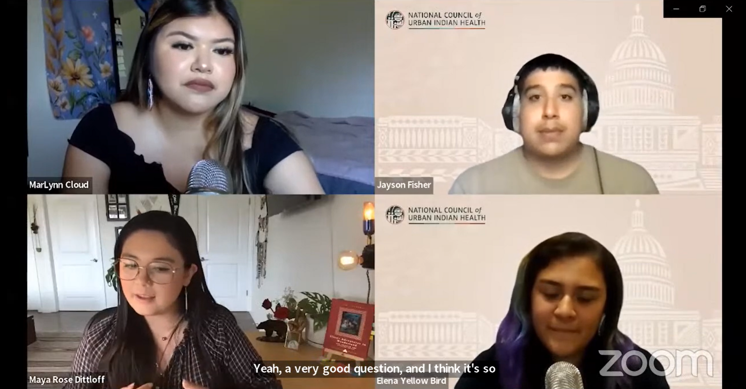
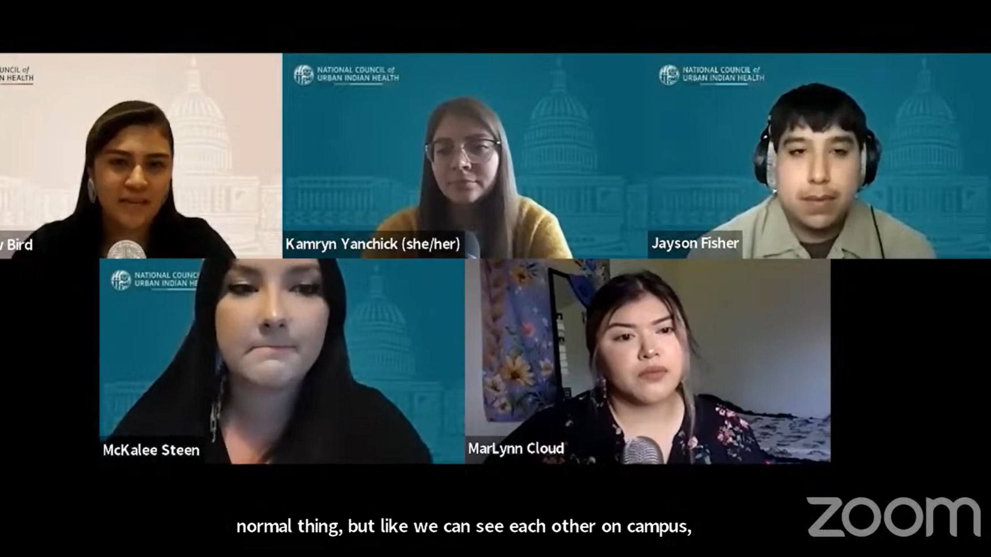
YOUTH ADVISORY COUNCIL

Slide 42
THANK YOU
FOLLOW US ON OUR SOCIAL NETWORKS
@NCUIH
@NCUIH_Official
@urbanindianhealth

Slide 43
NCUIH is Happy to Help You
FRANCYS CREVIER
Chief Executive Officer
fcrevier@ncuih.org
MEREDITH RAIMONDI
Vice-President of Public Policy
mraimondi@ncuih.org

Slide 44
