Slide 2
Who is Equality Ohio?
Equality Ohio identifies and transforms systems and institutions so LGBTQ+ Ohioans can fully access legal and lived equality. We envision an Ohio where people are welcome, affirmed and flourishing. We do this through:
Statehouse and Agency Advocacy
Municipal Policy Work
Legal Clinic
Public Education Programming
We are always here as a resource! You can ask us anything in a judgement-free space because we are here to help you become a full supporter of LGBTQ equality.

Slide 3
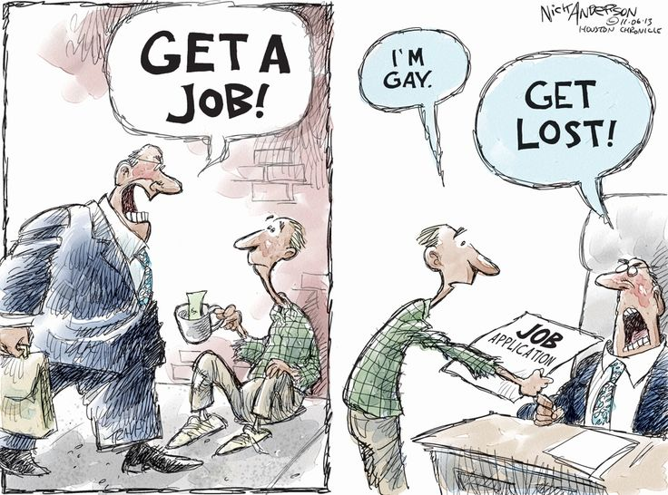
What We Do
We work with public officials, business leaders, faith communities, and other stakeholders to promote lived and legal equality throughout Ohio.
Lived Equality: Outcomes, community well being, and the lived experiences of LGBTQ people
Legal Equality: Equal protection of LGBTQ people in policies and laws

Slide 4
Equality Ohio & Race Equity
24+ month process to develop a strategic framework that has a race equity lens.
Racism is unique, systemic, and persistent; addressing it within ourselves, communities, policies, laws, systems and institutions is vital for the transformation we seek and need. We believe diverse leadership and meaningful engagement from across our LGBTQ+ and allied communities, most especially in communities of color, results in better solutions for everyone. We will fight such that those experiencing multiple forms of oppression are specifically addressed in policy and nobody is left behind.
Notes:
The time was spent getting everyone to a place of understanding, agreement and buy-in. Lots of internal education. The first question that must be answered is “can we truly do this work in a way that serves the most marginalized without a race equity lens? What happens when we focus on the most marginalized of our service population?”

Slide 5
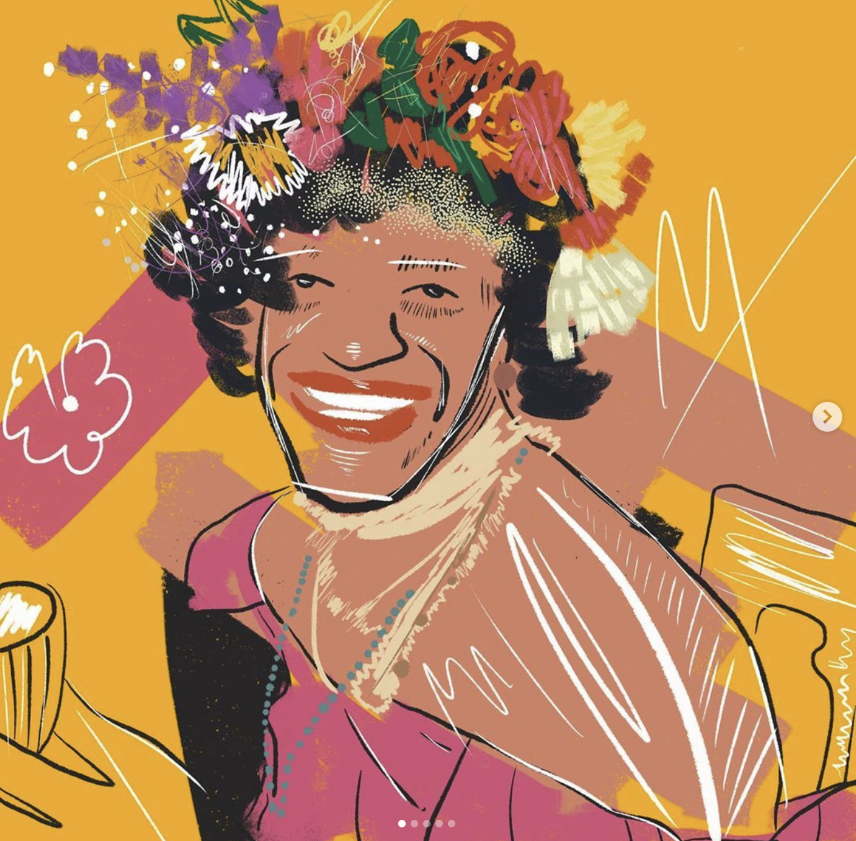
"History isn't something you look back at and say it was inevitable, it happens because people make decisions that are sometimes very impulsive and of the moment, but those moments are cumulative realities."
-Marsha P. Johnson
Artist: @robertojunior.me
Notes:
Stonewall Inn.
Ponder this quote from 50 years later in 2019 - “That was such a joke,” transgender activist Judy Bowen said of the apology. To her, it felt insufficient for the violence and harassment the police had doled out against LGBTQ people for years. “When the police commissioner was making that apology I broke down and cried,” Bowen said. “I remember too much about things that I remember happening in the past … things that should not ever happen to any human being.”

Slide 6
Where We’re Going
SOGIE Overview/Terms and Terminology
Risk Factors and Vulnerabilities
in the LGBTQ Community
Serious Threats to LGBTQ+ People in Ohio and Across the US
Lessons Learned from our Campaign

Slide 7
Understanding
SOGIE
Notes:
We’re first going to walk through some common definitions and terms that come up when working with the clients in the LGBTQ community.
You may be asking why we should care whether our clients are gay or straight, cisgender or transgender. The reason we care, why we must care, is because this allows us to identify risk factors and vulnerabilities, to identify other legal issues that might be present in our case, to ensure that we are approaching the case in a trauma-informed way if needed, and to be aware of any social determinants of health that may also be involved. In short, to provide the best representation to our clients we haev to know them and this means knowing their full selves.

Slide 8
Sexual Orientation & Gender Identity
(SOGIE - The Data)
Sexual Orientation: An inherent or immutable enduring emotional, romantic or sexual attraction to other people.
Assigned Birth Gender (or Sex): An individual’s determined gender based upon genitals, reproductive organs, and/or chromosomes; what the doctor said you were when you were born.
Gender Identity: One's innermost concept of self as male, female, a blend of both or neither – how individuals perceive themselves and what they call themselves. One's gender identity can be the same or different from their sex assigned at birth.
Gender Expression: External appearance of one's gender identity, usually expressed through behavior, clothing, haircut or voice, and which may or may not conform to socially defined behaviors and characteristics typically associated with being either masculine or feminine.

Slide 10
Straight: Having attraction to the opposite gender.
Lesbian: Women who have attraction to other women.
Gay: Men who have attraction to other men (women who are attracted to women sometimes use this term).
Bisexual/Pansexual: Having attraction to two or more genders (such as men and women).
Same-Gender-Loving (SGL): An Afrocentric alternative to LGB identities coined in the 90s
Sexual Orientations

Slide 11
A special note about “Queer”
16th century: originally meant strange, peculiar or odd.
Early 20th century: began being used as a slur for LGBTQ folks.
Late 1980’s: partial reclamation as part of the LGBTQ equality/AIDS rights movement.
Today: An umbrella term that some LGBTQ+ people may use to describe themselves or the community at large.
Should not be used to describe any person who has not first identified themselves as Queer.

Slide 12
Gender Identities
Cisgender: A person whose gender identity conforms with the gender they were assigned at birth; a person who is not transgender.
Transgender: A person whose gender identity differs from the gender they were assigned at birth; a person who is not cisgender.
Transgender Woman (MTF): A woman who was assumed male at birth.
Transgender Man (FTM): A man who was assumed female at birth.
Genderqueer/Gender Nonconforming/Gender Non-Binary (Enby): Umbrella terms for an individual who does not necessarily identify as male or female.
Intersex: A person born with a variation in sex characteristics and cannot be distinctly assigned as male or female. It is not the same as transgender.

Slide 13
Gender Identity Development
Gender identity typically develops in stages:
Around age two: Children become conscious of the physical differences between boys and girls.
Before their third birthday: Most children can easily label themselves as either a boy or a girl.
By age four: Most children have a stable sense of their gender identity.
Research suggests that children who assert a gender-diverse identity know their gender as clearly and consistently as their developmentally matched peers.
Source: Healthychildren.org

Slide 14
Transition
Transition: Steps––physical, medical, and/or social––an individual will take to align the world’s understanding of their gender with who they know themselves to be. Transitioning is a personal decision an individual makes; someone's transition may not be physical at all.
A person’s transition is a private decision and process. Questions about someone’s transition are highly personal and will often be considered rude and disrespectful. Some folks are more open and public than others about their transition journey––please do not assume that everyone is comfortable with sharing. If transition details are shared with you, they should be kept private.

Slide 15
Remember:
Gender Identity is who you are.
Sexual Orientation is who you are attracted to.
Gender Expression (how someone expresses themselves) does not tell you gender identity or sexual orientation.
Transition is different for every individual and it is personal.
Respectfully ASK if you do not know someone’s sexual orientation, gender identity, or pronouns.

Slide 16
Risk Factors and Vulnerabilities
in the
LGBTQ+ Community
Notes:
When we talked earlier about trauma-informed care, we mentioned that it is important especially for representing LGBTQ clients because many clients have likely experienced risk factors or vulnerabilities. That is why it is important to know your client’s background and identity. It is critical to ask questions that will allow you to get a better sense of what obstacles your client may have faced or is currently facing.

Slide 17
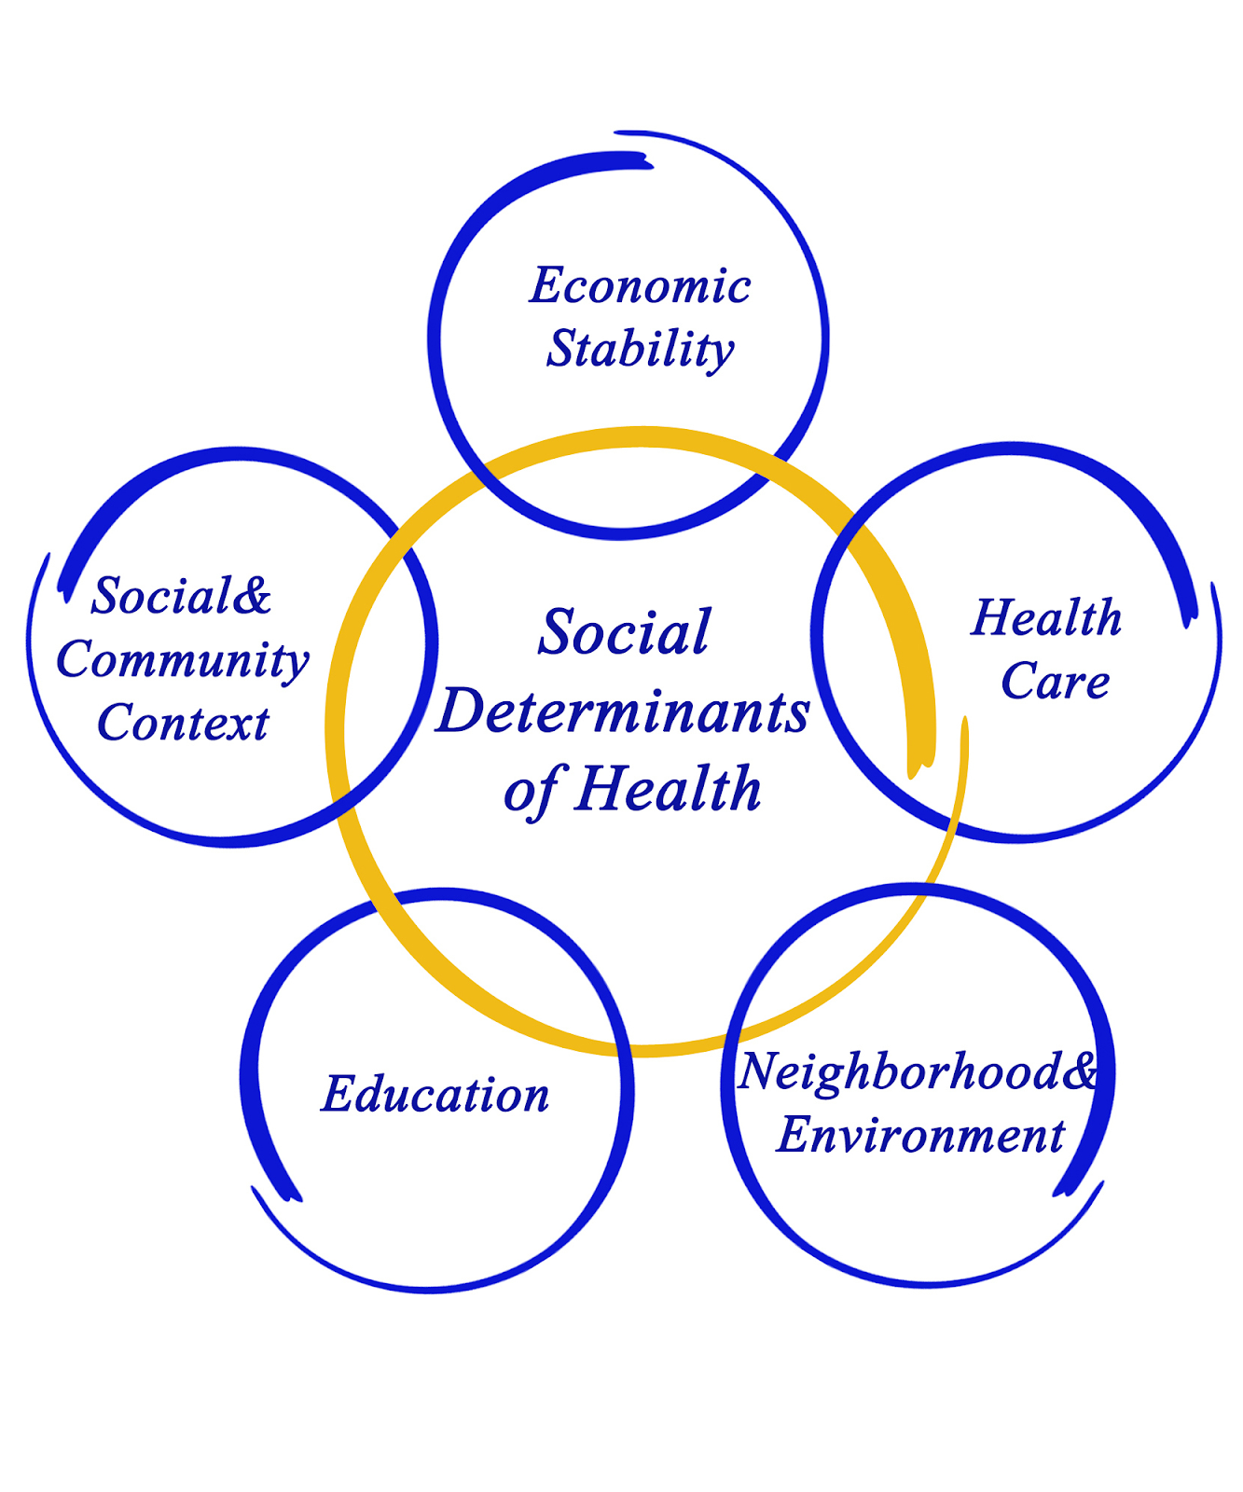
Social Determinants of Health
Graphics from the Kaiser Family Foundation & Integra Service Connect
Notes:
What are social determinants of health?
Why are we talking about this? Why does this matter to the work we are doing in the Clinic? Why does this matter to us as legal professionals in general?
For example: SDOH also contribute to wide health disparities and inequities. For example, people who don't have access to grocery stores with healthy foods are less likely to have good nutrition. That raises their risk of health conditions like heart disease, diabetes, and obesity — and even lowers life expectancy relative to people who do have access to healthy foods.
https://www.youtube.com/watch?v=8PH4JYfF4Ns

Slide 18
Minority Stress
An extensive body of research shows that exposure to anti-LGBT discrimination increases the risks of poor mental and physical health for LGBT people.
Discrimination is linked to health harms even for those who are not directly exposed to it, because the presence of discrimination, stigma, and prejudice creates a hostile social climate that taxes individuals’ coping resources and contributes to Minority Stress.
Manifestations of this stress, including internalized stigma, low self-esteem, expectations of rejection, and fear of discrimination, help explain the health disparities seen in LGBT populations.
Protective factors against the harms of discrimination include peer, community, and family support; access to affirming health care and social services; and the establishment of positive social climates, inclusive practices, and anti-discrimination policies.
Public Policy Research Portal
whatweknow.info

Slide 19
Health Disparities
An extensive body of research shows that exposure to anti-LGBT discrimination increases the risks of poor mental and physical health for LGBT people.
Discrimination is linked to health harms even for those who are not directly exposed to it, because the presence of discrimination, stigma, and prejudice creates a hostile social climate that taxes individuals’ coping resources and contributes to minority stress.
Manifestations of this stress, including internalized stigma, low self-esteem, expectations of rejection, and fear of discrimination, help explain the health disparities seen in LGBT populations.
Protective factors against the harms of discrimination include peer, community, and family support; access to affirming health care and social services; and the establishment of positive social climates, inclusive practices, and anti-discrimination policies.
Public Policy Research Portal
whatweknow.info

Slide 20
Discrimination
75% of LGBTQ youth reported that they had experienced discrimination based on their sexual orientation or gender identity at least once in their lifetime.
Half of all LGBTQ youth of color reported discrimination based on their race/ethnicity in the past year, including 67% of Black LGBTQ youth and 60% of Asian/Pacific Islander LGBTQ youth.

Slide 21
Suicide &
Self-Harm
42% of LGBTQ youth seriously considered attempting suicide in the past year, including more than half of transgender and nonbinary youth.
12% of white youth attempted suicide compared to 31% of Native/Indigenous youth, 21% of Black youth, 21% of multiracial youth, 18% of Latinx youth, and 12% of Asian/Pacific Islander youth.
only 1 in 3 LGBTQ youth found their home to be LGBTQ-affirming.
Affirming transgender and nonbinary youth by respecting their pronouns and allowing them to change legal documents is associated with lower rates of attempting suicide.

Slide 22
Homelessness & Housing Insecurity
LGBTQ+ youth are at 2.2x greater risk of experiencing homelessness
20 - 40% of all homeless youth are LGBTQ+ (but are only 7% of the greater population)
More than 1 in 4 LGBTQ+ youth are forced to leave home when they come out/turn 18

Slide 23
Status Offenses & Other Justice Involvement
Although only 5-7% of the youth population, LGBTQ+ youth make up nearly 20% of the population that are system involved.
Gender nonconforming Black boys and transgender Black girls are 3.3x (230%) more likely to be arrested for status offenses and nonviolent misdemeanors that are not sustained in court.
Gender nonconforming Black girls and transgender Black boys are 3.9x more likely (290%) to be charged with violent crimes or weapons violations.

Slide 24
Serious Threats to LGBTQ+ People in USA
Notes:
When these harms occur, what protections are in place? What recourse is available? Let’s briefly touch on some of the protections that exist at the federal, state, and local level

Slide 25
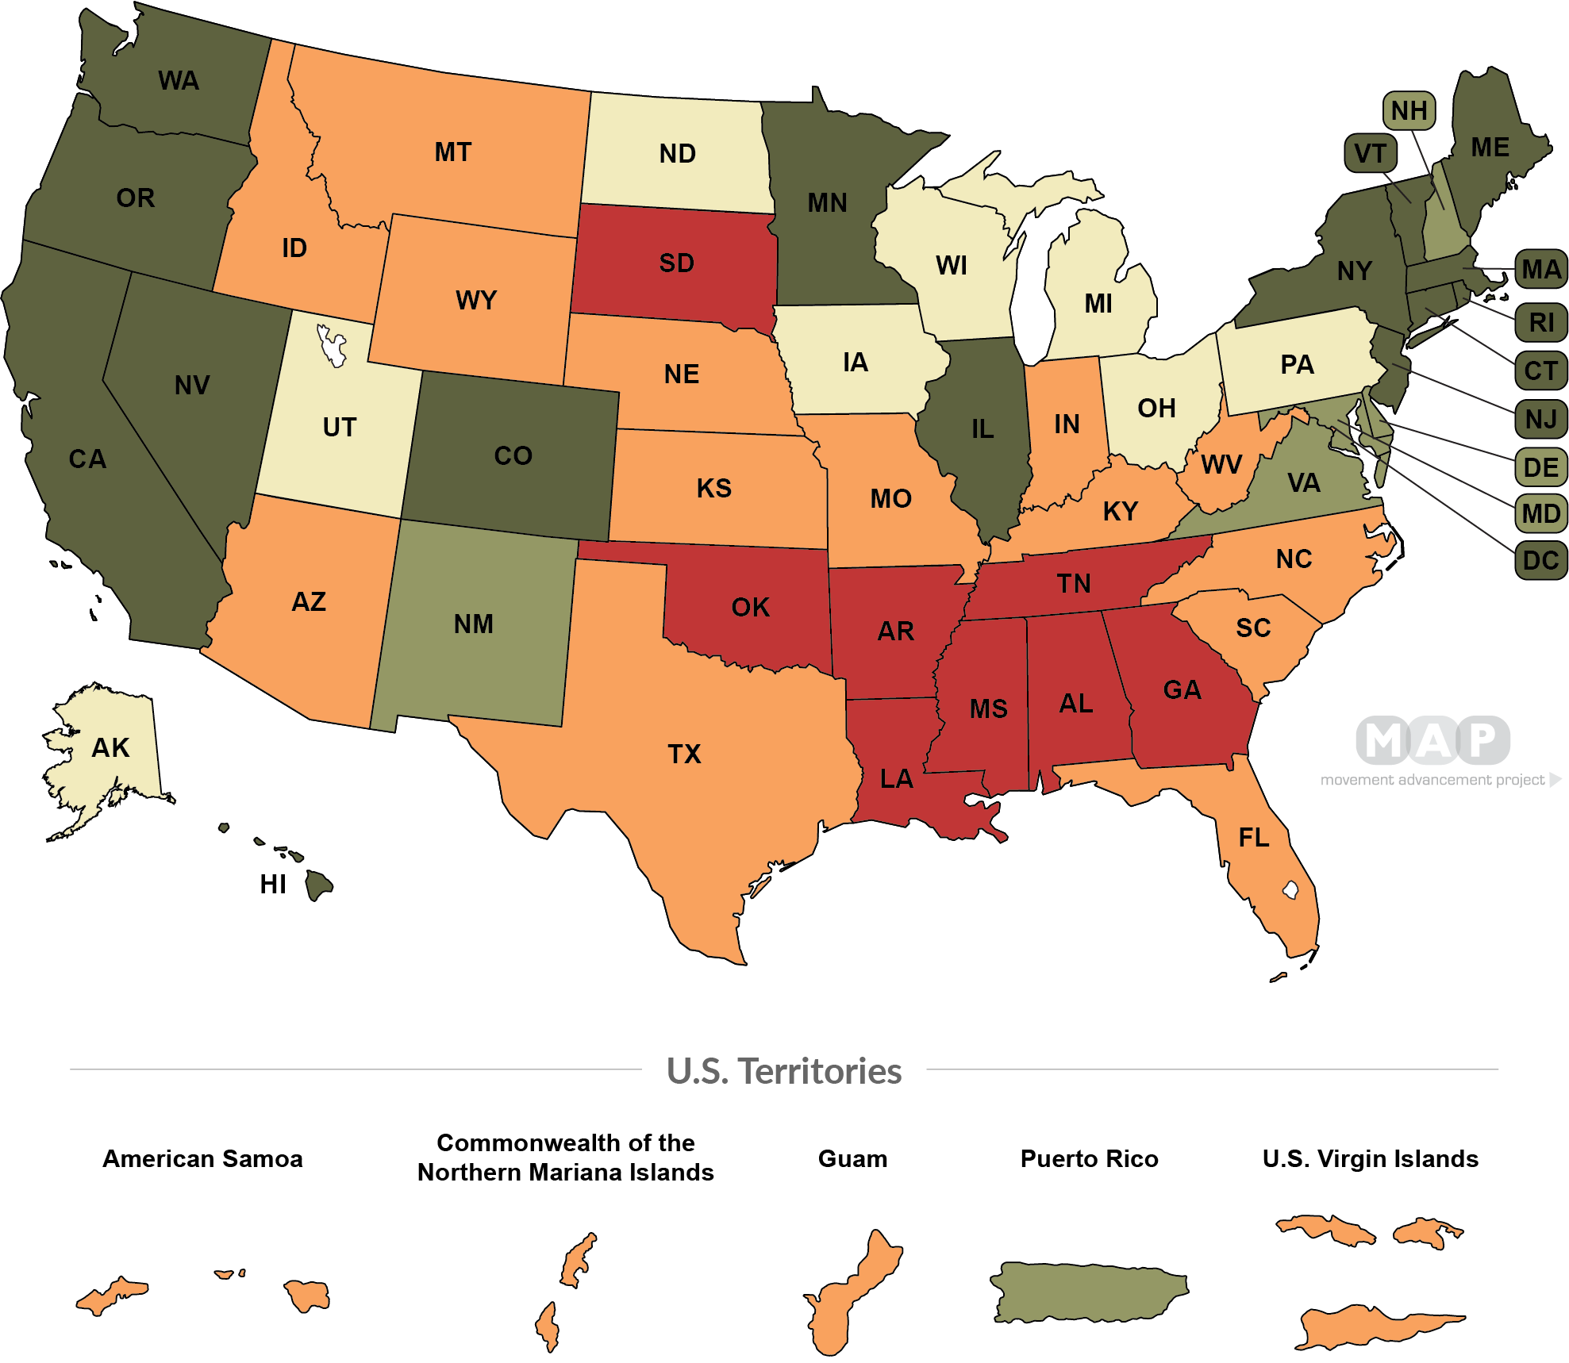
State of LGBTQ+ Equality Overall
DARK GREEN SHADING
High Overall Policy Tally (15 states + D.C.)
LIGHT GREEN SHADING
Medium Overall Policy Tally (5 states, 1 territory)
CREAM SHADING
Fair Overall Policy Tally (8 states)
ORANGE SHADING
Low Overall Policy Tally (14 states, 4 territories)
RED SHADING
Negative Overall Policy Tally (8 states)

Slide 26
More than 250 anti-LGBTQ bills have been introduced in state legislatures
Bills prohibiting health care for trans youth were introduced in more than 20 states
More than 30 states introduced restrictions on trans athletes
18 states have enacted the legislation into law
Bad Bills Everywhere
Notes:
https://www.hrc.org/press-releases/2021-officially-becomes-worst-year-in-recent-history-for-lgbtq-state-legislative-attacks-as-unprecedented-number-of-states-enact-record-shattering-number-of-anti-lgbtq-measures-into-law
More than 250 anti-LGBTQ bills have been introduced in state legislatures in 2021, including:
At least 35 bills that would prohibit transgender youth from being able to access best-practice, age-appropriate, gender-affirming medical care
At least 69 bills that would prohibit transgender youth (and in some cases college students) from participating in sports consistent with their gender identity
At least 43 bills that would allow people to assert a religious belief as justification for failing to abide by the law or provide services to people of whom they disapprove
At least 15 bills that would prohibit transgender people from having access to restrooms or locker rooms consistent with their gender identity

Slide 27
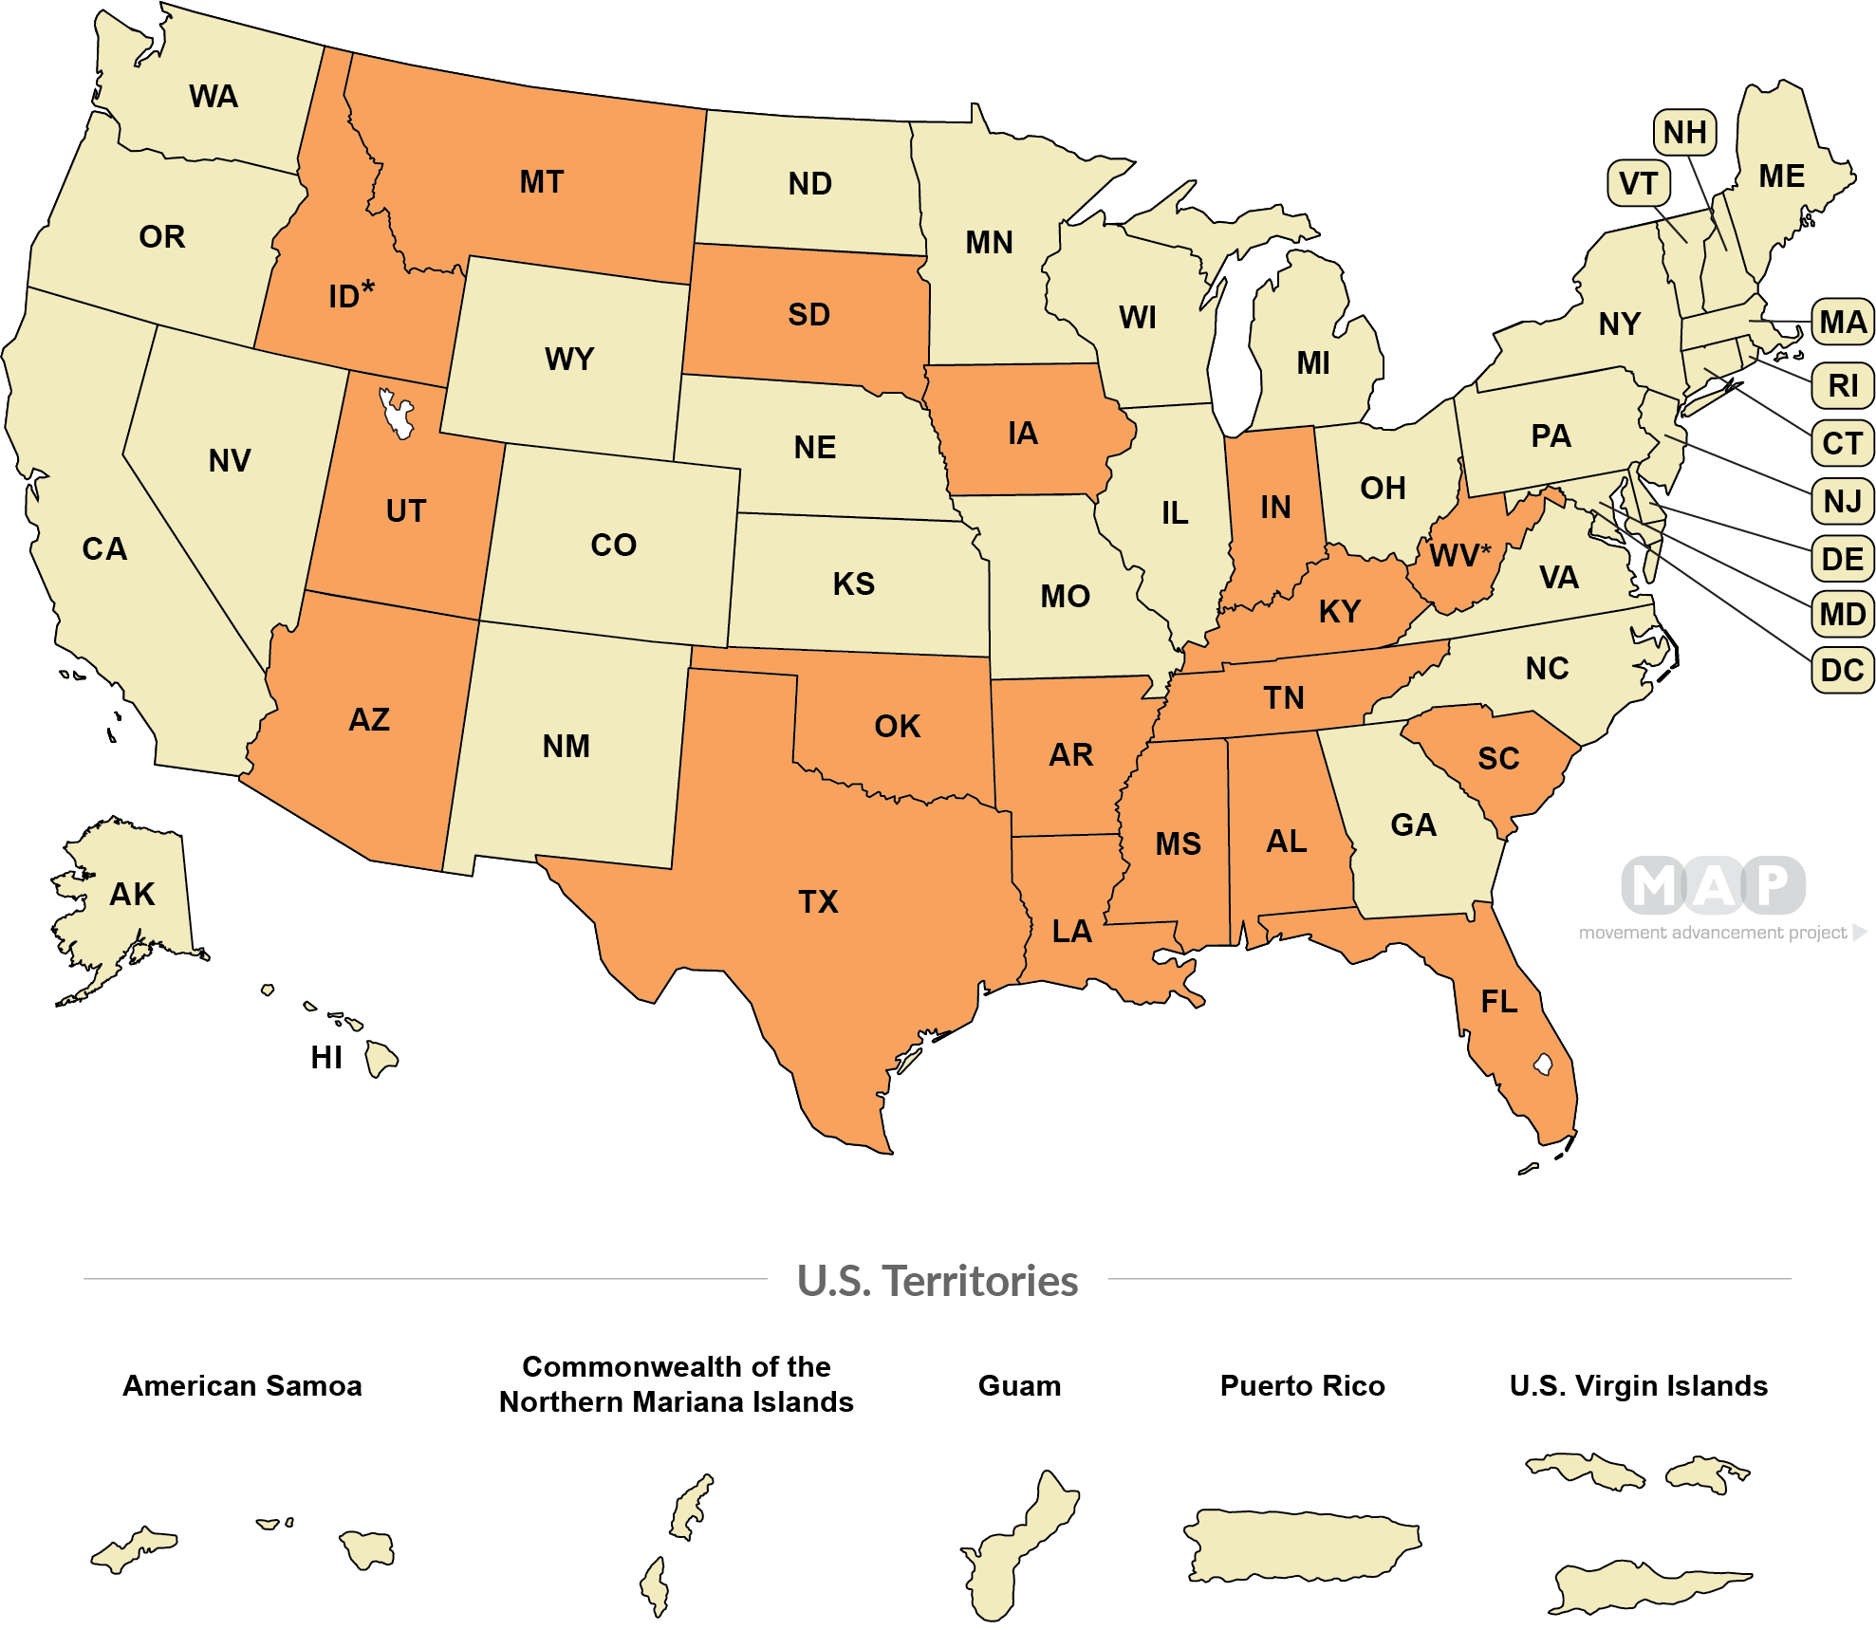
Bans on Sports for Transgender Students
ORANGE SHADING
State law bans transgender students from participating in sports consistent with their gender identity (18 states)
CREAM SHADING
State law does not ban transgender students from participating in sports consistent with their gender identity (32 states , 5 territories + D.C.)
Courtesy of Movement Advancement Project

Slide 28
OHSAA Already Has Rules for Transgender Athletes
Ohio presently has one transgender high school female athlete, Ember, who is approved to play by the Ohio High School Athletic Association
OHSAA has supported and provided regulations for transgender athletes for nearly a decade
Solution in search of a problem
https://www.ohiocanplay.com/

Slide 29
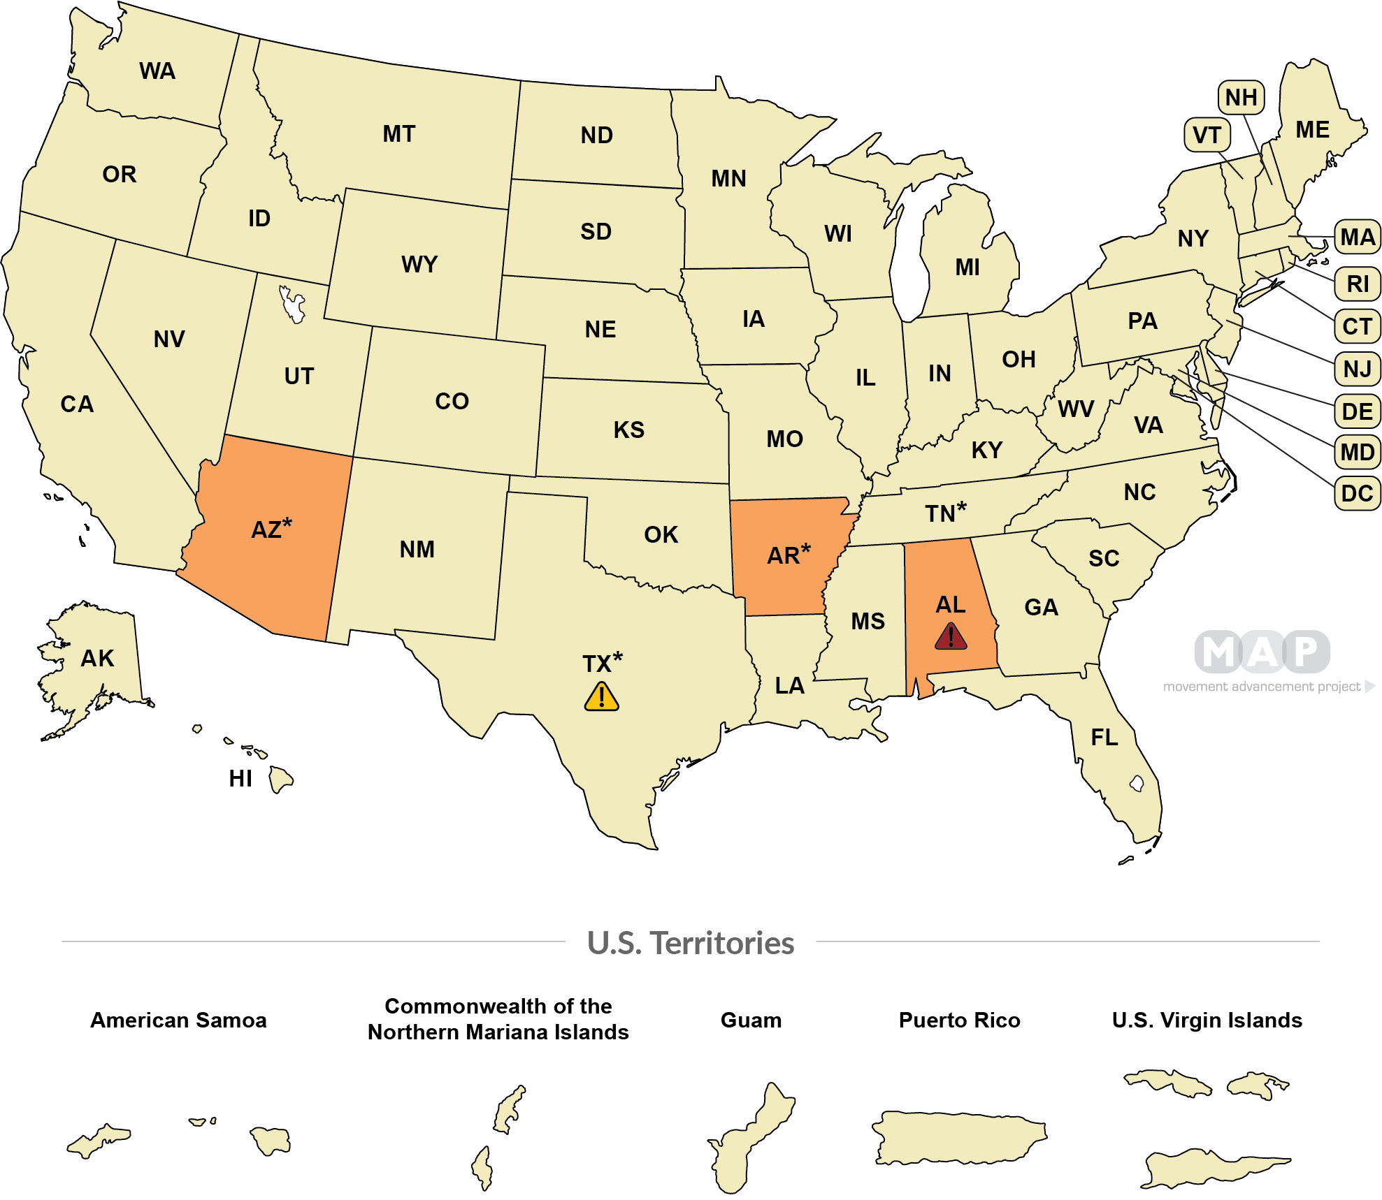
Bans on Medical Care for Transgender Youth
ORANGE SHADING
State law bans or restricts best practice medical care for transgender youth (see note)(3 states)
CREAM SHADING
State does not ban best practice medical care for transgender youth (47 states , 5 territories + D.C.)
AL - State ban makes it a felony crime to provide best practice medical care for transgender youth(1 state)
TX - State executives have attempted to limit or restrict medical care for transgender youth, but state law does not ban this care (see note)(1 state)

Slide 30
HB 454: The so-called “Safe” Act
Representative, sponsor of the bill and pastor = Gary Click
So-called “Save Adolescents from Experimentation” (SAFE) Act
First hearing in the Ohio Statehouse in February
Have now had 4 total hearings
What It Would Do: Prohibit medical, mental health and social services to transgender children (gender affirmation care)
Prevent gender-affirming care
No longer allowing doctors or other health care workers to provide medical procedures, hormone blockers, counseling or other care to trans youth.
Require counselors to tell parents about what the child says in therapy.
Health care workers who continue to provide this care would have their license removed and can be sued.
Public funding would be taken away from institutions that help transgender young people.
Insurance providers and Medicaid would not cover gender-affirming procedures.
Would jeopardize hospitals, private doctor and therapy practice, and would put healthcare workers in direct conflict with their ethical obligations
Notes:
HB 454, which would try to prohibit affirming care for transgender youth, has received only one hearing in the Ohio house, has no companion bill pending in the Senate, and has massive opposition against it. We are working closely with coalition partners, including our hospitals, and ally lawmakers to slow and ultimately stop the bill from moving forward.

Slide 31
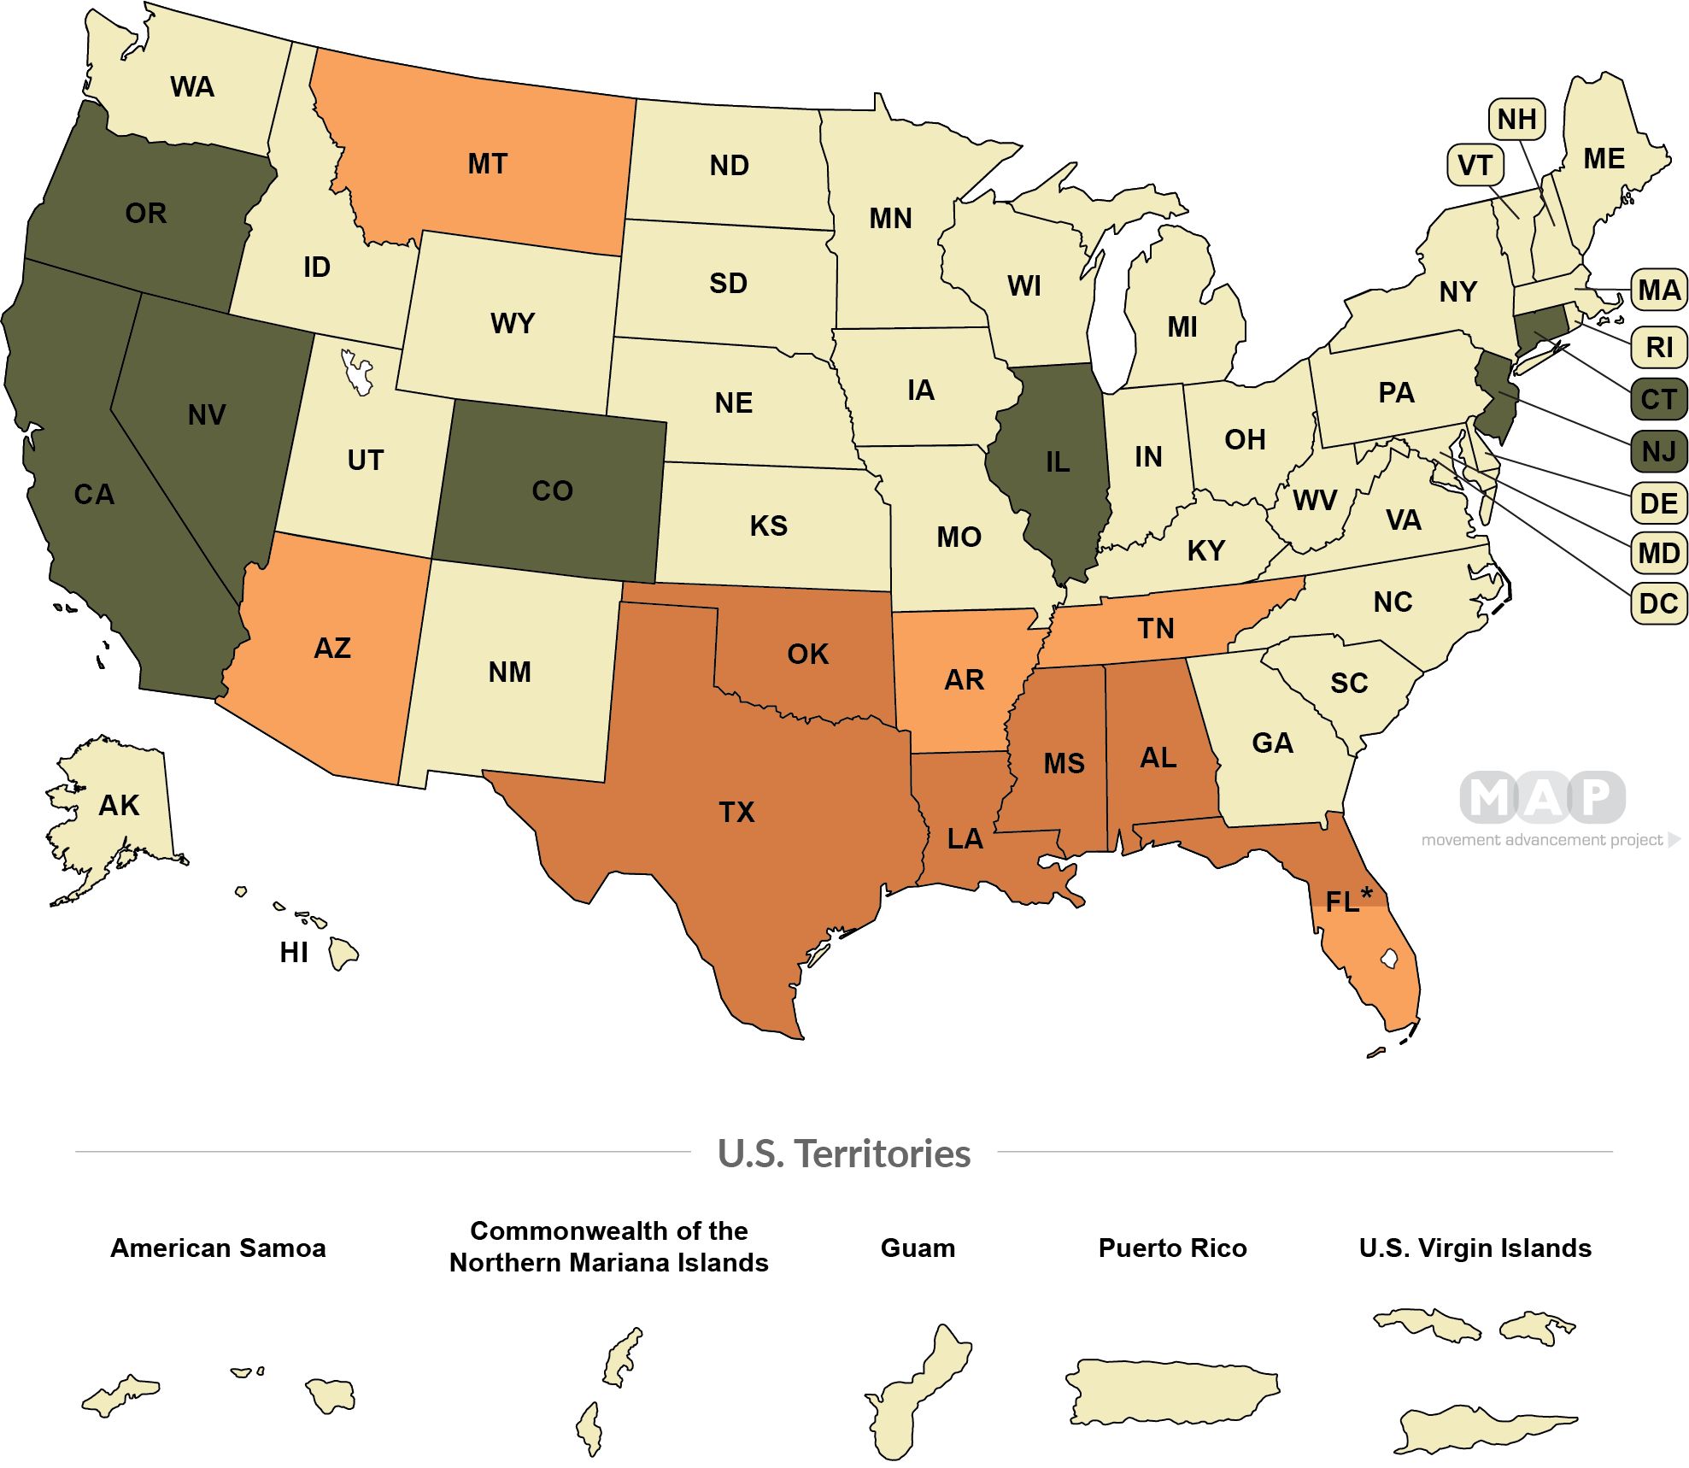
LGBTQ Curriculum Laws
GREEN SHADING
State law explicitly requires LGBTQ inclusion in state curricular standards (7 states)
CREAM SHADING
State has none of these LGBTQ-specific curricular laws (33 states , 5 territories + D.C.)
ORANGE SHADING
State law requires parental notification of LGBTQ-inclusive curricula and allows parents to opt their children out (5 states)
RED SHADING
State law censors discussions of LGBTQ people or issues in school (i.e., “Don’t Say Gay or Trans”) (6 states)

Slide 32
HB 616: “Don’t Say Gay, Don’t Mention Race” Bill
Would ban or censor speech about LGBTQ+ identity, racism, and “diversity, equity and inclusion” in grades K-12
What Would It Do in practice:
Silence authentic teaching regarding racism, DEI, history
Limit how we talk about gender and how we talk about the transgender community
Chill discussion of minority students’ everyday experiences
Outrage in Ohio paused momentum, but first hearing took place on May 31st
Working to ensure it will not pick up again - please look for action alerts

Slide 33
VHK & Equality Ohio: Lessons Learned from our Campaign
Notes:
When these harms occur, what protections are in place? What recourse is available? Let’s briefly touch on some of the protections that exist at the federal, state, and local level

Slide 34
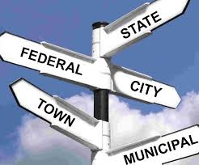
Ohio’s Preemptive Anti-LGBTQ+ Bills
HB 454 Banning Affirming Health Care
Would prohibit transgender youth from accessing mental or medical gender affirming care (counselors, social workers, doctors)
Preempts medical best practices, ethics regulations, and medical policies
HB 616 Don’t Say Gay, Don’t Mention Race
Would ban or censor discussion about LGBTQ+ identity and authentic teaching about racism
Preempts teacher curriculum & school board policies
HB 151 Banning Transgender Participation in Sports
Would prohibit transgender youth from playing sports on the team based on their gender identity
Preempts OHSAA & School policies
Notes:
https://equalityohio.org/about-yac/ Just in case you need it

Slide 35
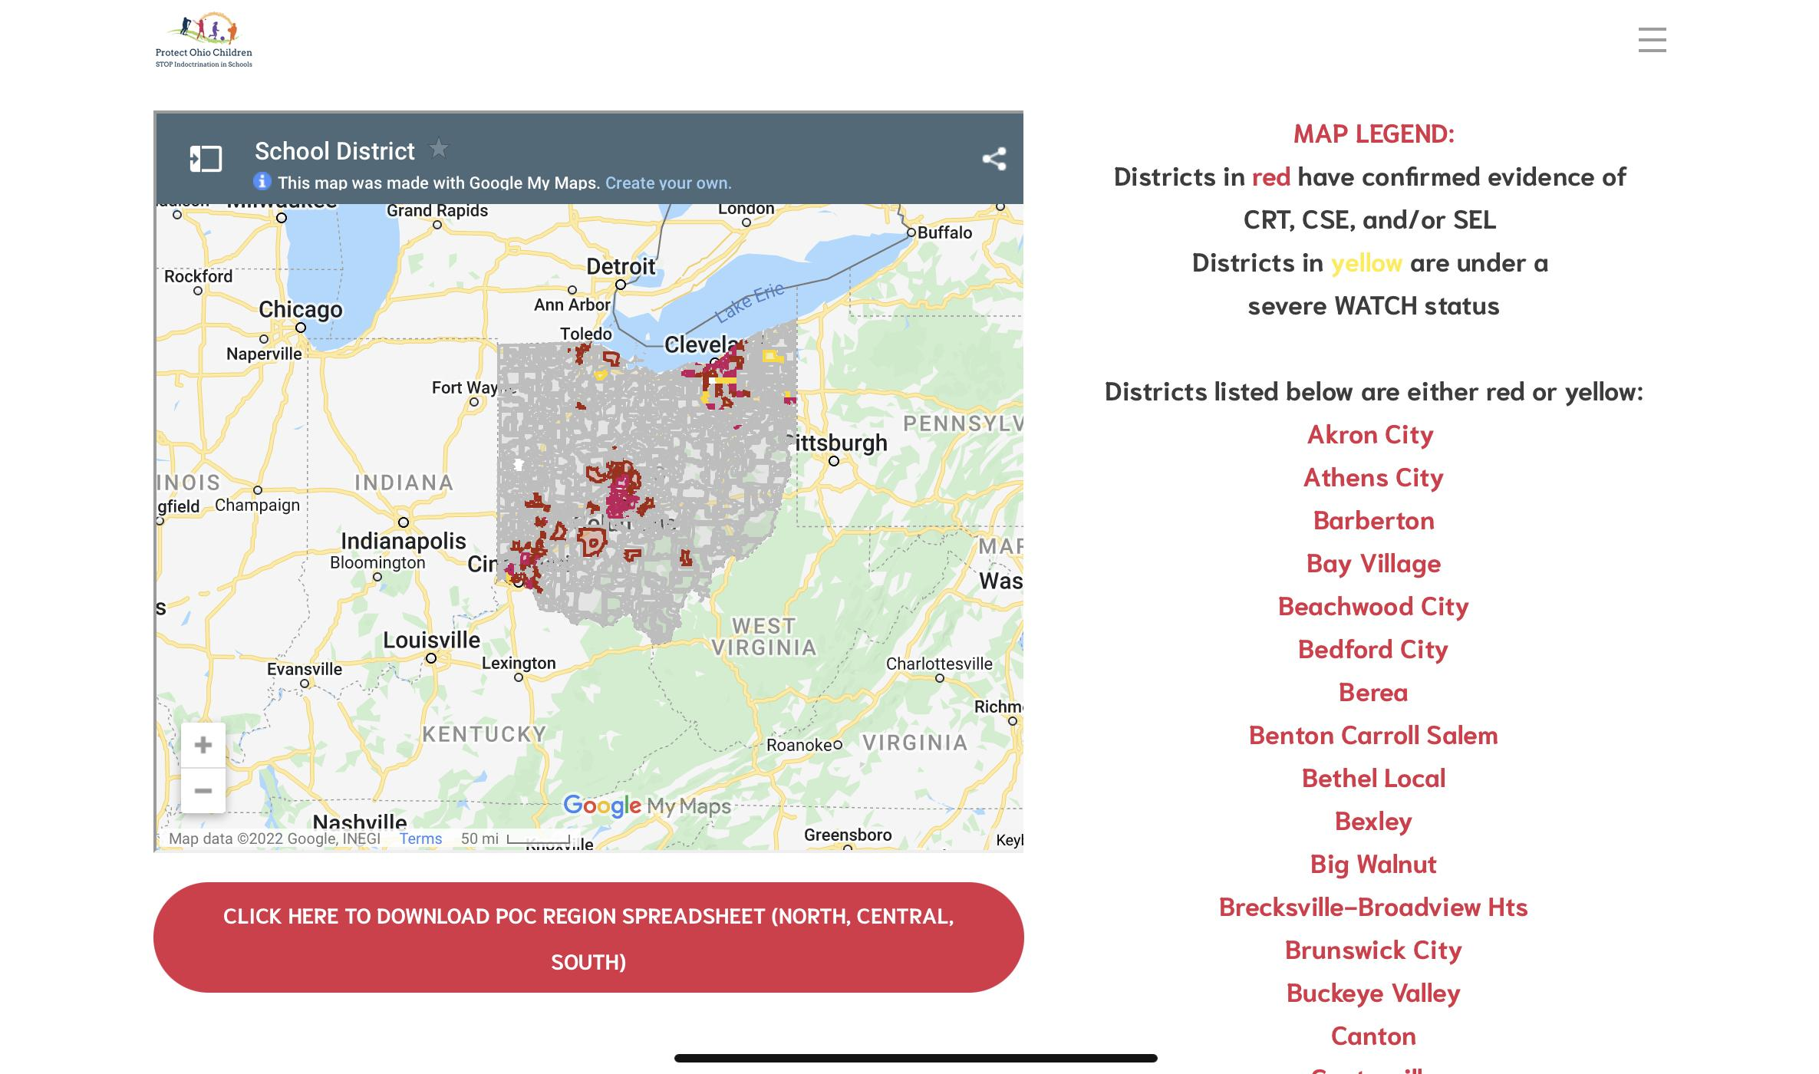
The opposition is well-resourced & organized
https://www.protectohiochildren.net
https://www.ccv.org/

Slide 36
Building Cross-Sectional Coalitions Against Bad Bills:
Our Campaign Supported by VHK
Goals:
Short term: Slow down bills & make the sponsors look foolish/cruel/extreme/etc.
Long term: Stall the bill until session ends, keep relationships with partners to have sustained pressure against more bad bills in the future
Actions:
Meetings with lawmakers
Public statements of opposition
Calls & emails to lawmakers
Letters to the editor & Op Eds
Community Education
Preparing testimony
Lobbying by coalition partners
HB 454 Banning Affirming Health Care
Uniting Hospitals, Doctors, Counselors, Educators, Youth, and Parents
HB 616 Don’t Say Gay, Don’t Mention Race
Uniting Educators, Local school boards & administrators, Civil Rights Groups, Youth, and Parents
HB 151 Banning Transgender Participation in Sports
Uniting Sports Associations, Student Athletes, Pro Sports teams, Parents, Educators
Notes:
https://equalityohio.org/about-yac/ Just in case you need it

Slide 37
Core Tactic: Tell the real story.
The opposition builds a dramatic narrative on false premises. Rather than quibble on the details of their narrative, we are telling our own narrative – which happens to also be the truth. But we are often not the best messengers.
Each stakeholder can tell the real story with authority, authenticity, and expertise. They can put to bed misconceptions, field hard questions, and provide receipts on why they’re right.
But most importantly, stakeholders can give the average observer a way to make sense of the bigger picture, and provide context for what they’re seeing and hearing.

Slide 38
Benefits of Cross-Sector Collaboration
Stay on message together
Share information learned together
Meet the moment with the voice that is most needed
A consistent narrative and messaging framework from all of the stakeholders – leaving room for personalization so it stays in their own voice – solidifies the picture for observers. That only happens with consistent communication and collaboration.
Building relationships and sharing intel can be the difference between getting ahead of a bad bill or actually having a shot to move a good bill.

Slide 39
As State Equality Orgs,
We Conduct the Orchestra

Slide 40
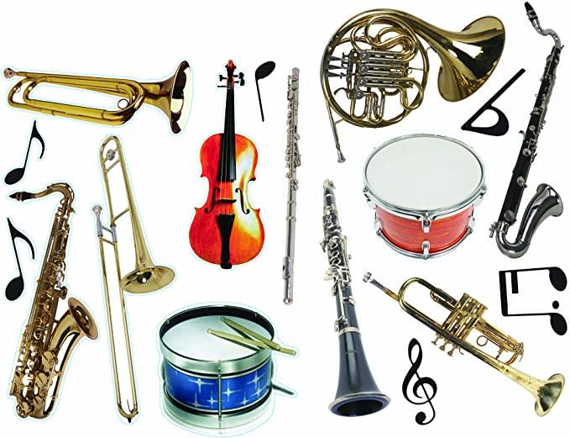
Assemble, Learn, and Practice Together

Slide 41
Working with Young People (GSAs, Centers)
Why they care:
Personally and directly impacted
These bills are wildly out of line with their personal politics
Lack control over the outcome (can’t vote or can’t be a decision-maker)
Considerations:
What do they need on a human level?
What’s their social environment in terms of affirmation, resources, and stressors?
Types of Activities:
Teach them how to use collective power
Give them specific calls to action
Deputize them to go into their communities to get friends involved
Builds long term movement power

Slide 42
What EO Does - Youth Engagement
Youth Advocacy Coalition
LGBTQ+ Youth and youth-serving individuals from across the state learning about civic engagement, advocacy tools, and educating legislators about the harms of these preemptive bills
Provide opportunities for youth from other parts of the state to share space
Social Media Outreach
Educational videos, posts, multimedia, and collaboration with partner organizations – low workload way to
Work with Student Groups
Have them elevate your programming to their networks
Collaborate on creative projects – don’t need to be big! Half the benefit is the skill building.
Provide skill building opportunities
Help them figure out how to plan their own protest or put on their own programming

Slide 43
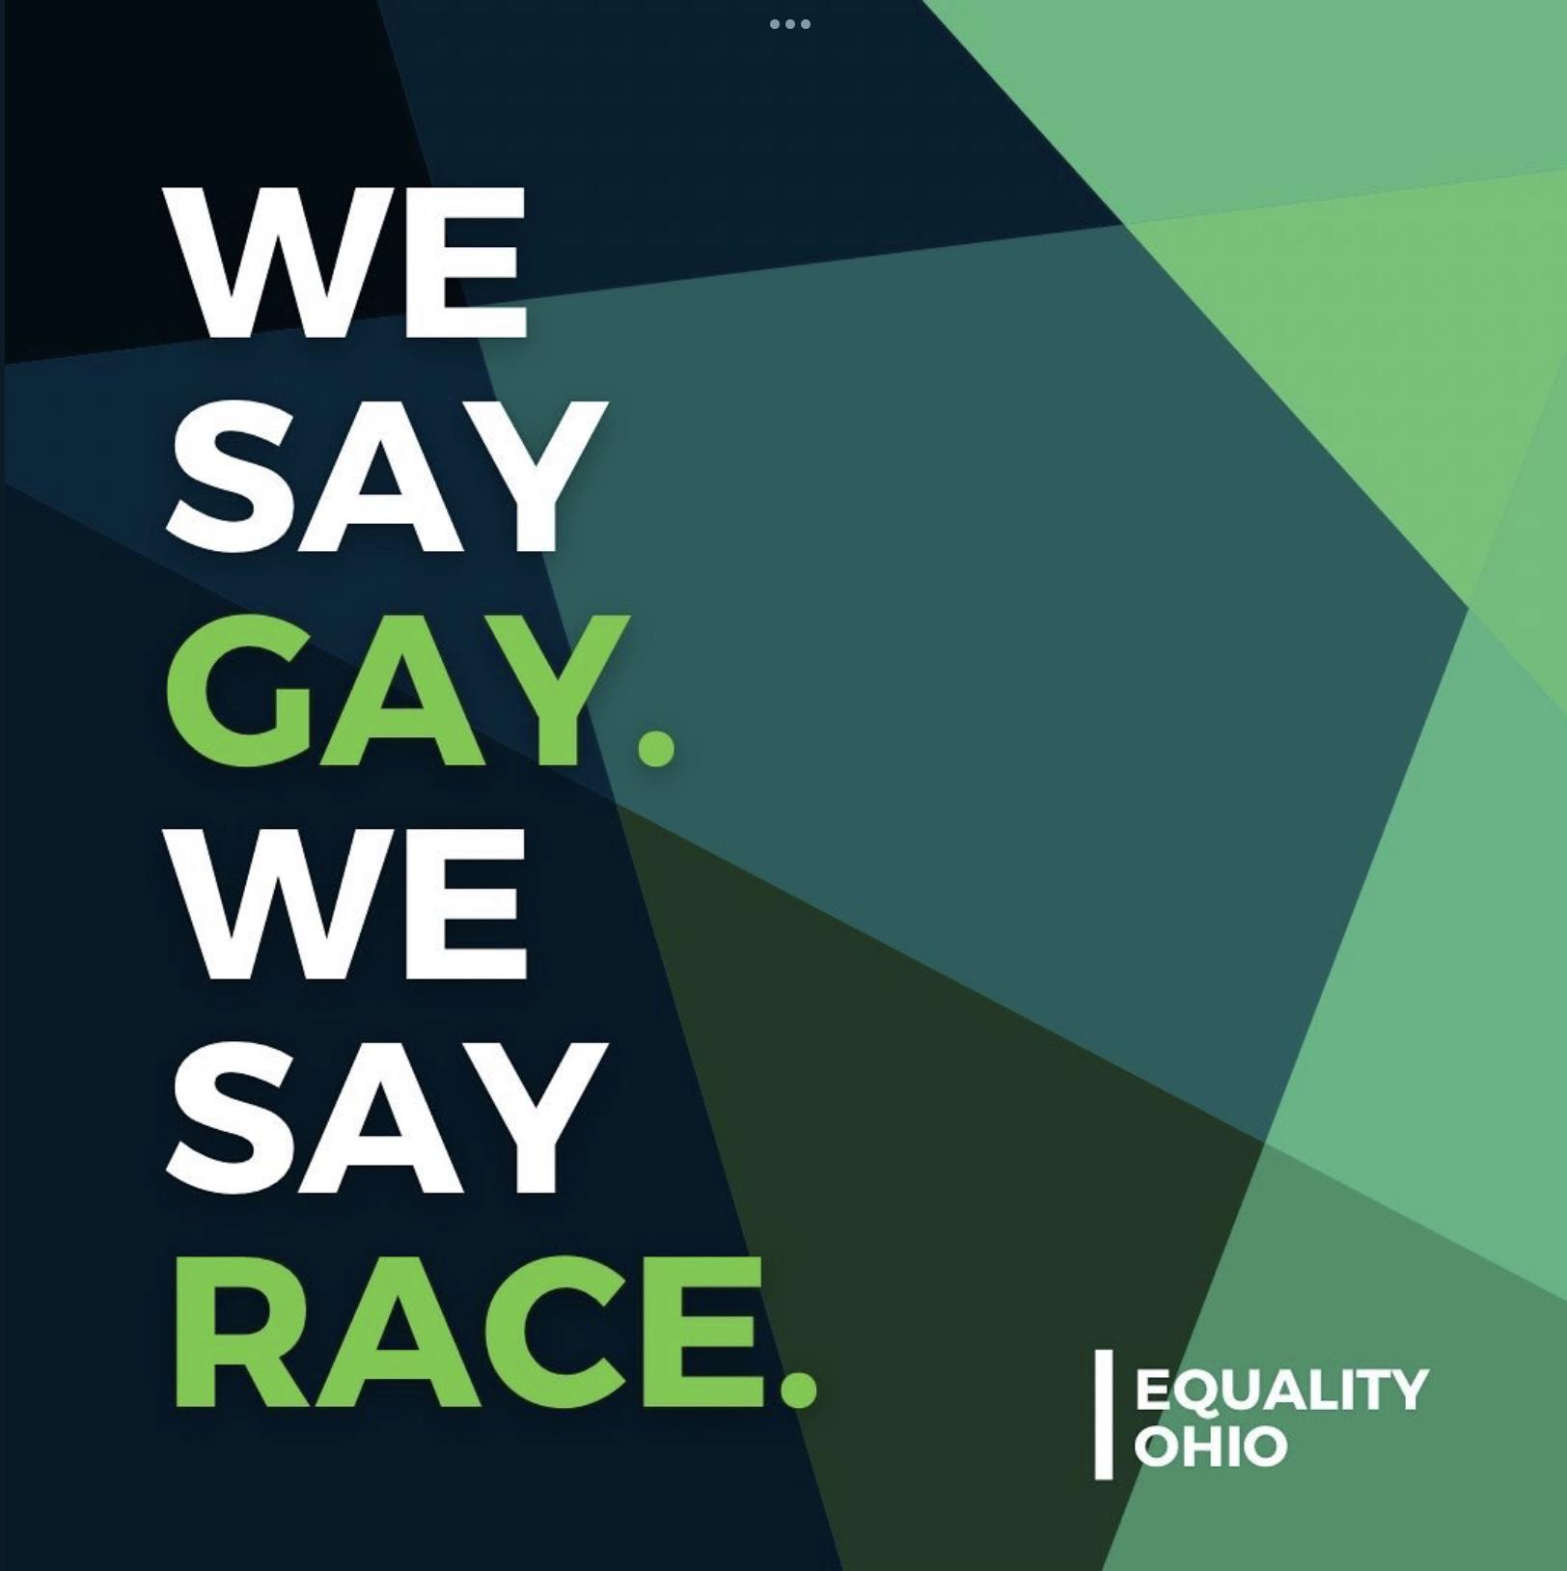
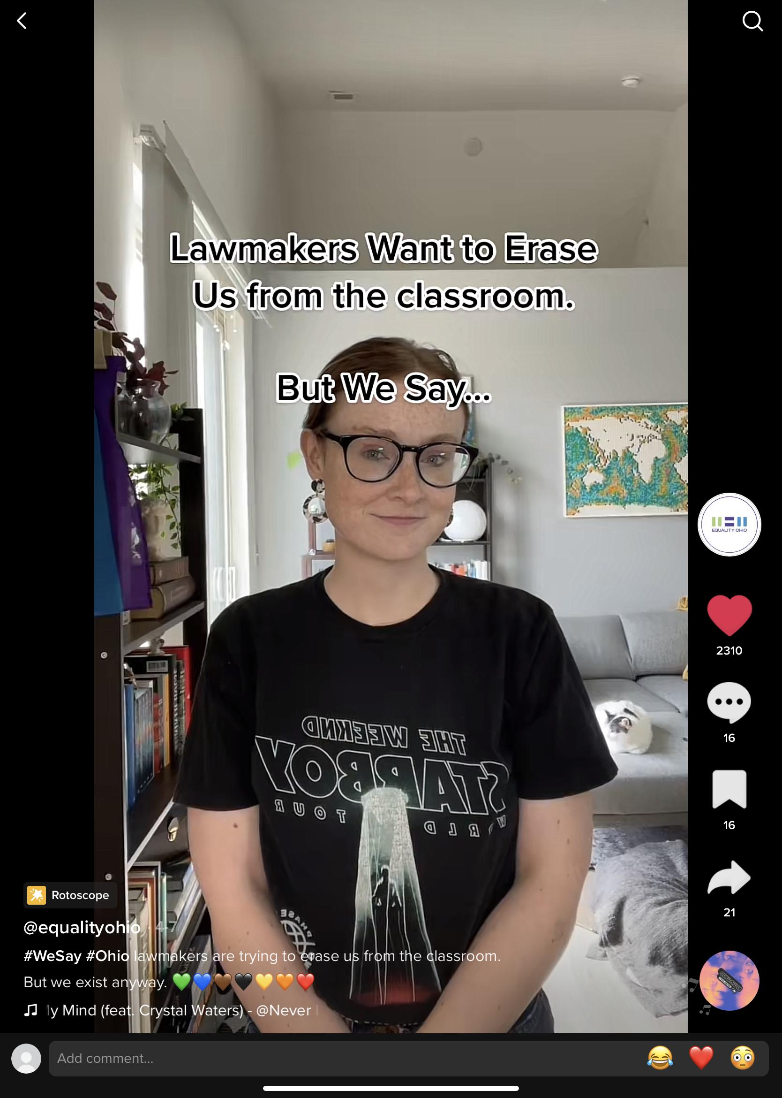
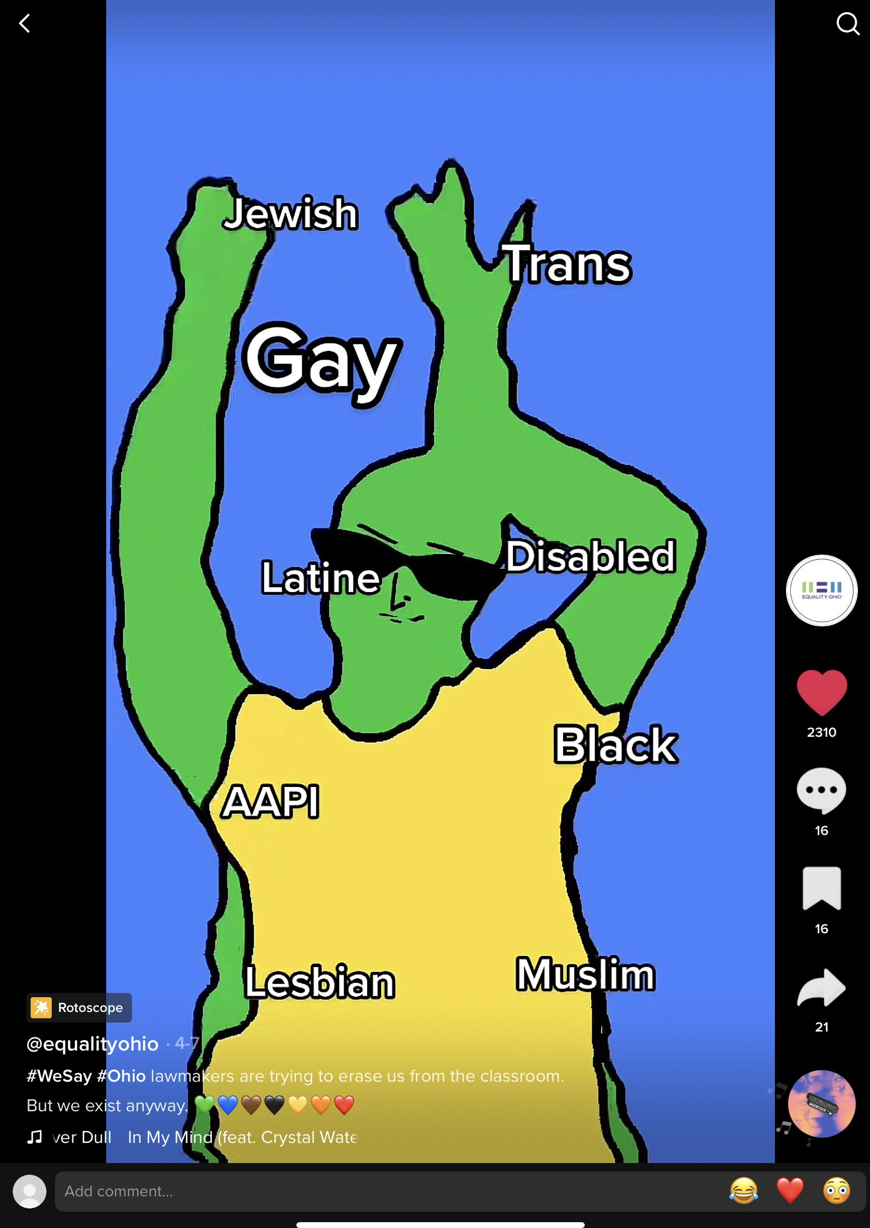
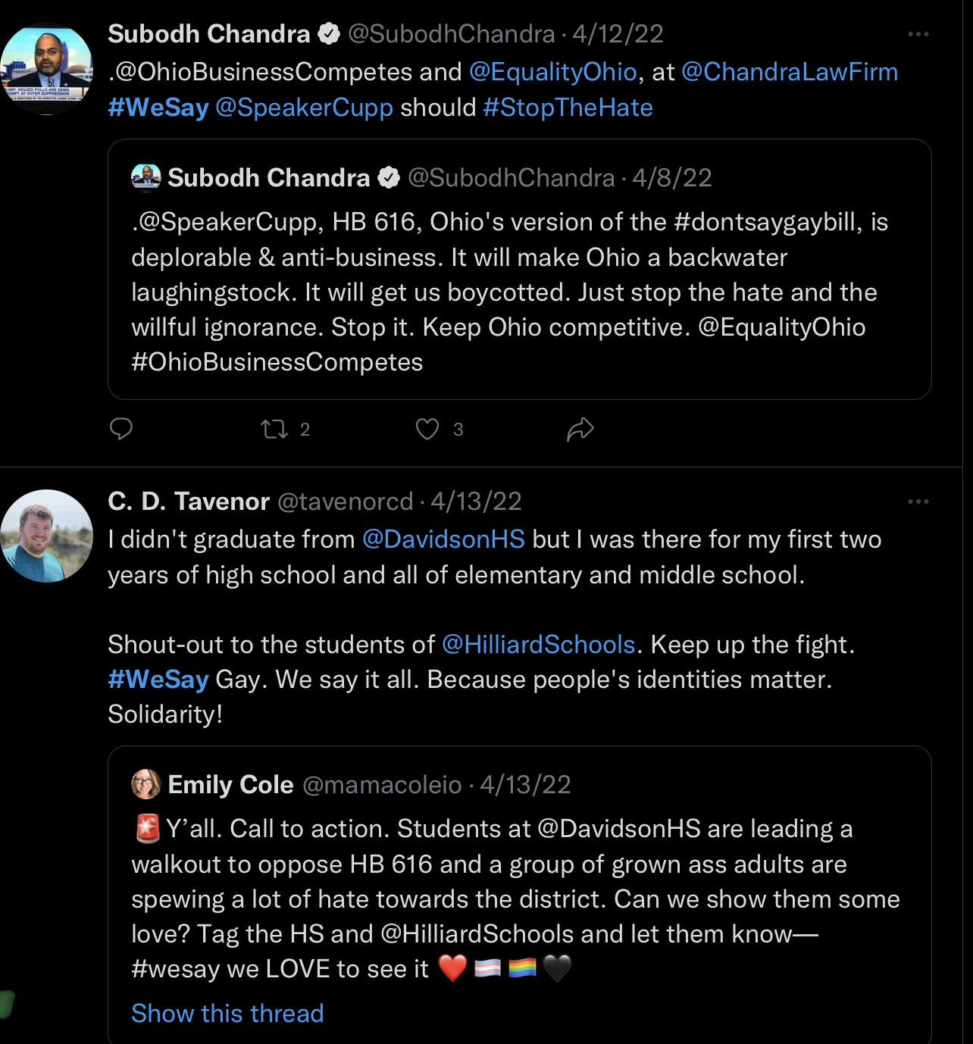
Our Campaigns To Fight Back: #We Say
Notes:
https://equalityohio.org/about-yac/ Just in case you need it
The Avalanche Method - our counter to it. Here’s what we’re going to say, here’s how loud we’re going to be about it. Make a message that is adaptable and ownable by other partners.

Slide 44
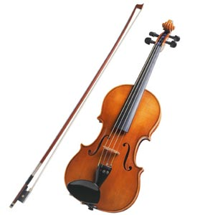
Athletic Groups (Athlete Ally, Sports Teams, OHSAA)
Why they care
Their favorite thing is now a political football
They want to follow rules and understand how to stay out of trouble and be inclusive
They care about their athletes
Considerations
How much creative and/or political freedom do they have?
Individuals have much more freedom to take a hard line than organizations do, but not always.
Sometimes our allies support us through providing critical intel and access to ears of politicians who otherwise wouldn’t listen to us
Are they a teammate or a referee in this situation?
Do they provide a neutral endorsement (e.g. OHSAA, as a regulating body, doesn’t advocate but instead provides neutral validation) or are they helping you move the conversation (e.g. Lebron says our issue matters and directs people to an advocacy action)
Types of Activities
Public statements of support for trans youth participation
Event Collaborations
Educational opportunities on how to be inclusive
Key to engaging athletic groups:
High barrier of entry is normal – can be slow to build the initial relationship or get in the door but can be reliable partners once there is mutual trust.
Keep it c3, especially when first engaging. You will learn over time who has more lateral space to take a firmer stance on specific initiatives.

Slide 45
What EO Does - #OhioCanPlay
#OhioCanPlay, Equality Ohio’s digital campaign
Campaign in support of trans youth athletes and all youth who want to play sports in the state. We’re asking supportive community leaders, organizations, and individuals to submit videos up to a minute long talking about their positive experiences with youth sports.
Running “Video Petition” available at OhioCanPlay.com
Excuse to reach out to every athletics related stakeholder to participate without a legislation-related ask.
Collaboration (Athletic groups can make something fun, which provokes youth interest!)
Presentations with Calls to Actions
Sample Slide:
How can you advocate as a coach, teammate, or Community Partner?
Engage your community
Join a coalition - in Ohio, check out Ohio Business Competes!
Spread Awareness in Your Community or on Social Media
Write an Op-ed in Your Local Paper
Celebrate Pride publicly as a Team + Making Supportive Statements
Donate to and support local organizations that serve LGBTQ+ youth
Contact lawmakers
Write to Your Lawmakers
Meet with Lawmakers
Send a Letter on Behalf of Your Team to Committee Members
Build relationships to prevent backsliding: Solid relationships with regulators and associations allow open communication and avoid having them only hearing from more nefarious voices

Slide 46
#OhioCanPlay + Sports Governing Body + Education
Ohio presently has one transgender high school female athlete, Ember, who is approved to play by the Ohio High School Athletic Association
OHSAA has supported and provided regulations for transgender athletes for nearly a decade
HB 151 is a solution in search of a problem
Direct violation Of Title IX
https://www.ohiocanplay.com/

Slide 47
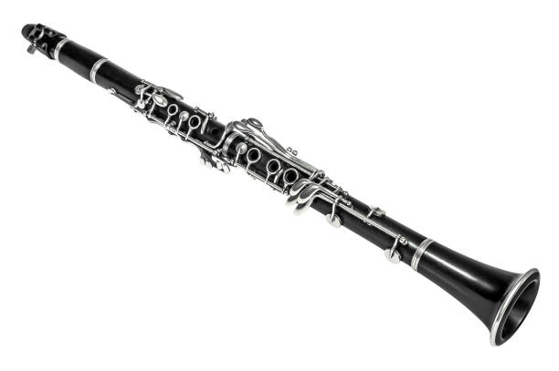
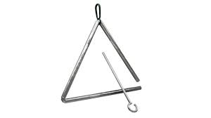
Impacted Industries
e.g. Hospitals, Doctors, Teachers, Administrators, Universities
Why they care
Financial and legal liabilities created by legislation
Threats to licensure
Government overreach into an otherwise autonomous field overseen by actual experts
Considerations
What are they a better authority than your organization on?
There is mutual benefit to misinformation being corrected, how can you elevate partners in a way that rebuts right wing lies?
Types of Activities
Panels & Other platforms to share expertise with community
Testimonies and meetings with lawmakers
Information sharing – when licensing gets implicated, they are very motivated to work with whoever will help them squash it

Slide 48
What EO Does - Impacted Industries
e.g. Hospitals, Doctors, Teachers, Administrators, Universities
Let the experts do what they do! Orchestrate when they get a solo!
Expert conversations with lawmakers
Expert testimony
Expert panel
Expert media interviews

Slide 49
Economic Engines
e.g. Businesses, Chambers of Commerce
Why they care
Hard to sell Ohio if we are made to be a joke through harmful legislation and politicking
Tourism and industry (and therefore $$) goes down when Ohio gets pegged as a hateful state
Consistent legal standards across the state are easier to comply with.
Considerations
What is their unique contribution to your political power? Relationships with lawmakers? An expertise? Moral authority in the community? $$?
How can you elevate industries and businesses in a way that disrupts the right wing narrative?
Inclusion is good for business, Small businesses wouldn’t be harmed by nondiscrimination protections, talent recruitment would be harmed by harmful bills, etc.
Types of Activities
Public Statements
Insider scoop sharing

Slide 50
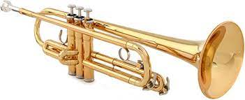
What EO Does - Economic Engines

Slide 51
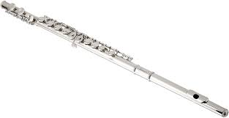
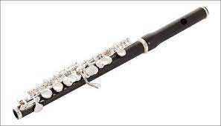
Local Governments, agencies, & Advocacy Groups
Preemption!
City councils, mayors:
Statements and resolutions for/against statehouse bills
Cincinnati ; Columbus ; Akron - Resolution Text
Local School boards
Local advocacy organizations

Slide 52
Religious Organizations and People of Faith
Moral Authority
Diversity across faith spectrums
Disrupt the right wing narrative
Ohio Faith Coalition
Example:
Faith In Public Life
HB 454 hearing, knew faith would be weaponized
Press statement from faith organizers out the same day as the hearing to neutralize their side
Neutralized the story of “Christians vs. LGBTQ+

Slide 53
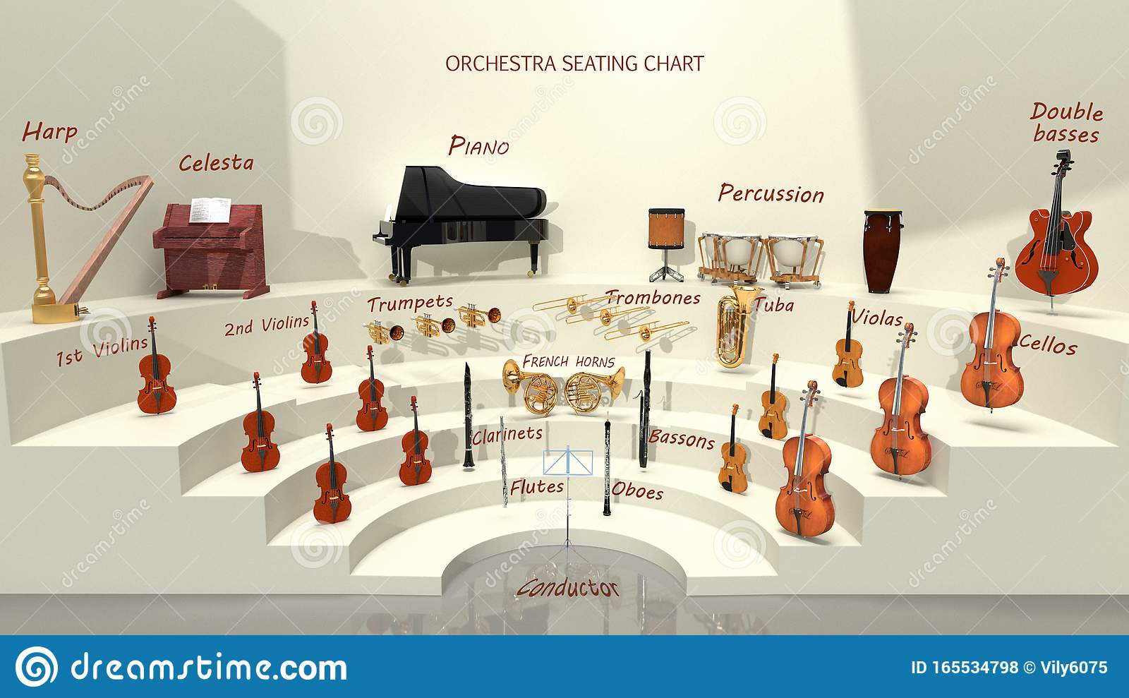
Conduct the Orchestra!

Slide 54
What EO Offers Coalition Partners
Orchestration!
Updated Information: Sign up for our email list & follow us on social media
Talking Points
Action Alerts
Rapid Response: Look to us for hearing information and next steps.
Trainings on the Leg Process, Testimony, and Advocacy (Upcoming!)
The Ohio Legislature 101
Writing Testimony Training
Meeting with A Lawmaker Training
Assistance Placing Opinion Articles or Letters to the Editor
Get one accepted? Let us know!

Slide 55
Advocacy Do’s and Don’ts
EO advice to partners & supporters
Do:
Think about your unique contribution to the movement
Have a safety plan in place
Have disciplined messaging
HB454 EO messaging guidance
HB616 EO messaging guidance
Partner organizations offer similar resources!
Don’t:
Out someone or put them in harm’s way, particularly youth (Careful about images, names, and other identifying details of young people)
Speak over minority voices

Slide 56
Questions?

