Slide 1
Relationships Matter!
Developing Faith-Based Alliances and Winning Campaigns for Health Justice
David Masur, PennEnvironment
Pastor Willie Francois, Black Church Center for Justice and Equality
September 21, 2022

Slide 2
David Masur, PennEnvironment
PennEnvironment Director since 2002
Worked with BCC on ‘22 VFHK-funded project
Philly resident since ‘96
2 kids in Philly public schools
Contact info:
DavidMasur@PennEnvironment.org
Cell: (267) 303-8292
On Twitter, FB, Insta @PennEnvironment

Slide 3
Willie Dwayne Francois III, Black Church Center
BCC President since 2019
Worked with PennEnvironment on ‘22 VFHK-funded project
Progressive Pastor
Racial Justice Activist and Educator
Author, Silencing White Noise: Six Practices to Overcome our Inaction on Race
Contact info:
wfrancois@nyts.edu
On Twitter, FB, Insta @WillieFrancois3

Slide 4
Outline
Principles of a Good Faith-Based Fit;
Tips for Developing Faith-Based Alliances
Creative Tactics Together
Group participation exercise
Q&A

Slide 5
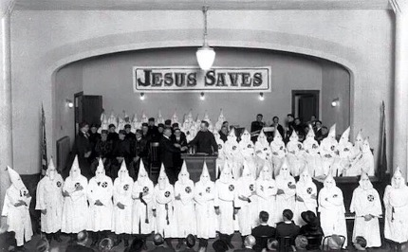
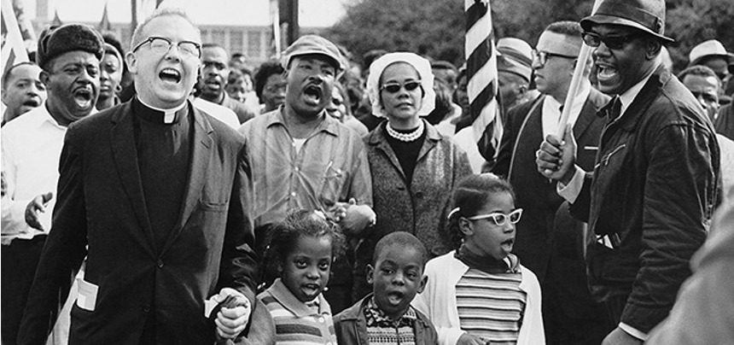
Some faith-based partnerships might not work…

Slide 6
Principles of a Good Faith-based Fit
Preferential Option for the Unprotected
Builds community with…
Advocates with…
Listens to…
Ongoing Counter-imagination
Understands the present is not permanent
Understands hard history does not have to rhyme
Understands a future without a cross reference
Sacred Intolerance to Injustice
Sees Inequity as iniquity
Practices Social justice as article of faith
Speaks truth from power to power
Demonstrated Willingness to Act
Seems eager to cut issues out of problems
Distinguishes justice and charity
Welcomes backlash

Slide 7
Tips for developing successful faith-based alliances
Takes time and energy–must be sustained over time.
Don’t do it in the heat of the moment…When you want/need something….
Be transparent. If you have an agenda, say so.
Be authentic (everyone can sniff out a B.S.’er)
Reciprocate. Meet people in the middle. Collaborate on things that may not be your top priority.
Tap existing relationships that are 1-2 degrees of separation.
Attend faith-based events in your community/sphere
Share the credit for and celebrate the win(s)

Slide 8
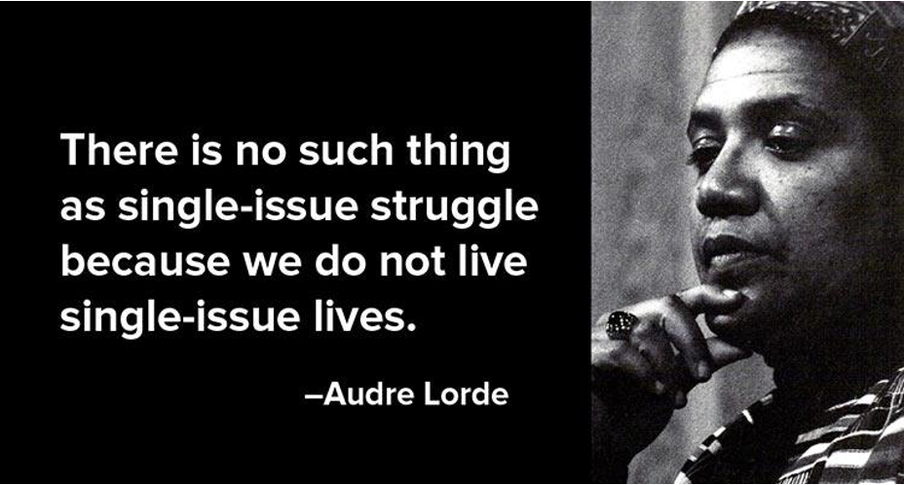
We live, work and lead at the intersections…

Slide 9
Bringing it all together–collaborating on cool tactics

Slide 10
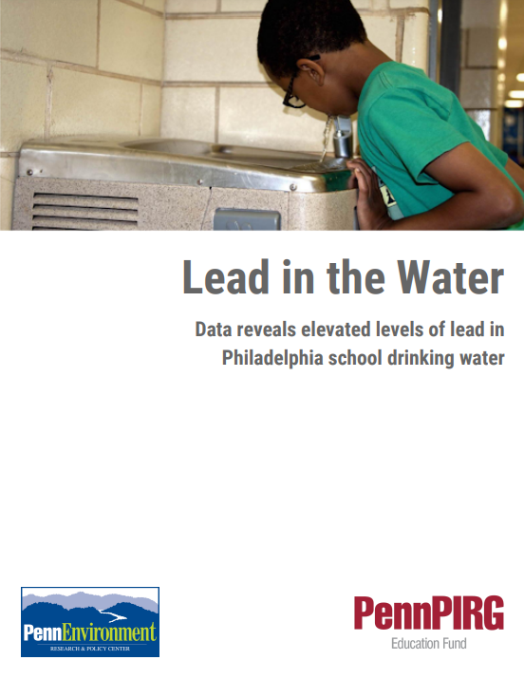
Lead in school drinking water report

Slide 11
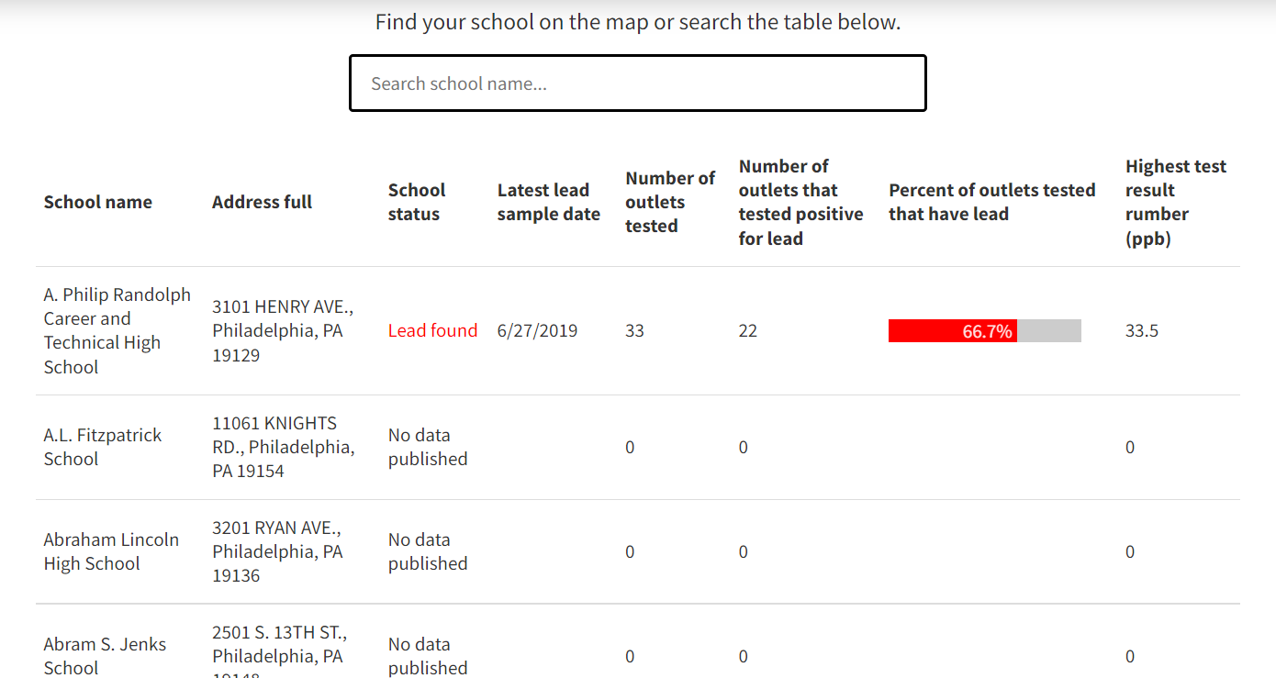
www.PennPirg.org/PhillyLeadMap.

Slide 12
Cobranded BCC/PennEnvironment factsheet

Slide 13
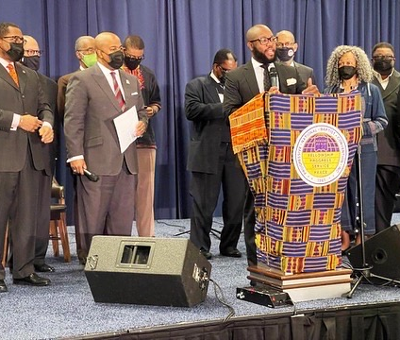
BCC drafts PNBC into ongoing national and state advocacy

Slide 14
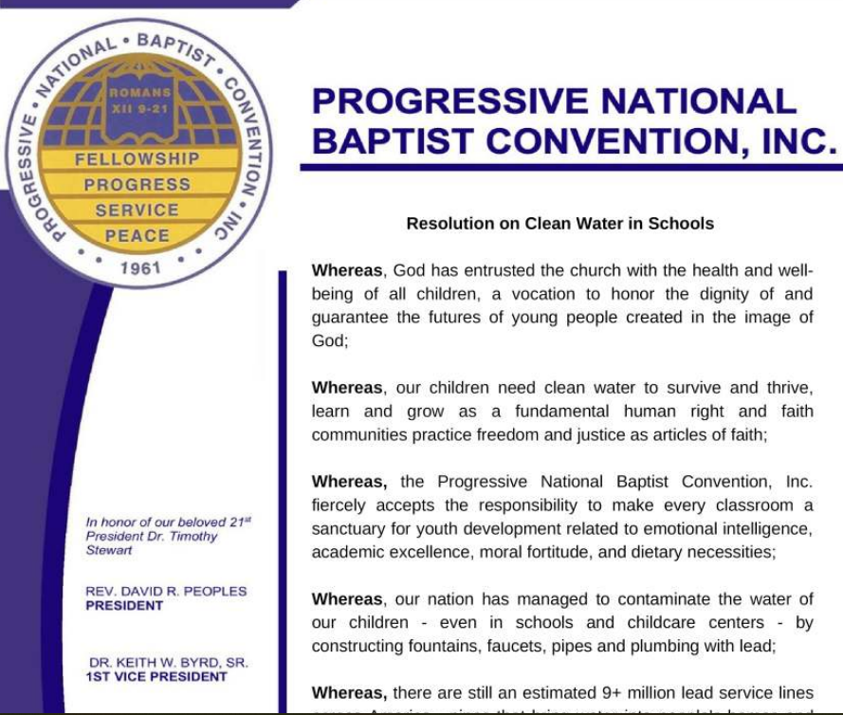
BCC convinces PNBC to pass national resolution

Slide 15
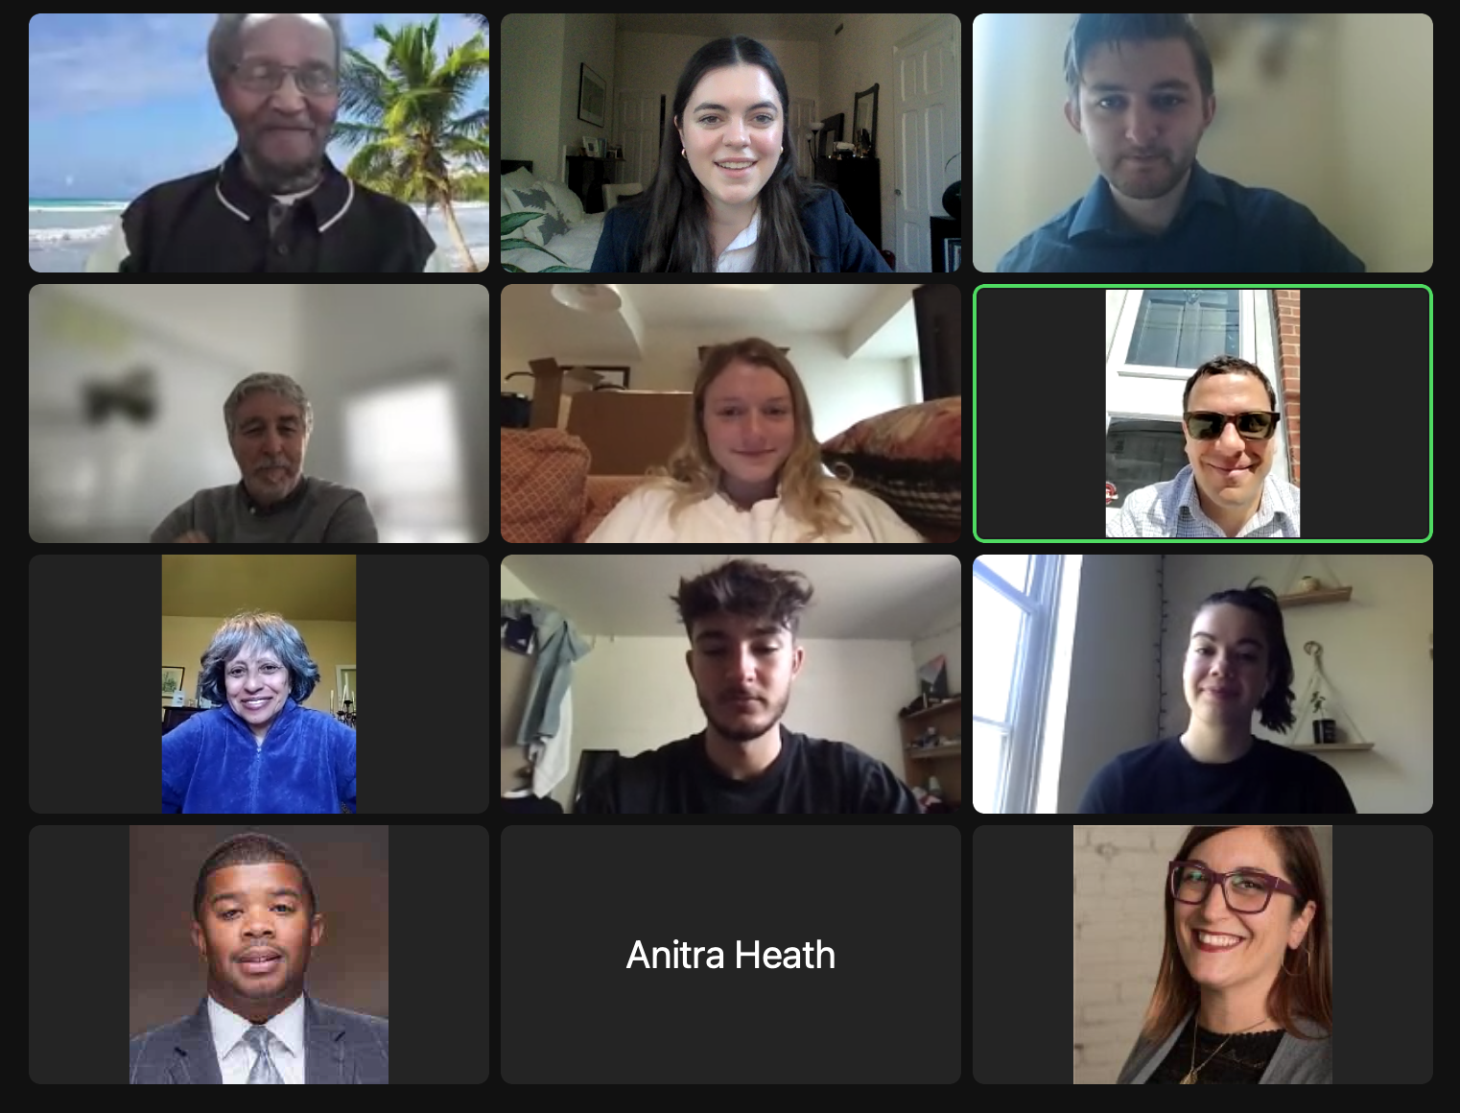
Citizen Lobby Day w/Philly City Council

Slide 16
Short Exercise–Creative Tactics Brainstorm
Give an example of 1-2 creative tactics you’ve seen the faith community or other groups use to amplify their campaign’s goals?
Give an example of a creative tactic you’ve done in one of your campaigns to spark ideas for other groups
If you weren’t constrained by money, time, etc: come up with 1-2 creative/non-traditional tactic you’d like to implement on one of your current campaigns.

Slide 17
Q & A

