Slide 1
motheringJUSTICE
ABOUT OUR MOVEMENT

Slide 2
Danielle Atkinson (She/Hers)
National Founding Director

Slide 3
Eboni Taylor (She/Hers)
Michigan Executive Director

Slide 4
About Mothering Justice
Mothering Justice is a grassroots policy advocacy organization that provides mothers of color with the resources and tools to use their power to make equitable changes in policy. We are dedicated to improving the quality of life for families by empowering mothers of color to take action with American policy on behalf of themselves and their families.
We envision a world where Mamas of color will be a dominant voice in policy-making and politics in the USA by changing the conversation around what really matters in the U.S.A. Mamas of color will lead.
To Learn More, visit
Motheringjustice.org/about

Slide 5
WHAT IS MOTHERING JUSTICE'S & ACTION FUND'S PURPOSE OF EXISTENCE?
OUR THEORY OF CHANGE
THE WAY WE GET TO A SOCIETY THAT REFLECTS THE VALUES AND NEEDS OF MOTHERS OF COLOR IS BY CENTERING THE EXPERIENCES OF THE MOST AFFECTED INDIVIDUALS AS THE CATALYST FOR CHANGE. MOTHERS’ OF COLOR EXPERIENCES HAVE TO BE AT THE CENTER OF POLICY, ORGANIZING AND COMMUNICATION.
OUR VISION
MOTHERS OF COLOR WILL BE A DOMINANT VOICE IN POLICY-MAKING AND CHANGE THE CONVERSATION AROUND WHAT REALLY MATTERS IN AMERICA AND LEAD AN INDEPENDENT POLITICAL SYSTEM THAT GIVES DECISION-MAKING POWER TO FAMILIES OF COLOR.
OUR MISSION
TO EMPOWER MOTHERS OF COLOR TO INFLUENCE POLICY ON BEHALF OF THEMSELVES AND THEIR FAMILIES.

Slide 6
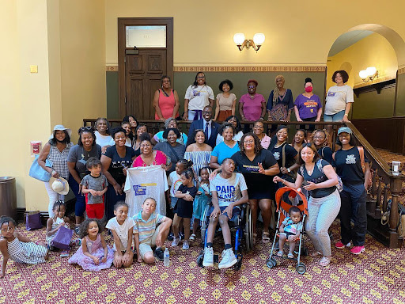
Our Membership Base | Mothers of Color In America
How Do We Define Mothers of Color in America?
By Race/Ethnicities:
Black/AA
Indigenous (Native American)
Latina/e American
Asian American and Pacific Islander
Arabic American
By Status of Motherhood:
New Moms
1 child aged 8 or younger
Veteran Moms
1 or more children aged 9 or older
Informal Care Providers (i.e. othermother?)
Not a mom, but a woman of color who provides care for children

Slide 7
WHAT IS MOTHERING JUSTICE'S & ACTION FUND'S PURPOSE OF EXISTENCE?
WE DO THIS WORK BY CENTERING, VALUING, AND DEVELOPING AGENDA ITEMS BASED ON THE LIVED EXPERIENCE OF OUR MEMBERS. CONSTANTLY CHALLENGING OURSELVES TO CONFRONT ANTI-POC POLICIES IN OUR OWN WORK ENVIRONMENT AND PRACTICING OUR VISION AND VALUES AMONGST OURSELVES AND OUR MEMBERS.

Slide 8
Mothering Justice's Mamas' Agenda
Maternal Health and Reproductive Justice
Black Maternal Health + Abortion Rights + Women's Health
Affordable and Quality Child Care
Funding for the MI + Provider Pay
Paid sick days and paid leave
Maternity Leave + MI Paid Sicks Days Law
Basic Needs
Guaranteed Income + Housing + Utilities Access

Slide 9
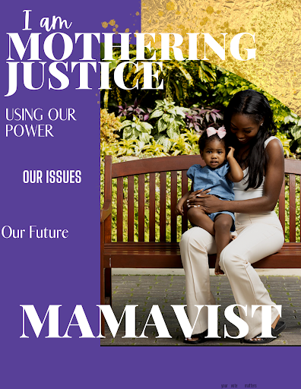
What does it mean to center women of color in a policy agenda?

Slide 10
Arrival to our Mamas' Agenda
Digital Purple Cards
One-on-Ones
Mama Conversations
Fellowships + Events + Data

Slide 11
One-on-Ones
This is an informal conversation where an organizer and a mama meet. The goal is to introduce the mama to Mothering Justice and gain an understanding of who she is, her desired level of political participation or community work, and where we can offer an opportunity for her growth and development as an advocate.
In a 1 on 1, the organizer learns what the member is passionate about and asks if they are interested in hosting a mamas conversation with their own family/friends.

Slide 12
Mama Conversations
A mamas conversation is a potluck style gathering hosted by a mama member in their home (or place of their choosing). They invite 5-10 of their family/friends, coworkers, or community members who are connected by a common passion or issue. They discuss how the issue affects them and possible solutions.
These recurring issues that come up in these conversations is how Mothering Justice curates our Mamas Agenda.

Slide 13
Our Fellowships
Our programs are designed to empower, engage, and organize mothers of color to build power around policies that brings justice to mothers of color in America.
Movement
A 3-month virtual leadership development program designed to identify, engage, and activate a new generation of grassroots organizers and leaders to run and win issue and electoral campaigns. This program will recruit diverse leaders from across the region to organize around the Mama’s Agenda.
Mamas' University
A 3-month virtual leadership development program that offers a holistic approach to identifying, inspiring, and mobilizing a new generation of moms of color to run for elected office at the local level (i.e. school board) around the country. The program will be grounded in self-care, relationship building, and building political power. Addressing relationship issues, including their relationships with themselves, family, and most importantly, their relationships with power will be at the core of our curriculum.
BWW and Amy
Black Womxn Win Michigan is a 4-month leadership development program that aims to identify, develop, and invest in a pipeline of 30 diverse, Black womxn candidates to run for state legislative seats and to work on campaigns in key targeted areas in Michigan.
Advancing Michigan’s Youth (AMY) is a 6-week virtual leadership development program designed to identify, engage, and mobilize pregnant and parenting young moms of color (ages 16-24) to learn about the intersectionality of policy and advocacy, understanding self-interest, building power, and organizing around the Mama’s
Agenda.
White Womxn's School
A 6-week virtual leadership development program designed to agitate, hold accountable, and activate progressive white womxn to be better allies and accomplices for womxn of color, especially Black womxn. Participants will learn how to identify and unpack their privilege, how to dismantle white supremacy, and take action on the Mama’s Agenda in their communities.

Slide 14
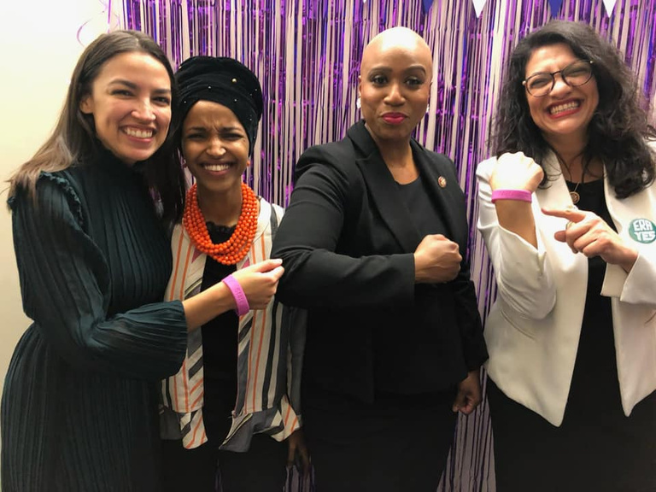
Our Events
State of the Mama
Surrounding the State of the Union, State of the State and now the State of the City (of Detroit).
Black Maternal Health Week
Founded by Black Mamas' Matter Alliance (MJ is a kindred partner) in 2018. A week (April 11 –17) of events centering pregnancy and birthing in the Black community.
Mamas' March
MJ's key lobbying event. Since it's inception, it's been held in Lansing, MI, but in 2019 and 2022 a national version was also held in Washington, D.C.
Mamas' Summit
A day of sessions and keynotes focused on Mamas' Agenda-related issues.

Slide 15
COLLECTIVE THINKING
Understanding that, historically, white supremacy & patriarchy can keep us from confronting--and often even RECOGNIZING--a culture of
anti-blackness in most work spaces. (Professionalism is often the guise of white supremacy, so we can't recognize the anti-blackness hidden in that messaging.)
Let’s break into groups to discuss how we can all be better at minimizing anti-poc culture with our organizations.

Slide 16
1. What ways does your organization center and value the life experiences of the community you serve?
2. Where are you challenging and comforting anti-poc practices in your work environment?
3. In what manner does your organization encourage free speech?
4. How does your organization define professionalism?
5. Is the input of poc staff being incorporated in decision making ?
6. What is your path to greatness ?
7. What is your end goal and how do you get there while maintaining your values ?

Slide 17
THANK YOU
motheringjustice.org

