Slide 1
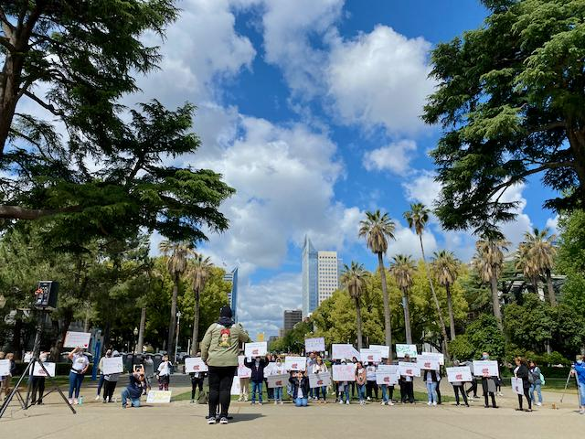
Advocating for a Healthy & Racially Just California

Slide 2
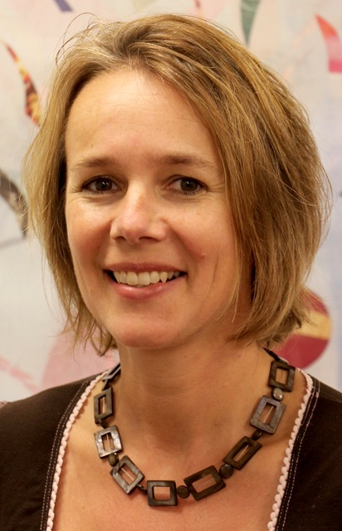
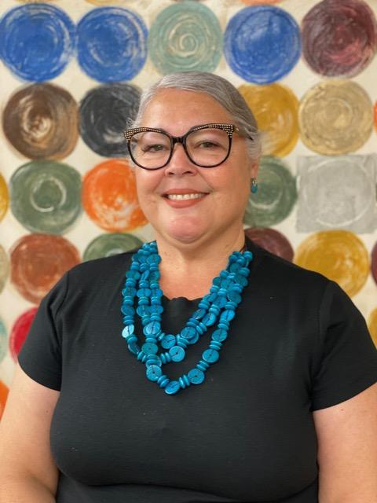
Successful Campaign Strategies
for the Health Equity & Racial Justice Fund (HERJF)
Genoveva Islas, Executive Director Cultiva Salud Fresno, CA
Doris Meier,
Program Manager
Roots of Change
Oakland, CA
Notes:
We are going to share with you some of our achievements and challenges from the Health Equity and Racial Justice Fund campaign which started two years ago and kicked into high gear this year with the help of grassroots organizations
Probably no time for this… Intro of organizations? Roots of change is a program of the public health institute, basically is a think and do tank working to make sure every aspect of the food supply in CA is climate smart, healthy, sustainable, equitable, fair to workers and profitable for companies. We are involved in food system related policy and advocacy work and general projects advancing those topics. working with farmers, ranchers, processors, grassroots organizations, universities and government
Cultiva La Salud?

Slide 3
Content
Health Equity & Racial Justice Fund
Background & Campaign Goals
Engagement & Communication Strategies
Rallies and Media Coverage
Campaign Results, Challenges, Lessons Learned
Q&A
Notes:
background, campaign goals & efforts, co-sponsors, grassroots partners

Slide 4
HE&RJ Fund: 12 Co-Sponsors
Asian Pacific Partners for Empowerment,
Advocacy and Leadership (APPEAL)
Black Women for Wellness Action Project
California Black Health Network
California Black Women's Health Project
California Latinas for Reproductive Justice
California Pan-Ethnic Health Network
Latino Coalition for a Healthy California
Public Health Advocates
Public Health Institute
Roots Community Health Center
Roots of Change
Fund is also supported by
9 legislators
Over 200 organizations (NGOs, CBOs & community clinics)
Notes:
Almost all Bipoc led organizations, support of 9 legislators, 200 organizations

Slide 5
HE&RJ Fund: Background
What is is?
Budget request for $100 million annually to fund
community-based organizations, clinics and tribal
organizations.
Innovative fund to provide resources directly to
CBOs instead of government institutions
Notes:
This is an innovative fund. Typically funds go to government institution, e.g. departments of public health,

Slide 6
HE&RJ Fund: Background
Why do we need it?
COVID-19 demonstrate more help is needed
Latinx, Black, Native Hawaiian, Pacific Islander, Asian American, American Indian, LGBTQ+ and low-income communities: higher risk of contracting/dying from COVID, higher rates of job and income loss, food and housing insecurity.
Notes:
VEVA - speak to this slide

Slide 7
HE&RJ Fund: Background
What will it accomplish?
reduce health and social inequities
transform community conditions and institutional government systems to promote racial justice
Notes:
VEVA - speak to this slide

Slide 8
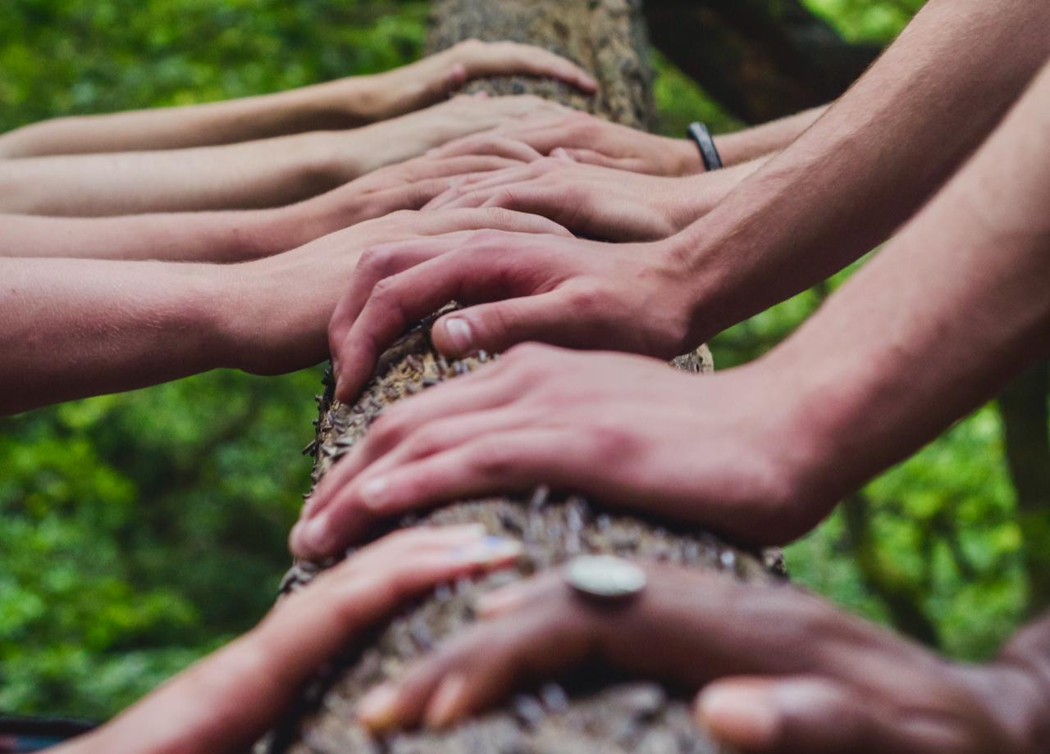
HE&RJ Fund: Campaign Goal
Get the State of California
to create the Health Equity &
Racial Justice Fund of
$100 million annually
Campaign is in its 2nd year; did not
get included in budget in 2021.
This year’s campaign: create a buzz!
(Photo credit: Shane Rounce, Unsplash)

Slide 9
Engagement Strategy
Get the public involved
Hire grassroots organizations with a focus on health and racial justice
activate their communities to participate in in-person events
help organize rallies for visibility, education, photo opps, media coverage
Help run social media campaigns
Ask Speaker of the CA Assembly for a public demonstration of support
Engage Lobbyists
Pay for advertising, run an op-ed
Notes:
DORIS
In the first year a social media campaign and lobbyist trying to put pressure on some legislators. Show grassroots support, create pressure by having the governor and legislators hear directly from the people who are mostly affected by health and racial inequities..Getting grassroots organization involved was THE crucial link for us to run a successful campaign…With their help we decided to stage rallies in several cities across the state that served as an educational platform and photo opportunity for our social media campaigns.
engaged lobbyists to work the halls of the capital, asking leaders of the legislature and the governor directly for support and we took out an ad in the Sacramento Bee.
https://www.eastcountymagazine.org/advancing-healthy-communities-california-health-equity-and-racial-justice-fund-will-help-underserved

Slide 10
HE&RJ Fund: ROC’s Grassroots Partners
Cultiva La Salud, Fresno
United Parents and Students, LA
Seeds of Hope, LA
Notes:
Roots of Change has a vast network of allies through our food system related work. We reached out to a bunch of grassroots organzations and eventually hired these 3. backbone of the entire campaign, organizing and executing the rallies. They engaged and activating their base to show up at rallies. without them we could have not done this. So much gratitude and kudos to them.

Slide 11
Communication Strategies
Create
message
platform
herjfund.org
Notes:
includes all info on fund, background, FAQ, social media tool kit, press coverage and easy ways to take action (send emails, make a call to a legislator, etc.)

Slide 12
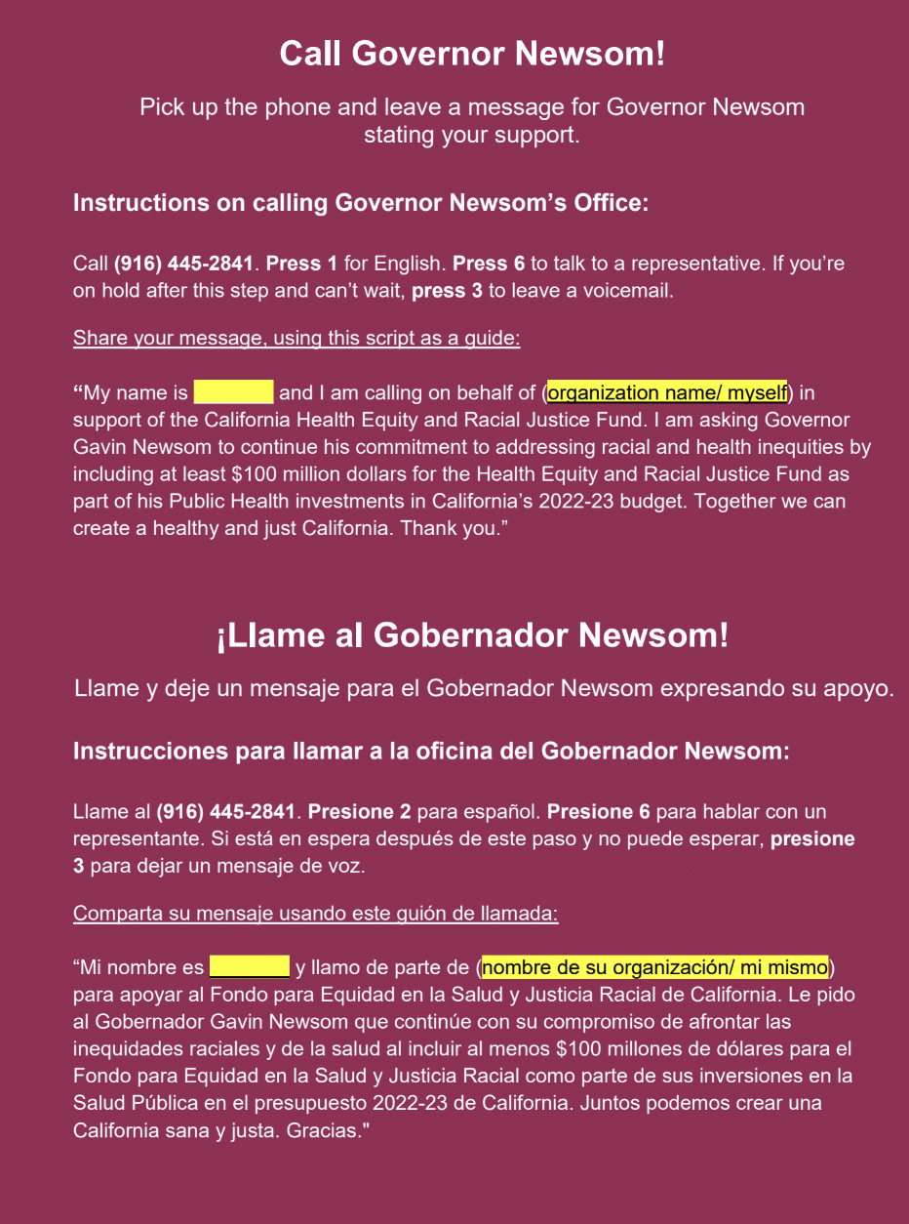
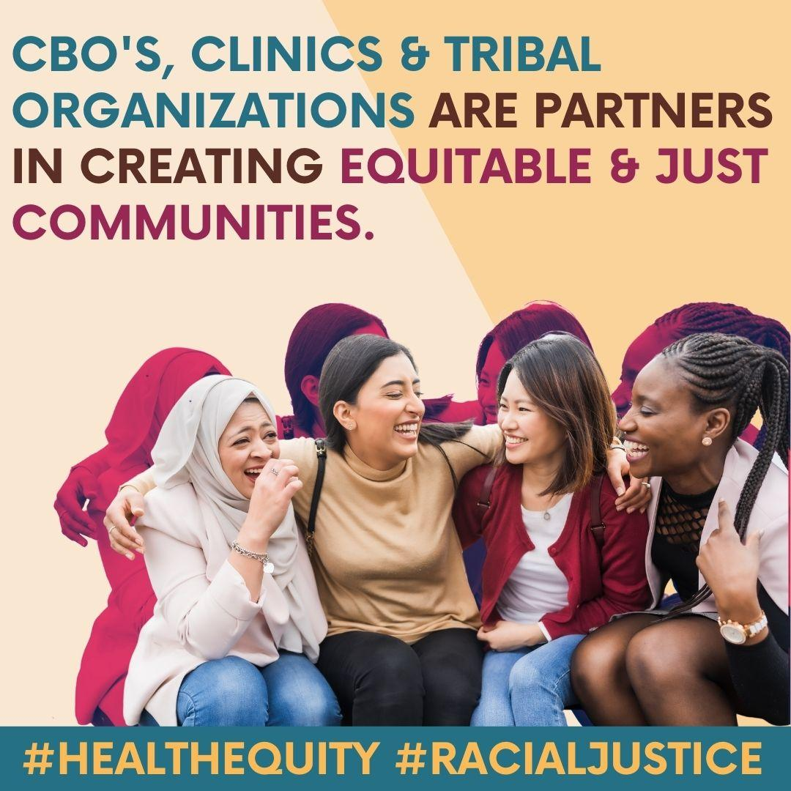
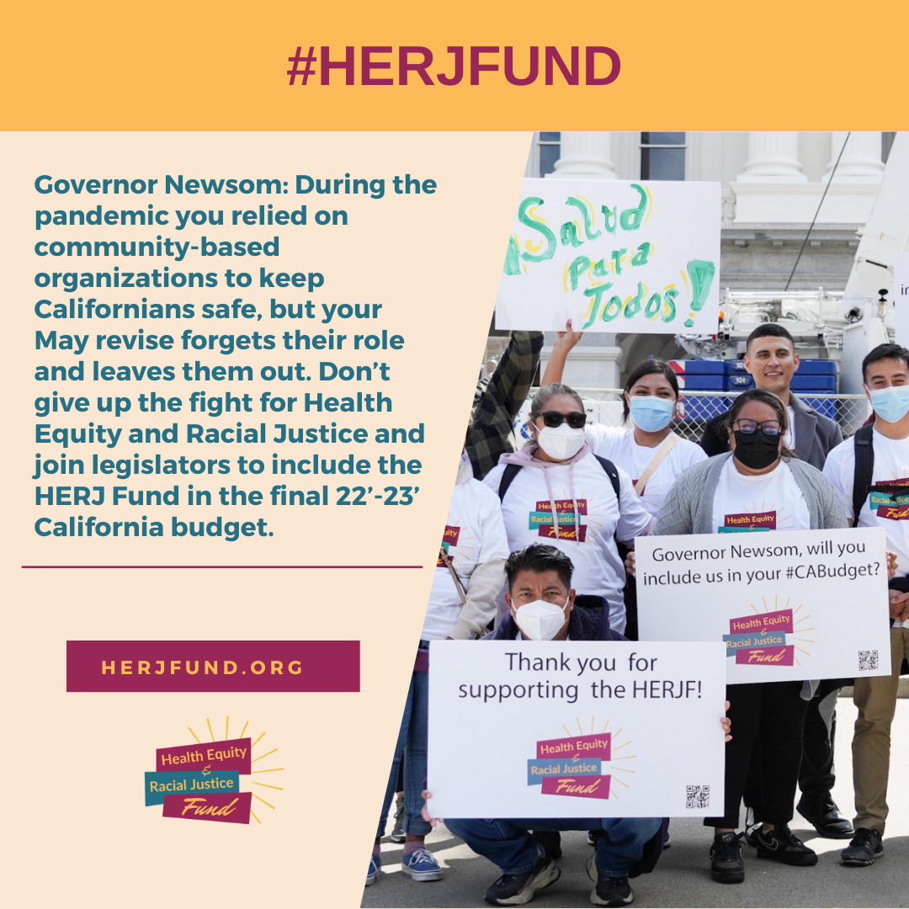
Invite advocates to take action!
Provide Social Media Toolkit in English AND Spanish
Invite advocates to write emails, make calls, spread the word on social media
Notes:
Getting folks to take action was basically the center piece of our efforts =

Slide 13
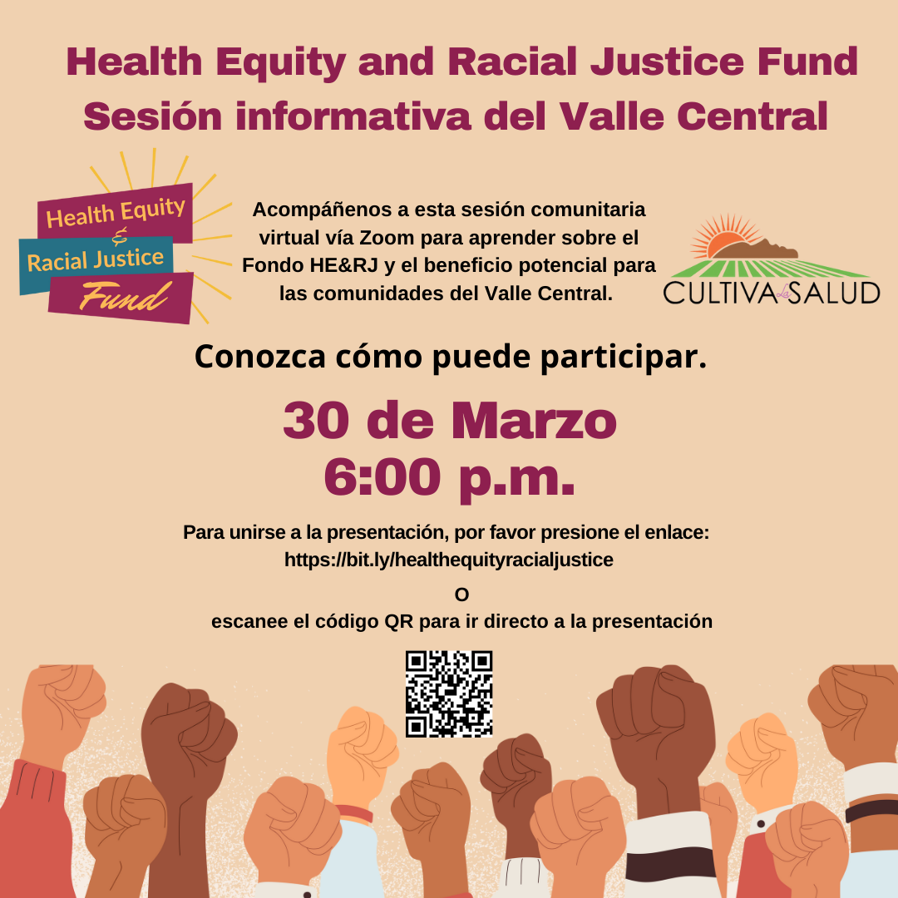
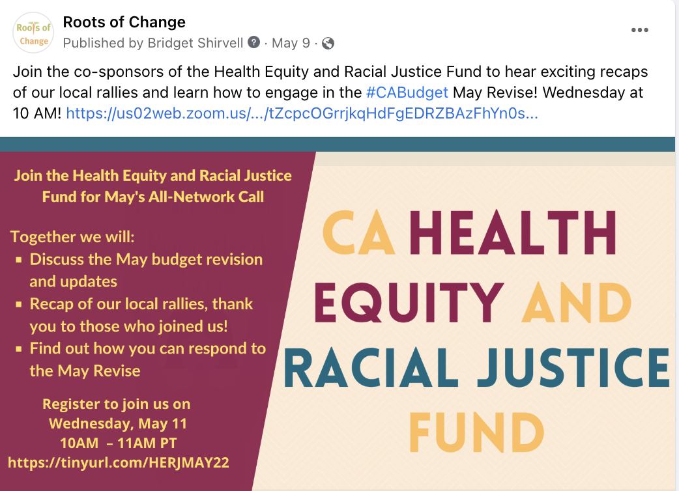
Conduct weekly meetings with co-sponsors re approach and communication strategies
Monthly All Network Calls for Updates
Offer onboarding events for grassroots partner organizations
Offer information events to educate public on HERJF’s purpose and goals
Notes:
Campaign efforts started in the fall of 2020. Tremendous amount of communication, mainly organized by one of the co-sponsors. weekly meeting w cosponsors, monthly meetings w everyone involved.

Slide 14
Half page ad in Sacramento Bee
Notes:
Addressed directly to Gov Newsom… quoting Gov Newsom

Slide 15
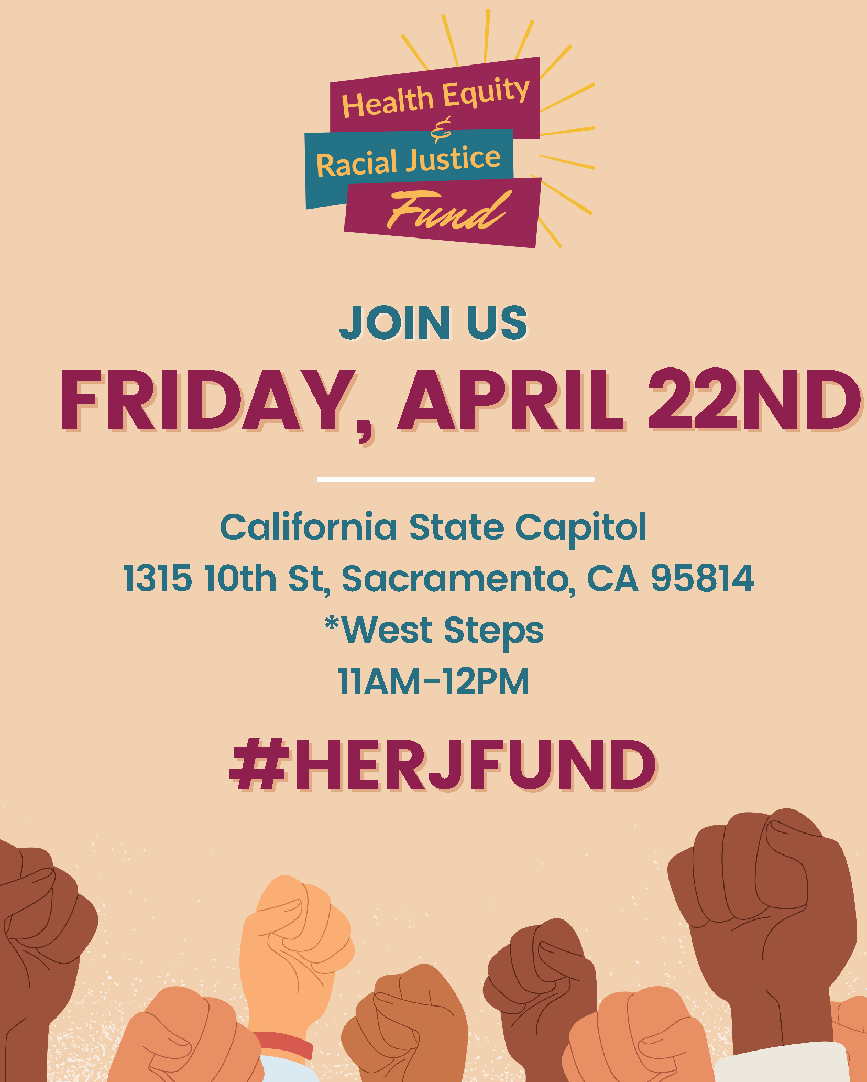
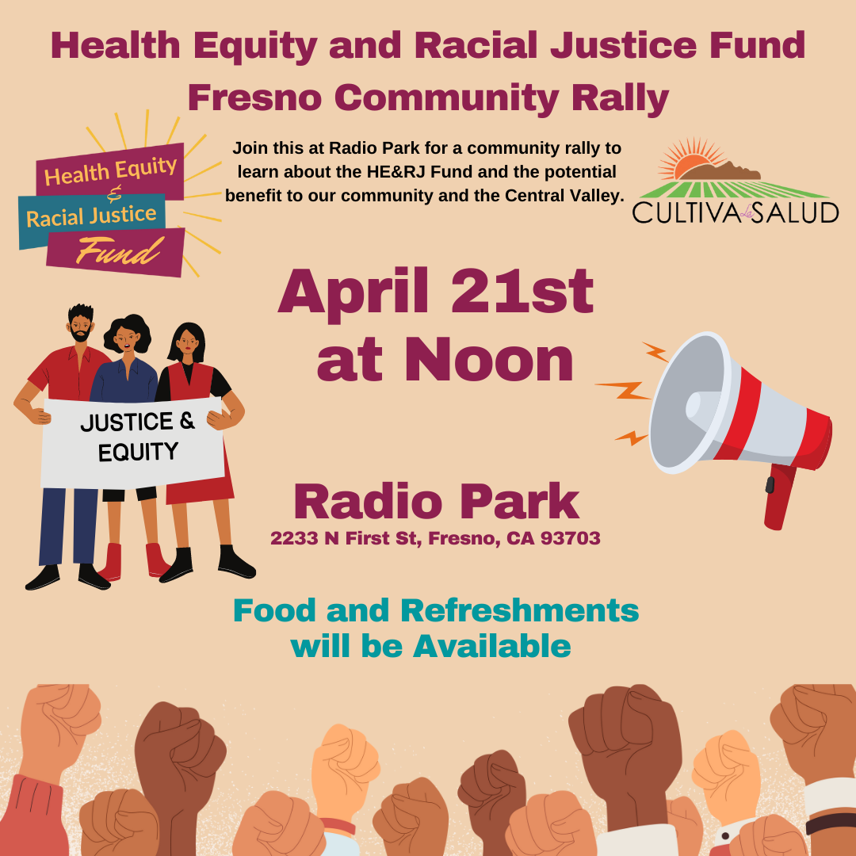
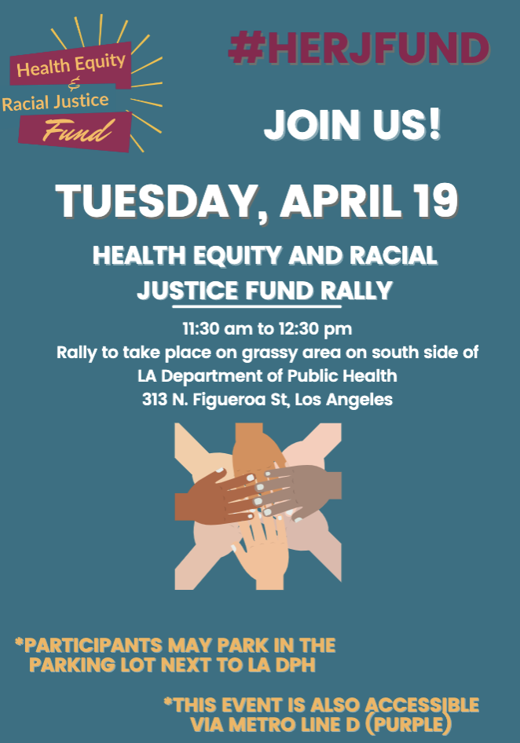
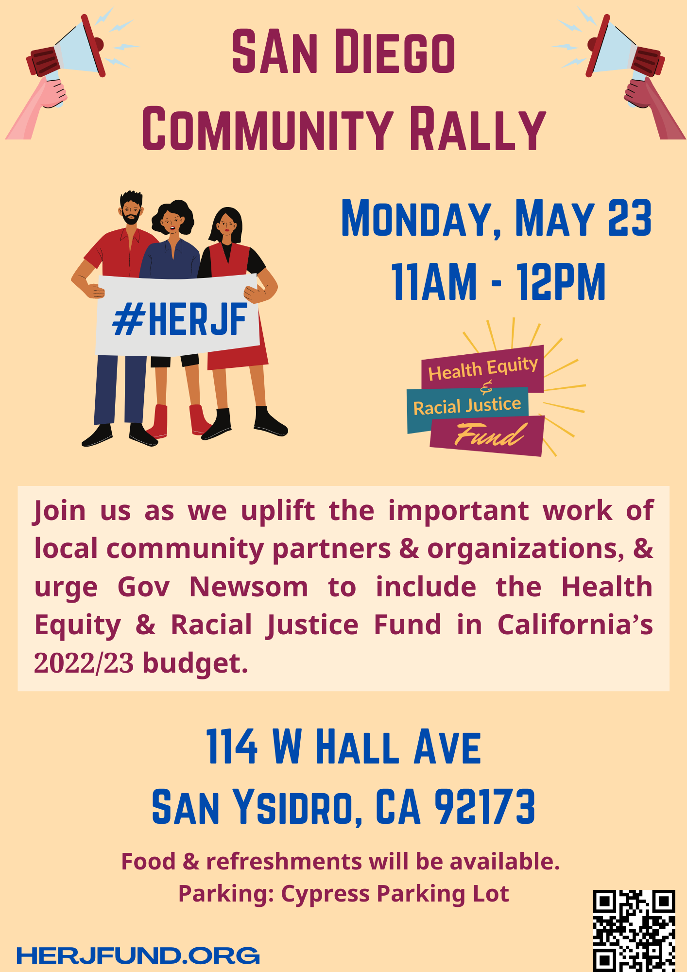
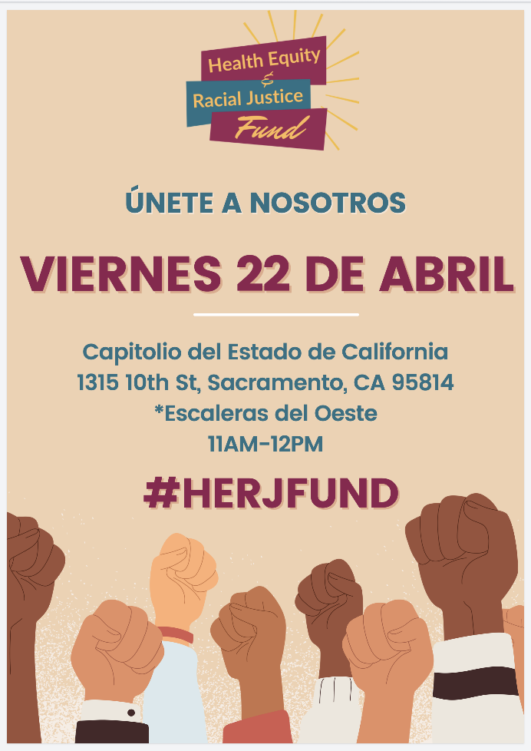
Rallies Across California
Notes:
The initial idea was to have one rally each day in April for full week in different cities starting w SD, LA, Fresno, SF/Oakland, ending in Sacramento. The timing was intentional and was coinciding with the MAY budget revise. And then flood social media for a whole week Ended up only being able to pull off 3 rallies before the budget revise and one last one after.

Slide 16
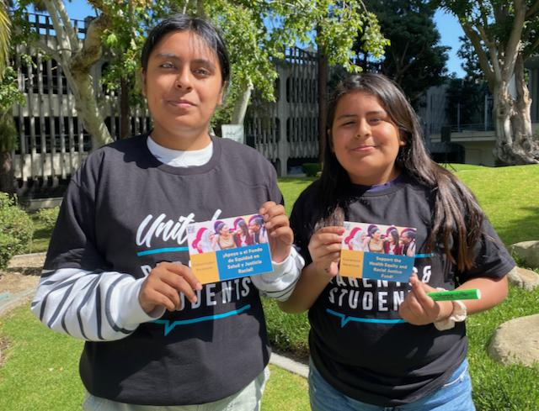
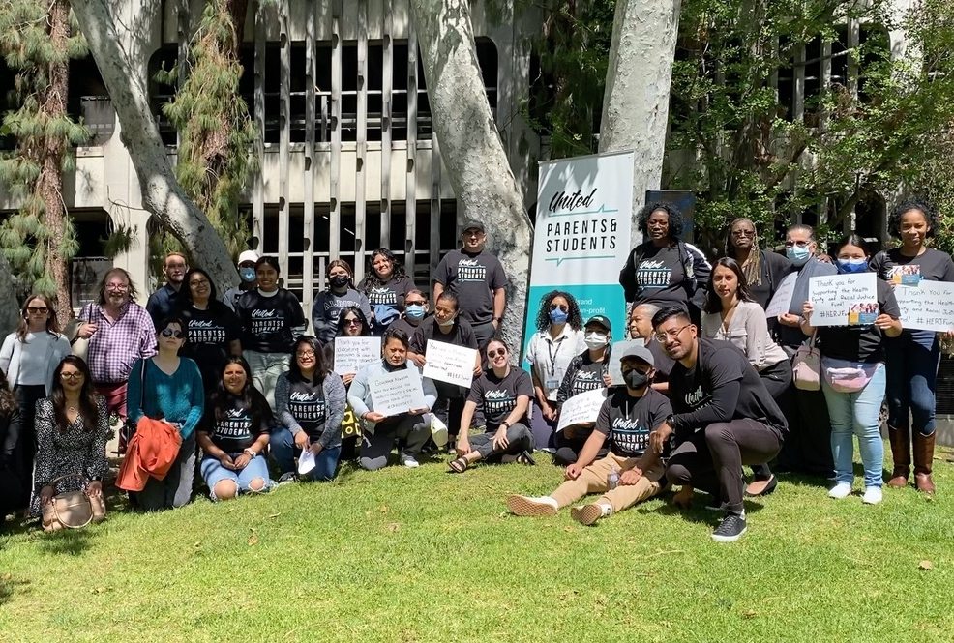
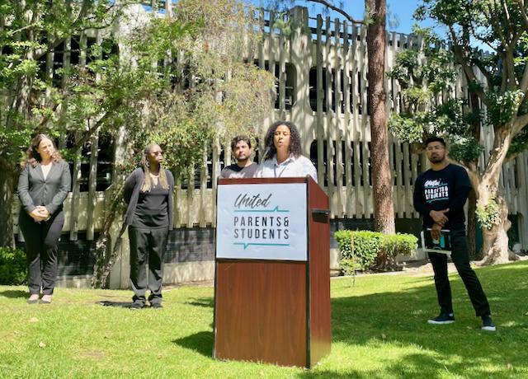
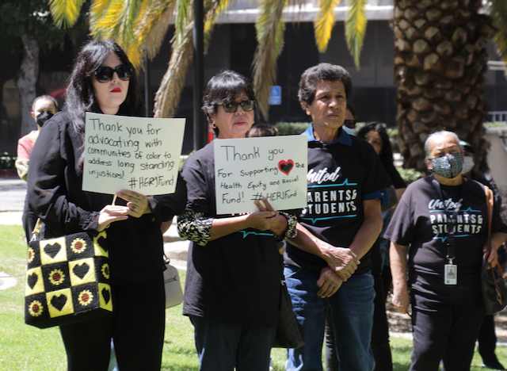
LA Rally - April 19, 2022
Organized by United Parents & Students, LA
Notes:
the first rally took place in LA on April 19. Pretty good turn out of about 60 folks.

Slide 17
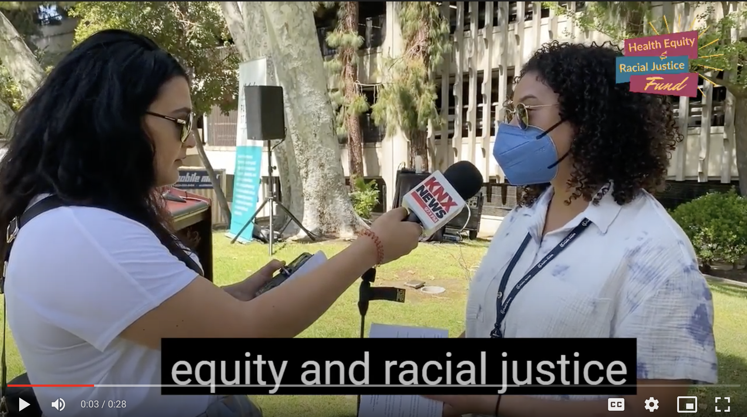
LA Rally, Media Coverage
Interview with
Megan McClaire,
Chief Deputy Director,
LA County Department
of Health
Press coverage:
KNX radio station
Notes:
Interview with Megan is significant because she is part of the government system that typically gets these funds but she is advocating for the funds to go directly to cbo, clinics and tribal organizations

Slide 18
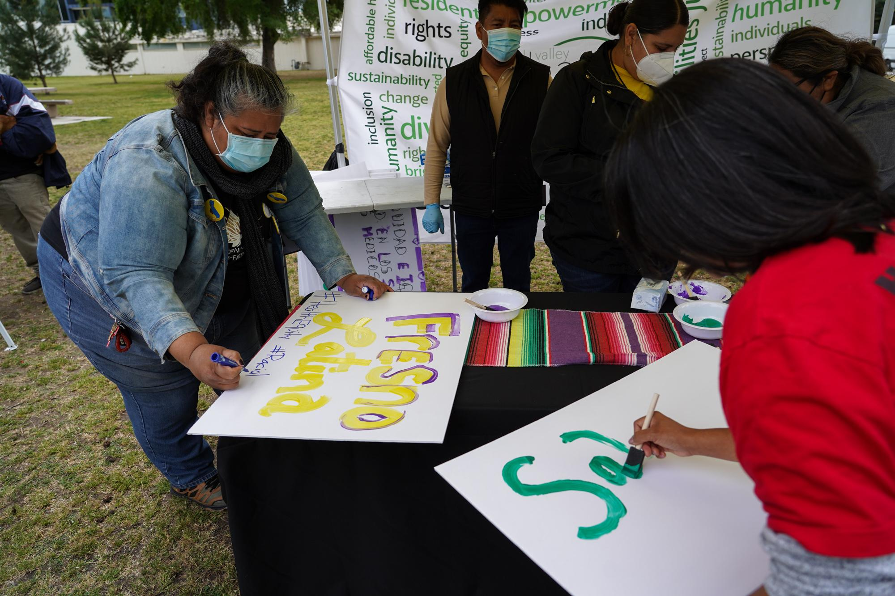
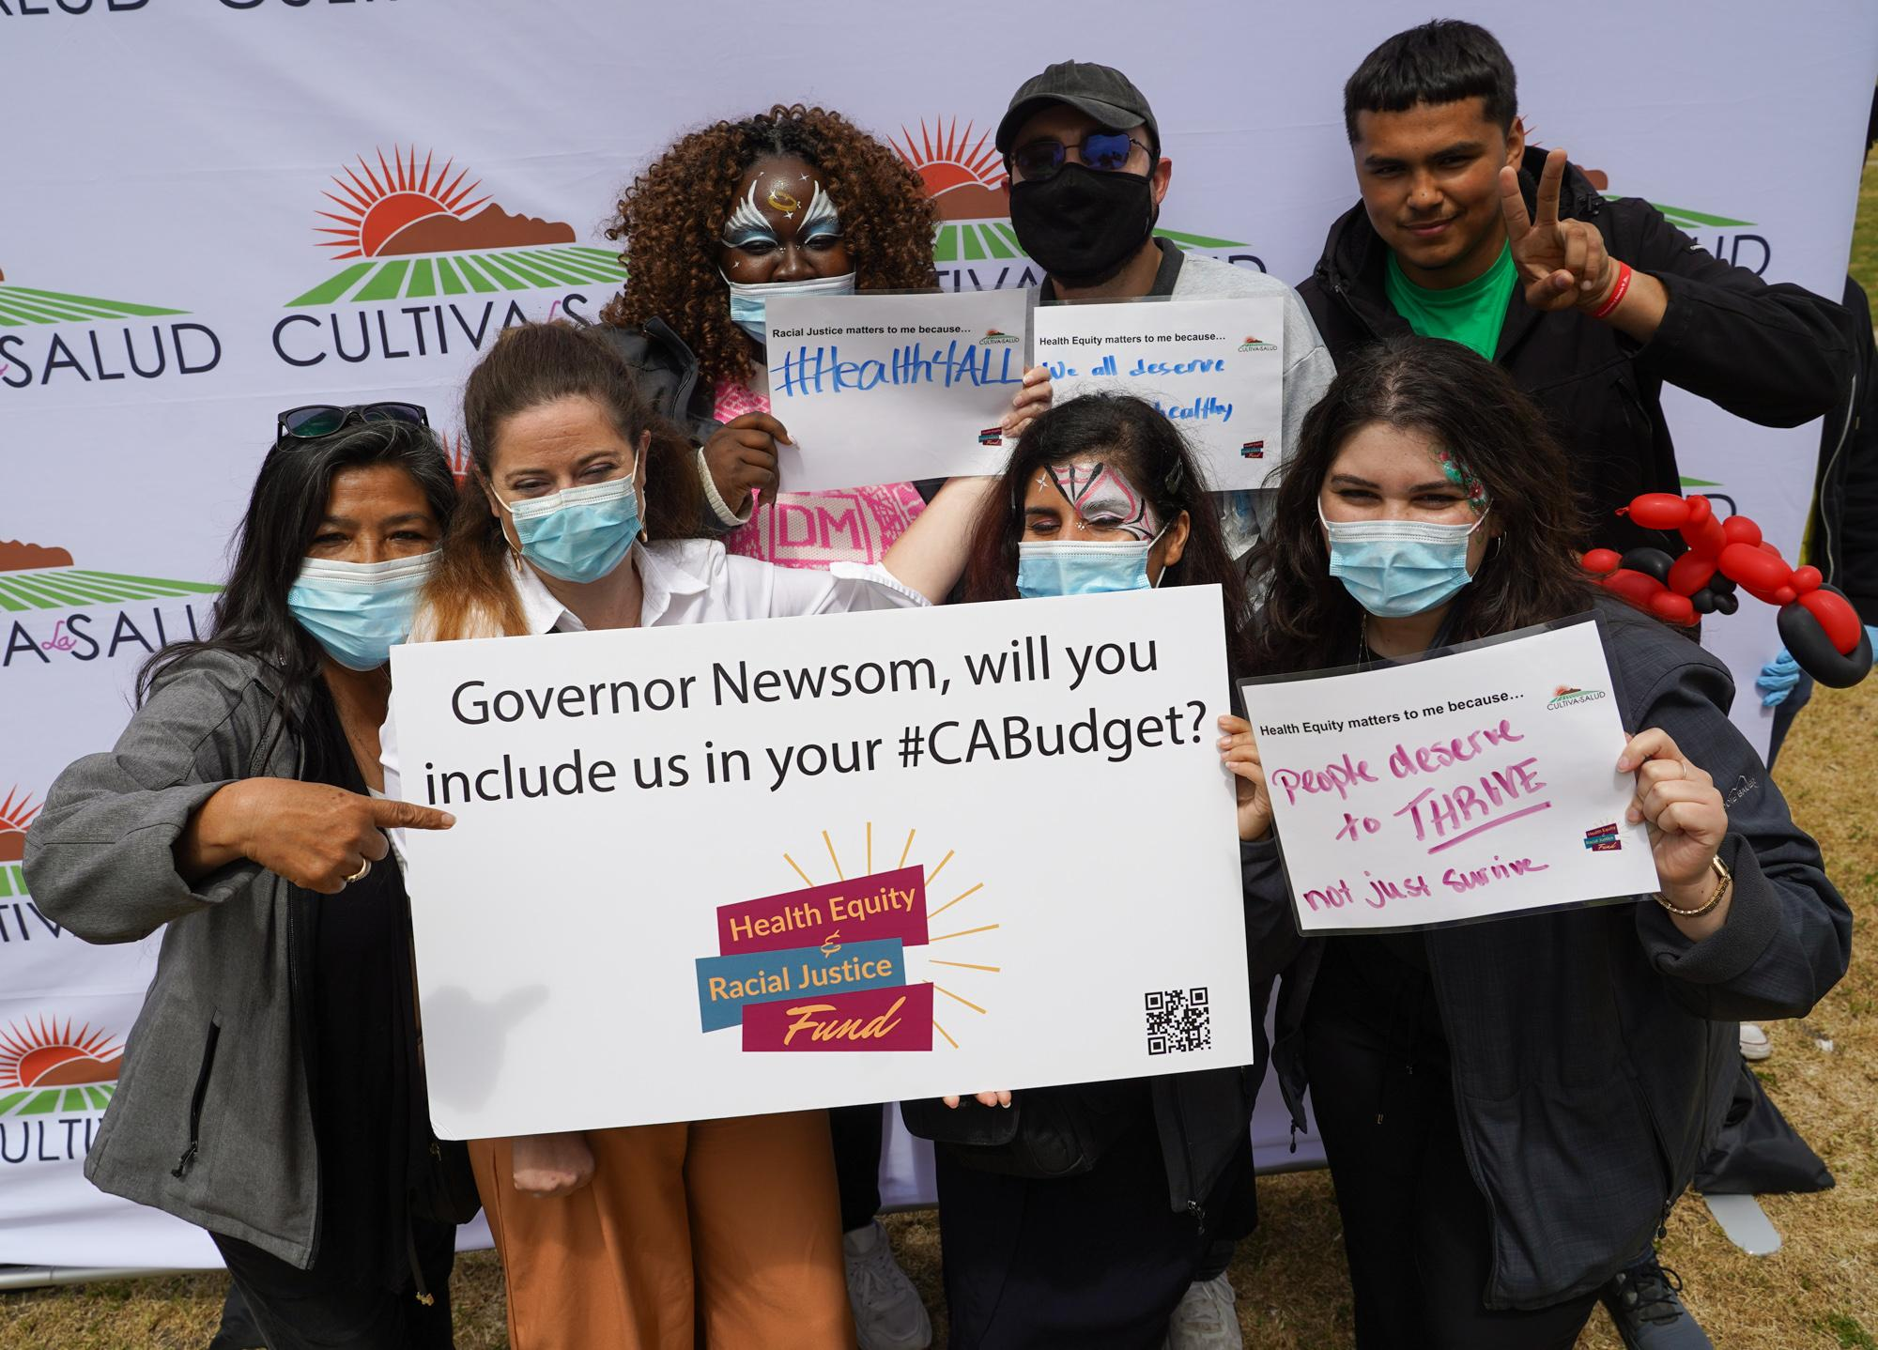
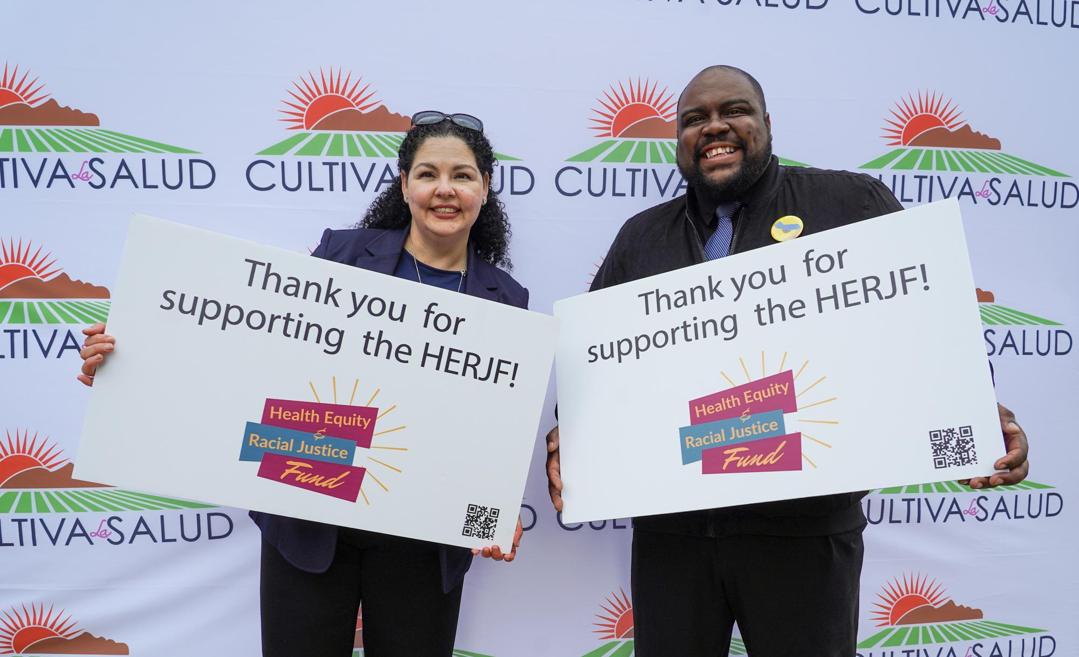
Fresno Rally - April 21, 2022
Organized by Cultiva La Salud, Fresno
Notes:
VEVA

Slide 19
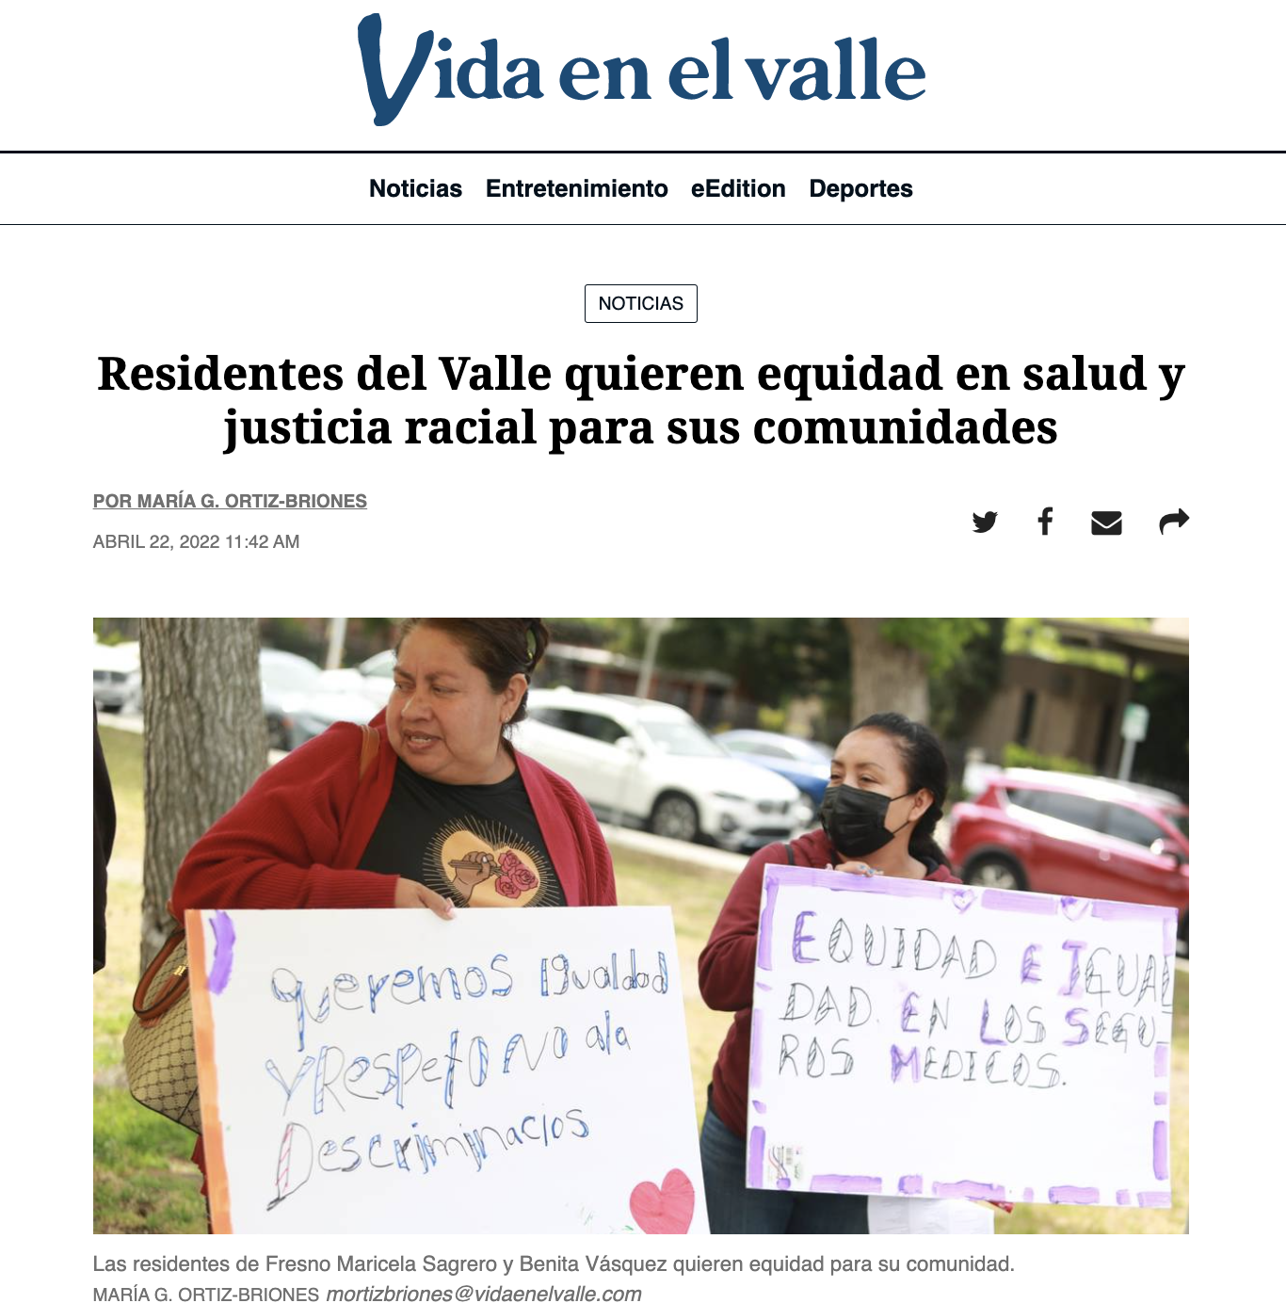
Fresno Rally, Media Coverage
Fresno Bee
Notes:
VEVA

Slide 20
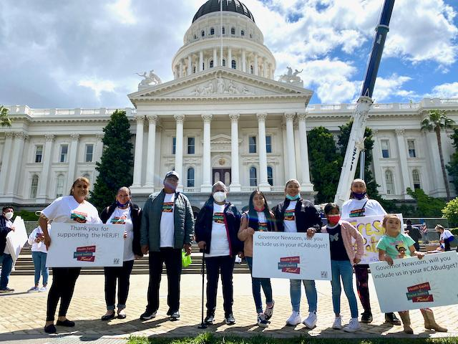
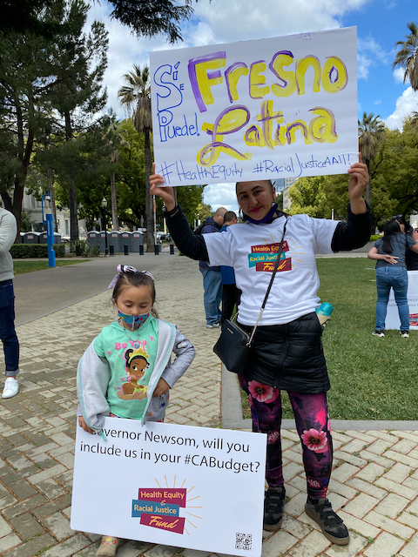
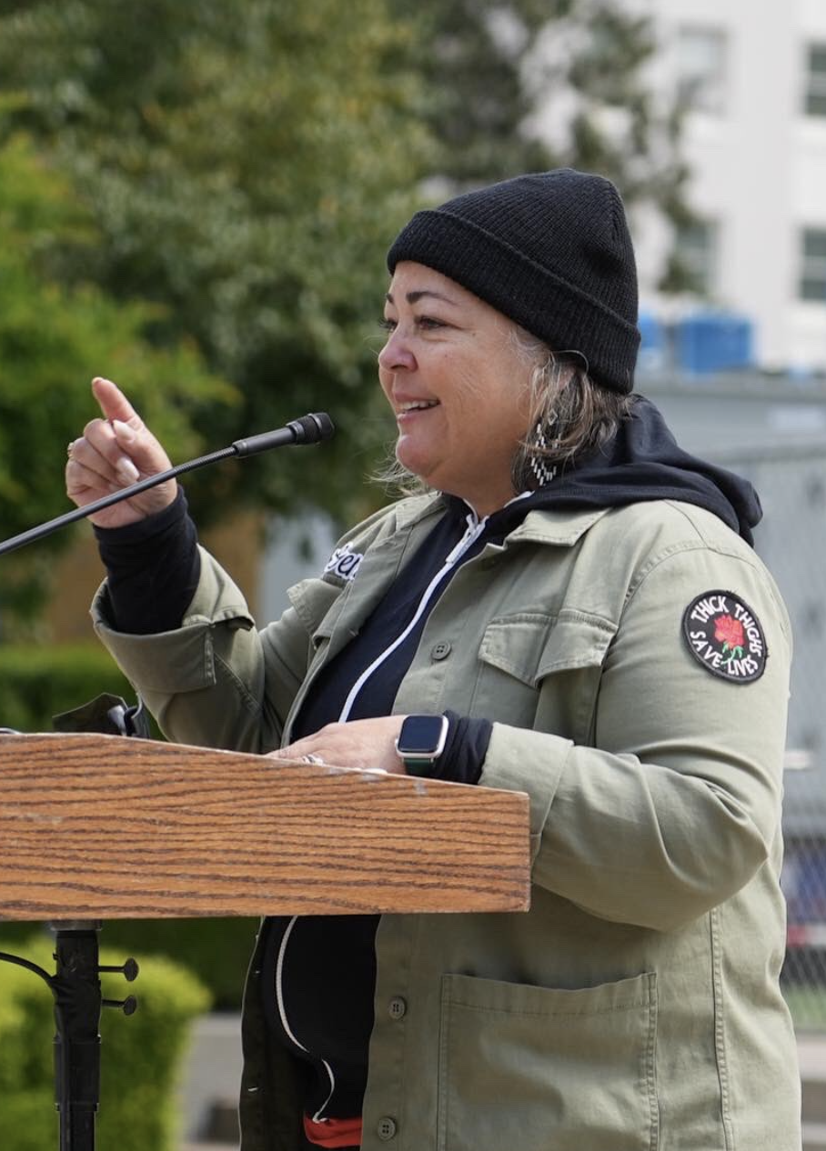
Sacramento Rally - April 22, 2022
Notes:
VEVA

Slide 21
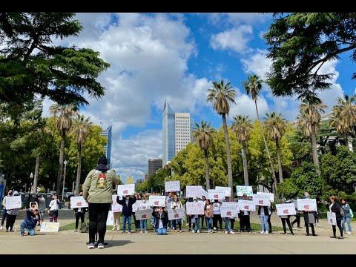
Sacramento Rally - April 22, 2022
Rally speech by Genoveva (Veva) Islas
Notes:
VEVA

Slide 22
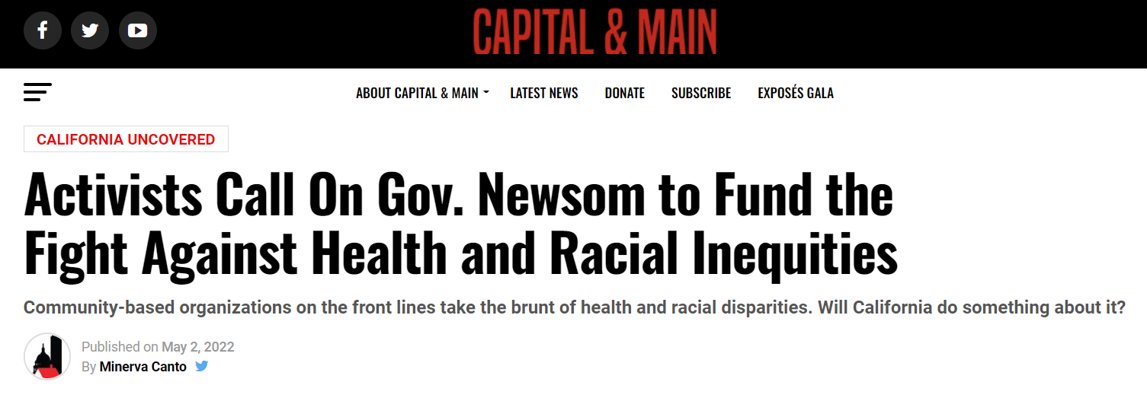
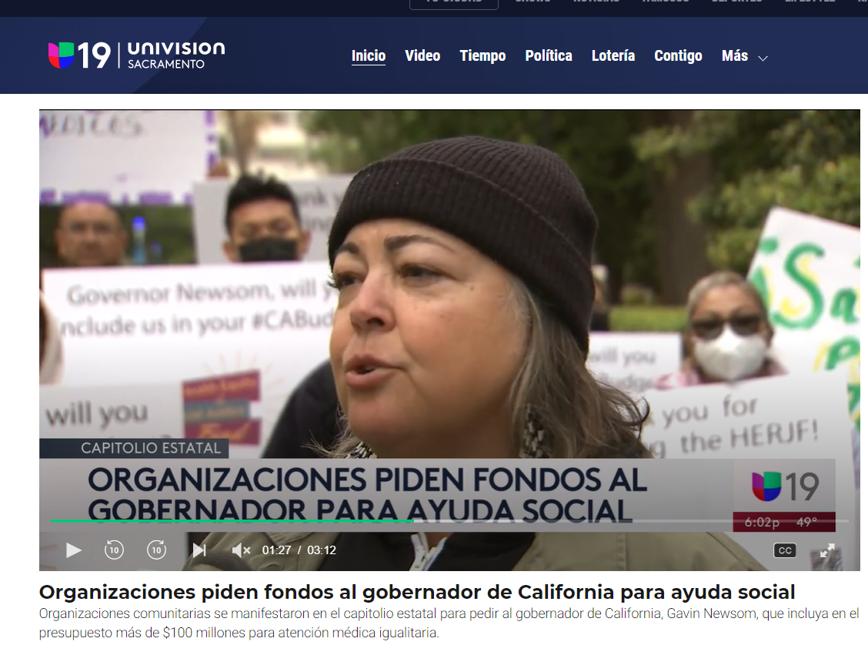
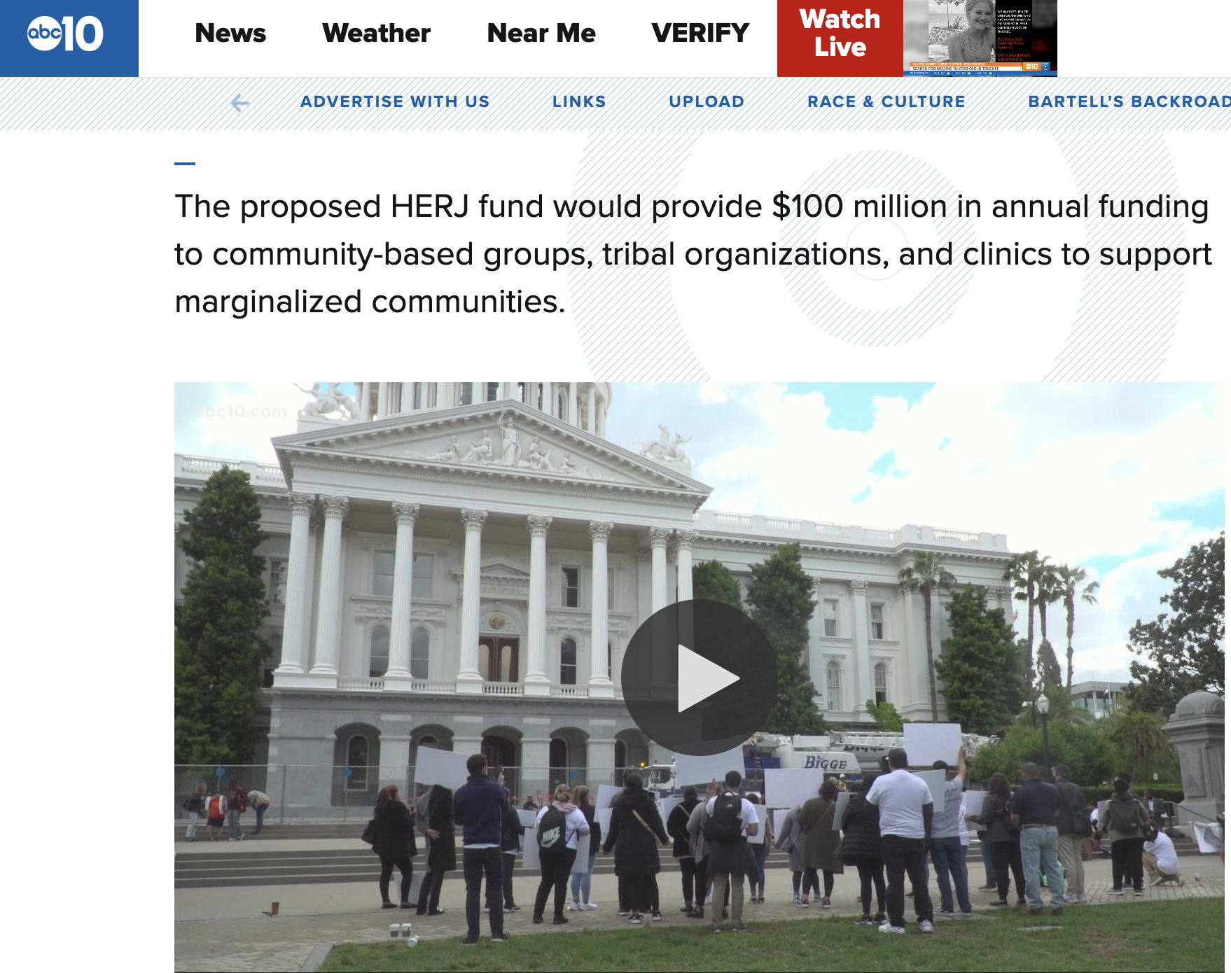
Sacramento Rally, Media Coverage
ABC 10
Notes:
VEVA

Slide 23
Challenges
Difficult to get people to show up for rallys
Capacity/commitment issue with one of the grassroot partners, unable to find one in the Bay Area
Two meetings with the Governor's office and the Head of the Department of Public Health failed to gain sufficient administration support.
Governor is already doing a lot in respect to health equity and racial justice- supports Medicaid coverage of uninsured, investments in reproductive rights (overturn of Roe v. Wade).
State-level public health union (SEIU) put up objections. The objectives of this fund are very much seen as a county public health departments’ job.
Notes:
DORIS Getting Megan McMegan McClaire, Chief Deputy Director, LA County Department of Health to say on camera and to the news reporter that they suppor the fund was a big deal.

Slide 24
Campaign Results
We made great progress in raising awareness of the fund and getting hundreds of advocates involved in the rallies and in taking other actions (emails, calls, etc).
Good media coverage
The Speaker of the CA Assembly tweeted his support of the fund.
The Legislature included the fund in its final budget, a one time proposal at $75 million
CA Governor has line-item veto power and he did not include the fund in the final budget.
Notes:
VEVA

Slide 25
Lessons Learned
Start identifying partner organizations willing to do in-person activism early on
Engage community members by demonstrating how the funds benefit them directly
Come up with innovative ways to get public to attend rallies
Activate personal & professional contacts
Tie overall campaign goals to metrics (e.g. how will the funds create jobs)
Notes:
DORIS & VEVA
Doris - early outreach is crucial, involve the right people/organizations, vet their capacity/commitment level Veva - explain to them how what they are advocating for directly affects and improves their lives.
offer ample opportunities to have a voice: create own signs, write in own words on postcards to legislators, send emails and make calls to legislators
Offer community events with food and fun activities, free t-shirts, free bus ride to the Capitol, all with potential press coverage, etc.
contacts to get legislature to influence the Governor, don’t underestimate the power of your network, ask folks to research their connections
This has been identified by the Governor as the main missing component of the HERJF campaign. We were advised by his office to tie campaign goals to metrics connected to issues that he is already committed to addressing. E.g. how will the funds create jobs.

Slide 26
Next Steps
Reconvene coalition partners to
restructure campaign activities for the remainder of 2022
get fund in the 2023/24 budget
Notes:
DORIS
We hope of course to get it in the budget next year with even more innovative campaign strategies.

Slide 27
Much gratitude to
for your generous support
of this campaign!

