Slide 1
Using the Power Prism to Leverage the NHCSL Resolution
Claudia Goytia
Katie Bishop Kendrick
Lori Fresina
September 21, 2022
Notes:
Claudia will do the welcome and intro to the session

Slide 2
The growing Hispanic power base
62.1 Million Hispanics living in the US
18.9% of US population
Second largest racial or ethnic group after non-Hispanic whites
"The nation's Hispanic population grew 23 percent to 61.1 million over the last 10 years," according to a recent article by Frank Bass for Social Explorer based on data recently published by the U.S. Census.
Notes:
This ethnic group includes any person of Cuban, Mexican, Puerto Rican, South or Central American, or other Spanish culture or origin, regardless of race. According to 2020 Census data, there are 62.1 million Hispanics living in the United States. This group represents 18.9 percent of the total U.S. population, the nation’s second largest racial or ethnic group after non-Hispanic whites. In 2020, among Hispanic subgroups, Mexicans ranked as the largest at 61.6 percent. Following this group are Puerto Ricans (9.6 percent), Central Americans (9.3 percent), South Americans (6.4 percent), Other Hispanic/Latino (including Spanish) (5.8 percent), and Cuban (3.9 percent). In 2020, states with the largest Hispanic populations were Arizona, California, Colorado, Florida, Illinois, Nevada, New Jersey, New Mexico, New York, and Texas. In 2020, 25.7 percent of Hispanics were under the age 18 compared to 53 percent of non-Hispanic whites.

Slide 4
The National Hispanic Caucus of State Legislators
Mission: To serve as a catalyst for joint action on issues of common concern to all segments of the Hispanic community; a forum for information exchange and member networking; an institute for leadership training; a liaison with sister U.S. Hispanic organizations throughout the country; a promoter of public/private partnerships with business and labor; and a partner with Hispanic state or provincial legislators and their associations representing Central and South America.
Notes:
The NHCSL is the preeminent organization serving and representing the interests of Hispanic state legislators from all states, commonwealths, and territories of the United States.
Our mission is to serve as a catalyst for joint action on issues of common concern to all segments of the Hispanic community; a forum for information exchange and member networking; an institute for leadership training; a liaison with sister U.S. Hispanic organizations throughout the country; a promoter of public/private partnerships with business and labor; and a partner with Hispanic state or provincial legislators and their associations representing Central and South America.
The NHCSL provides technical assistance and resources that will help legislators propose legislation and administrative actions to achieve a better quality of life. Our efforts focus on advancements in education, healthcare, housing, economic development, criminal justice, and employment and job training for the Hispanic community.
https://nhcsl.org/about/executive_committee/

Slide 5
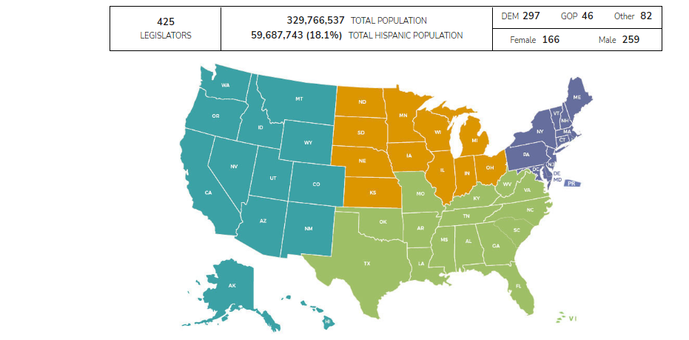
Hispanic Legislators Nationwide 2017-18
Notes:
In the next few slides, the lawmaker’s demographic data is based on the 2017 and 2018 election cycle.
The population numbers are based on the 2017 American Community Survey released in July 2018.
ADD Comparison to US Congress

Slide 6
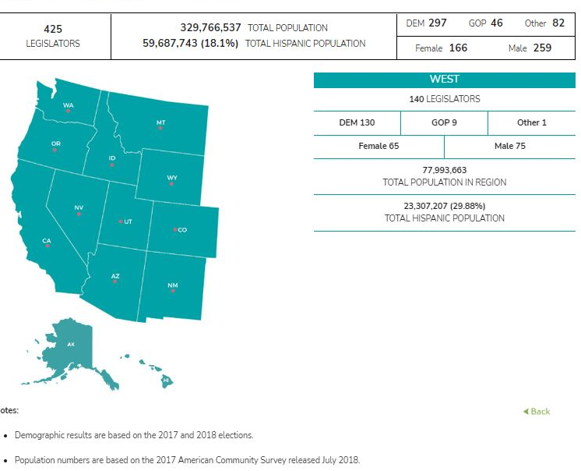
Hispanic State Legislators West

Slide 7
Hispanic State Legislators Midwest

Slide 8
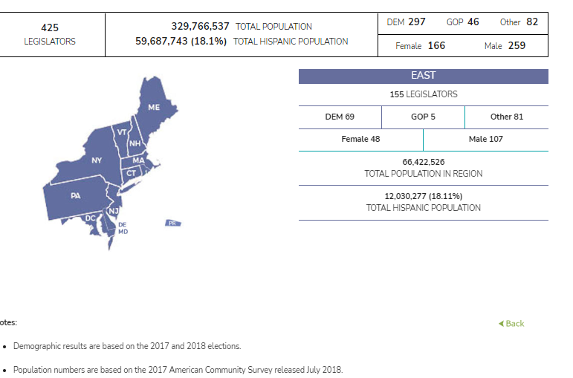
Hispanic State Legislators East

Slide 9
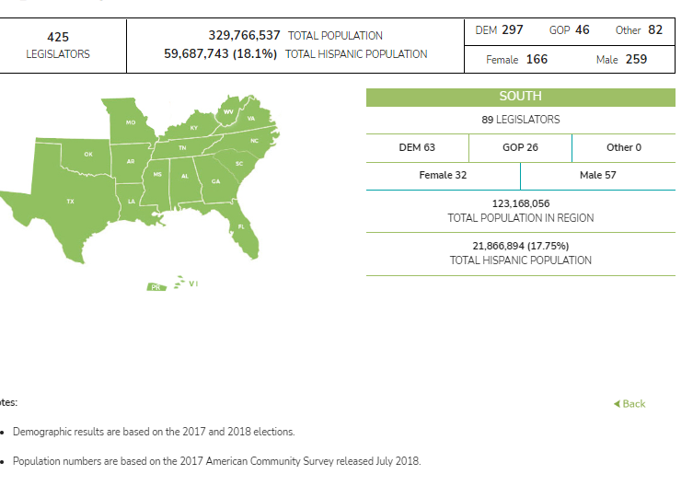
Hispanic State Legislators South

Slide 10
The NHCSL’s Resolution Process
Notes:
Resolutions
Note: NHCSL resolutions go through an extended research, deliberative and approval process that takes a minimum of 45 days and up to a year or more and provides the members with feedback and potential amendments from the NHCSL policy staff, the relevant Task Force and the NHCSL Executive Committee. Except in the case of emergency resolutions which can be approved via supermajority by the Executive Committee on behalf of the Caucus at any time, all final NHCSL resolutions are ratified and made public after the Annual Meeting of the full membership, which typically takes place close to the end of the year. Expect new resolutions to be published here in the second half of December or first half of January. Resolutions are numbered in the order in which they were introduced but are published in the order in which they were finally approved.
Resolutions are published on the NHCSL website in December/January following passage.

Slide 11
NHCLS Resolution Process
Resolutions must be submitted by an NHCSL member
Resolutions are reviewed by NHCSL staff
Voted on by the membership at the annual meeting

Slide 12
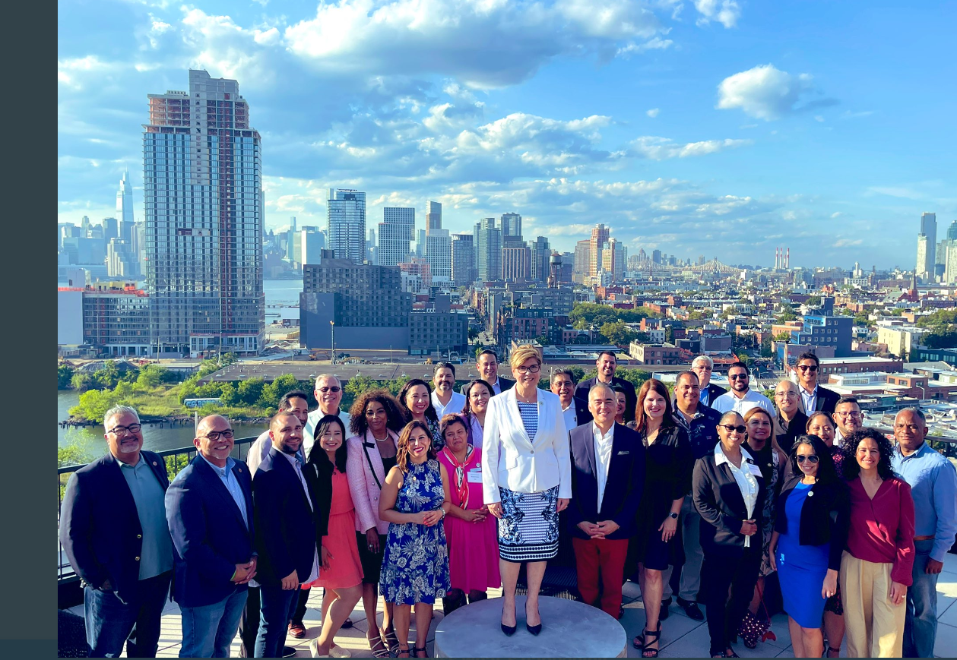
Notes:
Claudia will transition to Katie

Slide 13
National Hispanic Caucus of State Legislators (NHCSL)
2022-03 Resolution
GOVERNMENT, SOCIAL JUSTICE AND TAXATION
DEL. ALFONSO LÓPEZ (VA), CHAIR
Promoting Food Equity and Nutritional Security in the United States, including extending SNAP to Puerto Rico Sponsored by Rep. Juan Candelaria (CT), Rep. Rafael "Tatito" Hernández (PR), Asmb. Mia Bonta (CA), Rep. Victoria Neave (TX) and Rep. Carlos E. Tobón (RI)
Notes:
Katie

Slide 14
Nutrition Security Resolution
Nutrition security refers to “an individual or household condition of having equitable and stable availability, access, affordability, and utilization of foods and beverages that promote well-being and prevent and treat disease;”
An essential part of nutrition security is access to culturally appropriate nutritional food that fits the needs of peoples across culinary and religious traditions

Slide 15
Nutrition Security Resolution
Challenges to consuming a healthy diet are perpetuated by lack of access to a broad array of affordable and culturally-relevant food options, structural racism, and long-standing inequitable policies disproportionately affecting communities of color.
Congress then reduced Puerto Rico’s residents to assistance through a diminished block grant well below the resources of the Food Stamp Program exacerbating the growing gap between people’s need for assistance and the assistance available.

Slide 16
Nutrition Security Resolution
THEREFORE, BE IT RESOLVED, the National Hispanic Caucus of State Legislators recognizes that to equitably improve health and wellbeing, the U.S. government must invest in public-private partnerships with grocers and retailers, education over nutrition and nutrition programs, and policies that incentivize healthy food access and healthy eating.

Slide 17
Nutrition Security Resolution
The National Hispanic Caucus of State Legislators recognizes that residents of Puerto Rico, as Americans, deserve urgent and equitable funding for food and nutrition security through SNAP, same as other Americans in other US states and territories.
The Government, Social Justice, and Taxation Task Force Recommends this resolution to the Executive Committee for Approval.

Slide 18
Using the Power Prism to promote the new Food Equity and Nutrition Security Resolution adopted unanimously by the National Hispanic Caucus of State Legislators, summer 2022
EXERCISE

Slide 19
Large Group Practice

Slide 20
Small Group Activity

Slide 21
Discussion

Slide 22
Thank You!

